Slide 1
2015 EU Innovation Procurement event 28th October 2015, Paris 11h30 – 12h30 call for proposals for topic MG - 4.4 (CSA) on deployment of Urban Transport solutions
Bertrand Wert, Henriette van Eijl (DG MOVE, henriette.van-eijl@ec.europa.eu)

Slide 2
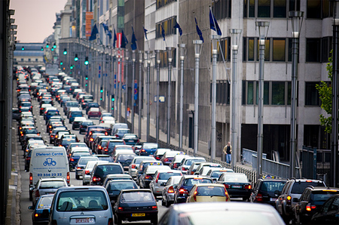
Challenges
Transport and mobility gap in Europe
EU Transport Policy has 2 'urban' goals:
Half the use of conventionally fuelled vehicles in cities by 2030
Towards ´zero emissions´ city logistics in major urban centres by 2030
"Valley of Death": holding back innovation
Lack of joined-up policies and capacity
Shortcomings in market uptake

Slide 3
Context
Regulation:
Urban mobility package, Clean Power for Transport Directive, Clean Vehicle (procurement) Directive
Urban mobility Member States expert group
Platforms for exchange best practices: CIVITAS, SUMP, ELTIS
Collaboration:
H2020 topics ("CIVITAS", procurement networks) 2016-2017
ELENA EIB Facility for cities 2016-2017
European Innovation Partnership in Smart Cities: marketplace
EIP Smart Cities Action Clusters in electric vehicles and in smart urban mobility services EIP Smart cities annual event May 2016
Acceleration:
Regional 'outreach' meetings for cities, industry, procurers in 2015-2016
H2020 SME 'urban' instrument in 2016-2017
MOVE event: Moving Europe’s smart urban mobility frontier on 28-1-2016

Slide 4
Objectives of Horizon2020 Societal Challenge 4 'Smart, green and integrated Transport'
Horizon 2020 - Transport Challenge
Horizon2020
Achieving a European transport system that is
Resilient
Resource-efficient
Climate and environmentally friendly
Safe
Seamless
Competitive
…and that benefits citizens, economy and society

Slide 5
Urban mobility: topics and budget Total EU contribution: EUR 36 Mio
Topic | Title | Action type | Stages | Budget (EUR Mio)
 |  |  |  | 2016 | 2017
MG-4.1 | Increasing the take up and scale-up of innovative solutions to achieve sustainable urban mobility | IA | 2 |  | 22
MG-4.2 | Supporting "smart electric mobility" in cities | IA | 2
MG-4.3 | Innovative approaches for integrating urban nodes in the TEN-T core network corridors | CSA | 1 |  | 2
MG-4.4 | Facilitating public procurement of innovative sustainable transport and urban mobility solutions | CSA | 1 | 2
MG-4.5 | New ways of supporting development and implementation of neighbourhood-level and urban-district-level transport innovations | RIA | 2 | 10
CSA = Coordination and Support Action
RIA = Research and Innovation Action; IA = Innovation Action

Slide 6
Topic MG-4.4-2016 (CSA)
Facilitating public procurement of innovative sustainable transport and mobility solutions in urban areas
https://ec.europa.eu/research/participants/portal/desktop/en/opportunities/h2020/topics/2100-mg-4.4-2016.html
Challenge
Boosting market demand for sustainable urban mobility solutions
Increasing purchaser awareness about technologies used in implementing sustainable urban solutions
Scope – open:
Preparing the ground for future actions, such as
establishing cross-border activities on PPI / PCP
new approaches for market consultations with suppliers, paying special attention to SME suppliers.
Activities driven by procurers' needs
All types of urban mobility solutions: vehicles, infrastructure, services, etc

Slide 7
Topic MG-4.4-2016 (CSA)
Facilitating public procurement of innovative sustainable transport and mobility solutions in urban areas
Expected impacts:
Setting up 'buyers groups' of public procurers that undertake joint, cross-border or coordinated procurements.
Exchanging experience in procurement practices and strategies in the specific area(s) of common purchasing needs.
A set of well-documented practices available for replication.
Increased awareness, capacity building and a demonstrated, increased public purchasing of innovative urban mobility solutions.
Estimated budget per proposal: EUR 0,6-1 Moi (probably 2-3 proposals can be funded)
Consortia expected to consist of public procurer (s) or groups thereof.
Deadline 26 January 2016

Slide 8
More information
Call topic:
https://ec.europa.eu/research/participants/portal/desktop/en/opportunities/h2020/topics/2100-mg-4.4-2016.html
Please check Frequently Asked Questions on website above for updates.
Thank you!

Slide 9
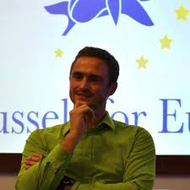
More information
http://ec.europa.eu/easme/sme/
Join us
EASME-SME-HELPDESK@ec.europa.eu
Join me
@bertrandwert
bertrand.wert@ec.europa.eu
@H2020SME

