Slide 1
Session on call EO-2 (PCP)
on Space/Earth Observation
DG GROW - Internal Market, Industry Entrepreneurship and SMEs
GROW/I1 - Space Policy and Research Unit
Nicolas.PETER@ec.europa.eu
Eafip Event, Paris, 28 October 2015

Slide 2
Summary
Horizon 2020 programme
Space research in Horizon 2020
Horizon 2020 Space Work Programme 2016-2017
Copernicus programme
PCP in Horizon 2020 Space Work Programme 2016-2017
Downstream services for public authorities
Additional information

Slide 3
1. HORIZON 2020
European Union programme for
research and innovation for 2014-2020

Slide 4
Space Programmes in MFF 2014-2020
Multiannual Financial Framework 2014-2020
~ 12.000 M€
~ 3.800 M€
~ 1.400 M€
~ 6.300 M€

Slide 5
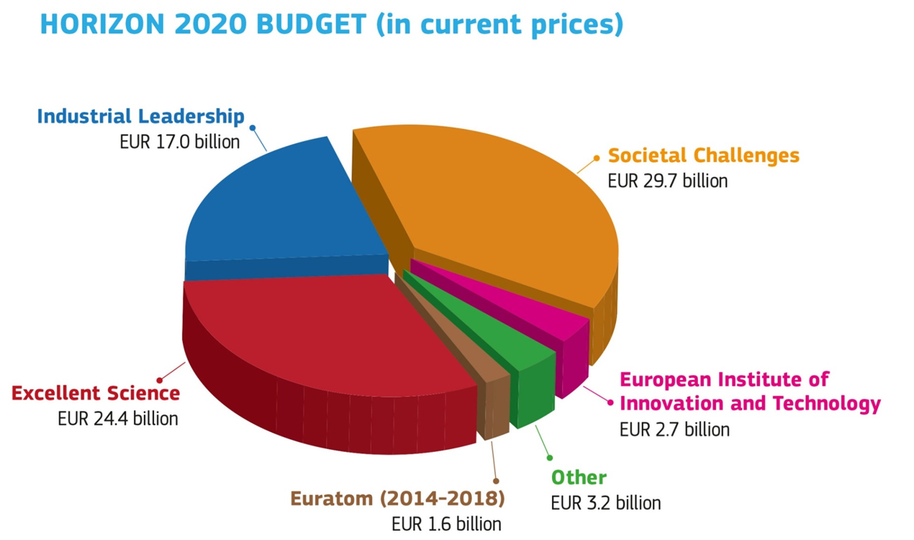
€ 79 billion from 2014 to 2020
Horizon 2020
2013 figures

Slide 6
2. Space Research in Horizon 2020

Slide 7
H2020 Space
Specific Programme
Enabling European competitiveness, non-dependence and innovation of the European space sector
Safeguard and further develop a competitive, sustainable and entrepreneurial space industry and research community and strengthen European non-dependence in space systems
Boost innovation between space and non-space sectors
Enabling advances in space technologies
Enabling the exploitation of space data
Enabling European research in support of international space partnerships
The application of space technologies shall be supported through the respective specific objectives of the priority "Societal challenges", where appropriate
For more information please consult Council Decision of 3 December 2013, OJ L 347/993.

Slide 8
H2020 Space
building blocks
Satellite Navigation
(Galileo and EGNOS)
Earth Observation
(Copernicus)
Competitiveness of the European Space sector
Protection of the European Space Assets
Applications
Applications
Technologies for European non-dependence and competitiveness
Space Surveilance and Tracking
EGNSS evolution
Data
Space Weather, Space Debris,
Near Earth objects
Independent
access to space
Copernicus evolution
Space Science and Exploration
Bottom-up engagement of SMEs in space R&D (SME Instrument)
Fast Track to
Innovation pilot

Slide 9
H2020 Space
Work Programmes
Horizon 2020 is being implemented through a sequence of work programmes
Horizon 2020 Space Work Programmes
WP
2014-2015
WP
2016-2017
…
2014: 167.57 M€
2015: 182.05 M€
2016: 165.67 M€
2017: 181.40 M€

Slide 10
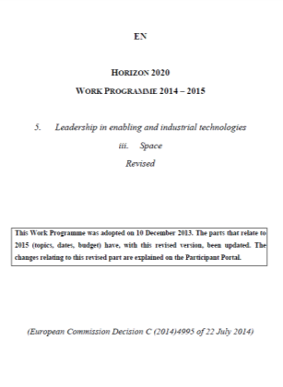
H2020 Space
Calls for proposals
2014-2015 work programme published on 10 December 2013
2014 call: call closed, grants signed, projects launched in January 2015
2015 call: call closed, projects in the phase of 'grant preparation'
2016-2017 work programme published on 13 October 2015
2016 call: call deadline 3 March 2016
2017 call: call deadline 1 March 2017
WP pre-published draft version (part 05iii LEIT-Space) is available at:
http://ec.europa.eu/programmes/horizon2020/en/draft-work-programmes-2016-17
The associated draft guidance documents are available at:
http://ec.europa.eu/growth/sectors/space/research/horizon-2020/

Slide 11
H2020 Space WP 2016-17 structure
EGNSS
Galileo & EGNOS applications and infrastructure
EO
Earth Observation
applications and services
COMPET
Competitiveness of the European Space sector:
Tecnology and Science
(incl. Space Weather)
SST
Space Surveillance and Tracking support framework
Calls for proposals:
EGNSS applications
Calls for proposals:
EO downstream applications
Evolution of Copernicus services
EO "big data" shift
Calls for proposals:
Critical space technologies
Strategic research clusters
EO & SatCom technologies
Science and Exploration
Space Weather
Space Portal
Technology transfer
Other actions:
Contribution to the SST support framework
Improving the performance of SST at European level
Other actions:
Evolution of EGNSS infrastucture, mission and services
Other actions:
ESA Engineering support
Horizon prize on
low-cost access to space
SME Instrument
Fast Track to
Innovation 'pilot'
Notes:
Don't forget to mention:
"Miscellaneous" activities implemented under Other actions include:
H2020 proposal preparation, evaluation and project monitoring.
Studies and communication activities supporting H2020 LEIT-Space.

Slide 12
H2020 EO
In Horizon 2020, Earth observation (EO) research and innovation is addressed in LEIT/space and in the GEO part of societal challenge 5
future generation of the Union space systems including Copernicus; innovative products and services based on remote sensing, geo-positioning or other types of satellite enabled data; data access
global environmental observation and information systems; environmental and climate services; global markets
LEIT/space
Copernicus user uptake: stimulate business environment and foster public demand
Copernicus evolution: services, data infrastructure
Cross-cutting: technologies, international cooperation, market intelligence
SC5/GEO
Global and in-situ observing systems
GEOSS challenges
Cross-cutting: data, international cooperation

Slide 13
H2020 Space
Earth observation calls for proposals
'Space' WP 2016/2017
 | 2016 | 2017
Call for proposals | Indicative budget (M€) | Indicative budget (M€)
EO-1-2016/2017: Downstream applications | 9.85 | 12.0
EO-2-2016: Downstream services for public authorities | 3.0 | -
EO-3-2016: Evolution of Copernicus services | 9.0 | -
EO-4-2017: EO Big Data Shift | - | 7.5
Sub-total EO-2016/2017 | 21.85 | 19.5
COMPET-2-2017: Competitiveness in Earth observation mission technologies |  | 7.0
Total EO related 'Space' (2016/2017) | 21.85 | 26.5

Slide 14
H2020 Space WP 2016-17
EO topics
SC2: Blue Growth – demonstrating an ocean of opportunities (H2020-BG-2016-2017):
BG-9-2016: An integrated Arctic observing system
BG-12-2016: Towards an integrated Mediterranean Sea Observing System
SC2: Sustainable Food Security – resilient agri-food chains (H2020-SFS-2016-2017):
SFS-43-2017: Earth Observation services for the monitoring of agricultural production in Africa
SC5: Earth Observation (H2020-SC5-2016-2017):
SC5-18-2017 - Novel in-situ observation systems
SC5-19-2017 - Coordination of citizens' observatories initiatives
SC5-20-2016 - European data hub of the GEOSS information system
LEIT/space: Earth Observation (H2020-EO-2016 and H2020-EO-2017)
EO-1-2016 and EO-1-2017: Downstream applications
EO-2-2016: Downstream applications for public sector users
EO-3-2016: Evolution of Copernicus services
EO-2-2017: EO Big Data Shift
LEIT/space: Competitiveness of the European Space Sector: Technology and Science (H2020-COMPET-2017)
COMPET-2-2017: Competitiveness in Earth observation mission technologies
SME Instrument (H2020-SMEInst-2016-2017)
SMEInst-04-2016-2017: Engaging SMEs in space research and development
SMEInst-12-2016-2017: Boosting the potential of small businesses

Slide 15
3. Copernicus Programme

Slide 16
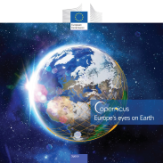
Copernicus
The Copernicus programme is a cornerstone of the European Union’s efforts to monitor the Earth and its many ecosystems, whilst ensuring that its citizens are prepared and protected in the face of crises and natural or man-made disasters.
The Copernicus programme places a world of insight about our planet at the disposal of citizens, public authorities and policy makers, scientists, entrepreneurs and businesses on a full, free and open basis.

Slide 17
Copernicus
The Copernicus programme entered its operational phase with the launch of Sentinel-1A in 2014 and its governance is based on the Copernicus Regulation adopted the same year which establishes the Commission as the Programme manager owning the infrastructure and data rights on behalf of the Union;
Copernicus services are based on information from a dedicated constellation of satellites, known as “Sentinels”, as well as tens of third-party satellites known as “contributing space missions”, complemented by “in situ” (meaning local or on-site) measurement data;
By making the vast majority of its data, analyses, forecasts and maps freely available and accessible, Copernicus contributes towards the development of new innovative applications and services, tailored to the needs of specific groups of users, which touch on a variety of economic and cultural or recreational activities, from urban planning, sailing and insurance to archaeology.

Slide 18
Copernicus

Slide 19
Copernicus
COPERNICUS SERVICES
http://www.copernicus.eu/main/overview/
Address six main thematic areas:
Land monitoring
Marine monitoring
Atmosphere monitoring
Emergency management
Security
Climate change
Data access
Copernicus users can also have a direct access to satellite data
Copernicus Space Component
Earth Observation Satellites
http://www.copernicus.eu/main/satellites
NEW
COPERNICUS
Brochure
http://www.copernicus.eu/main/Brochure

Slide 20
Economic and Societal value added
Copernicus
Copernicus constitutes a cornerstone of the broader EU space
and industrial policy, and will generate significant economic and social benefits.
Driver for research, innovation and the creation
of highly skilled jobs, with direct and indirect benefits
for the EU economy.
The bottom-line can be summarised as follows:
Cost per EU citizen = ~€1,07/year;
Every €1 spent generates a return of ~€3,2;
Expected minimum financial benefits by 2030 of ~€30 bn. on Europe's GDP;
An estimated 50.000 jobs will be maintained or created over the next 15 years.

Slide 21
4. PCP in Horizon 2020 Space Work Programme 2016-2017

Slide 22
WP 2016-17 structure
of the 'calls'
The 'problem' Identifies the aspects of the challenge that needs to be tackled. WP text does not outline the expected solutions to the problem, nor the approach to be taken by the applicant ("non-prescriptive" approach)
H2020 Space Work Programme
Calls for proposals
Calls for proposals
Calls for proposals
The 'problem in detail' Provides more details on the specific challenge by specifying a perimeter to the problem described
Topics
Topics
Topics
Specific challenge
Scope
The 'change' to be achieved Provides a broad description of what is the impact to be achieved through the projects to be funded. The dissemination and exploitation of future research results are vital for the impact
Expected Impact
Notes:
Specific challenge (= THE PROBLEM): the aspect of the Societal Challenge or Industrial Technology that needs to be tackled (i.e. the problem). The applicant should understand what is at stake. The WP text does not outline the expected solutions to the problem, nor the approach to be taken by the applicant.
Scope (=SPECIFICATION OF THE PROBLEM): the scope can be used to focus, or specify a perimeter to, the problem stated in the specific challenge. It can be used in a positive way ( eg explicitly highlight the range of R&I activity required) or a negative way (used in the assessment of whether a proposal falls out of scope -or partly out of scope- of a call).
Impact: the extent to which project outputs should contribute to the expected impacts described for the topic, to enhancing innovation and integration of new knowledge, to strengthening the competitiveness and growth etc. The dissemination and exploitation of future research results are vital steps in the chain towards achieving impacts. Therefore funded projects should result in concrete, meaningful and Europe-wide benefits to many stakeholders, thereby helping solving pressing issues faced by many.

Slide 23
EO-2-2016
EO-2-2016 | Reccomended project size Indicative budget Type of action
Downstream services for public authorities Specific Challenge: Copernicus, the Union's Earth observation and monitoring programme entered into force in 2014 and produces a wealth of data and information regarding the Earth sub-systems (land, atmosphere, oceans) and cross-cutting processes (climate change, emergency and security). Such information can be very helpful for reporting obligations of Member States and can enable informed decision-making. At the same time such information needs either adaptation to local conditions and contexts, or adaptation to the specific needs of public authorities as part of workflow and procedures. The challenge is to deepen user integration and thus foster exploitation of Copernicus information to match the needs of public authorities at national, regional or local levels. | 3 M€ Pre-commercial Procurement (90% funding rate + 25% indirect costs) More info on the Participant Portal

Slide 24
EO-2-2016
EO-2-2016 | Reccomended project size Indicative budget Type of action
Downstream services for public authorities Specific Challenge: New and innovative solutions are needed to address the existing and emerging societal challenges faced among others by the public sector. Some of these societal challenges require public sector transformations for which no commercial stable solutions exist, and that require a more forward looking public procurement strategy either through incremental or radical innovation. | 3 M€ Pre-commercial Procurement (90% funding rate + 25% indirect costs) More info on the Participant Portal

Slide 25
EO-2-2016
EO-2-2016 | Reccomended project size Indicative budget Type of action
Downstream services for public authorities Scope: The objective is to launch demand-driven innovation actions by public authorities aiming at customising Copernicus information as part of the solution (i.e. possibly alongside other space or non-space data sources) for their needs. Transnational collaboration has a key role to play in this context, as it can facilitate knowledge transfer and optimisation of resources for public authorities. It also fosters service providers who can benefit from an strengthened digital single market. Application products are expected to adopt open standards for data documentation, data models and services. | 3 M€ Pre-commercial Procurement (90% funding rate + 25% indirect costs) More info on the Participant Portal

Slide 26
EO-2-2016
EO-2-2016 | Reccomended project size Indicative budget Type of action
Downstream services for public authorities Scope: The choice of Copernicus service and associated downstream EO-based services left to the proposer. Applicants are advised to consult further information on availability of Copernicus Sentinel Data, access to Copernicus Contributing Mission data, as well as issues recommended to be detailed in the proposals at the Commission’s website. It should also be noted that coupling with ESIF actions could facilitate this process and can ensure continuity. http://www.copernicus.eu/main/data-access European Structural and Investment Fund. | 3 M€ Pre-commercial Procurement (90% funding rate + 25% indirect costs) More info on the Participant Portal

Slide 27
EO-2-2016
EO-2-2016 | Reccomended project size Indicative budget Type of action
Downstream services for public authorities Expected Impact: The establishment of buyers group for Earth observation services; Copernicus-enabled regional or local applications in support of public authorities; Fostering the emergence of similar EO-based actions in smart specialisation strategies; Establish sustainable supply chains for delivery of downstream EO-based services to public authorities. | 3 M€ Pre-commercial Procurement (90% funding rate + 25% indirect costs) More info on the Participant Portal

Slide 28
5. Additional information

Slide 29
Earth observation
Image credits: ESA
WP 2016-2017 – EO Support documents
Access to Copernicus data
http://www.copernicus.eu/main/data-access
Evolution of Copernicus services
http://ec.europa.eu/growth/sectors/space/research/horizon-2020/index_en.htm
29

Slide 30
WP 2016-2017
Implementation calendar
Calls | Opening dates | Deadlines
EO-2016 COMPET-2016 | 10 November 2015 | 3 March 2016

Slide 31
Beyond the deadline… Example of the evaluation process (2015)
8 April: closure Call
6-10 July: Ethics screening
5 August: Inform applicants
Remote evaluations
11 May – 5 June
Central evaluations
8 June – 3 July
Receipt of proposals
Individual
evaluation
Consensus
group
Panel
Review
Finalisation
Eligibility check
Allocation of proposals to evaluators
Individual
Evaluation
Reports
(done remotely)
Consensus
Report
Panel report
Evaluation Summary Report
Cross-readings
Panel ranked list
Final ranked list
Evaluation results sent to applicants
Initiation Grant Agreement Preparation
8/4/2015 Time-To-Inform (TTI): 5 months 8/9/2015

Slide 32
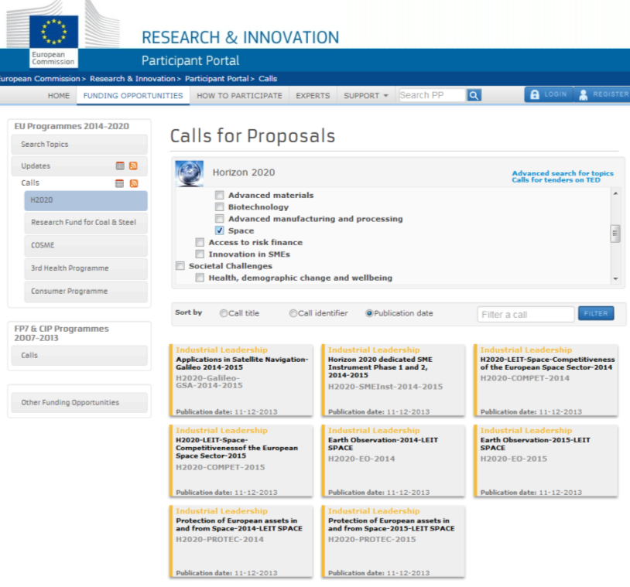
Horizon 2020 Space
2016-2017 'calls'
Horizon 2020 Participants Portal:
http://ec.europa.eu/research/participants/portal/desktop/en/opportunities/h2020/
H2020 Space Work Programme
Calls for proposals

Slide 33
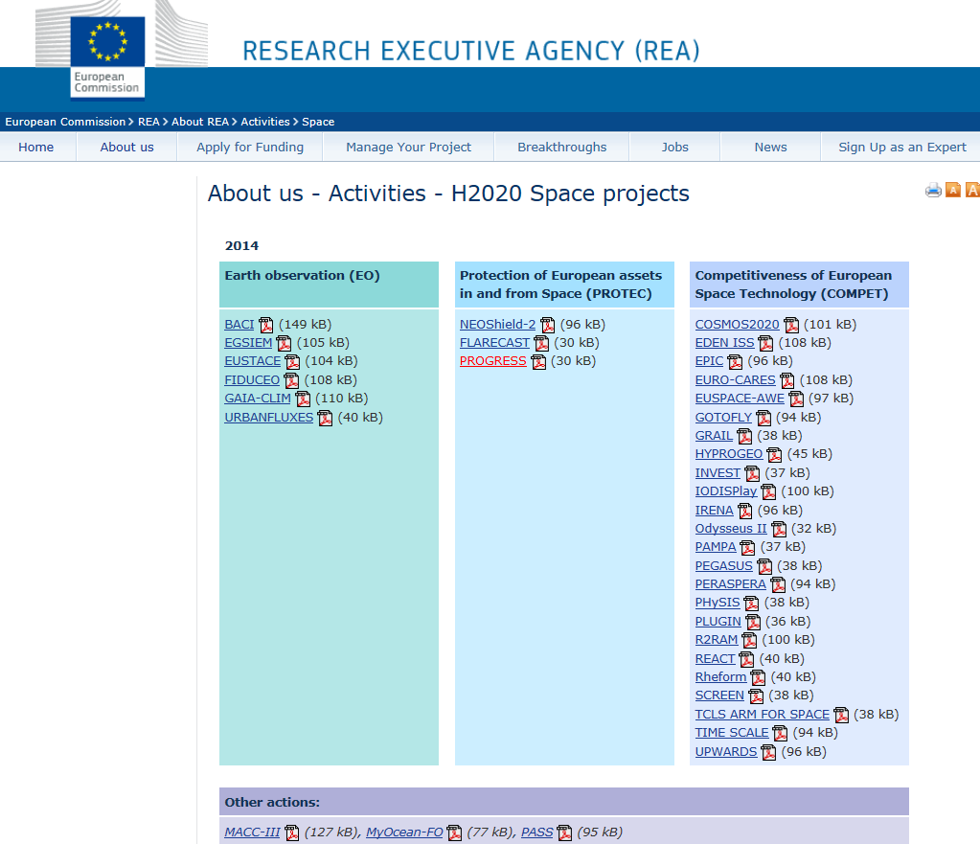
Work Programme 2014-2015
Horizon 2020 Space projects
H2020 Space Projects at REA webpage

Slide 34
Place | Type of event | Date
Paris | National info day | 17 September 2015
Toulouse | National info day | 29 September 2015
Warsaw | National info event | 28-29 September 2015
Madrid | National info day | 7 October 2015
Brussels | NCP day | 13 October 2015
Rome | National info event | 21-23 October 2015
Lisbon | National info day | 28 October 2015
Brussels | H2020 EU info day | 9-10 November 2015
Stockholm | National info event | 9 December 2015
UK | National info day | 22 September 2015
Ukraine (Kiev) | National info day | Tbd (end of 2015)
Horizon 2020 Space Info days in 2015
Venue | Type of event | Date
FR (Paris) | National info day | 17 September 2015
UK (London) | National info day | 22 September 2015
PL (Warsaw) | National info day | 28-29 September 2015
FR (Toulouse) | National info day | 9 October 2015
ES (Madrid) | National info day | 20 October 2015
Brussels (BE) | Space NCPs meeting | 13 October 2015
IT (Rome) | National info day | 21-23 October 2015
FR (Paris) | Horizon 2020 Innovation Procurement Event | 27-28 October 2015
PT (Lisbon) | National info day | 28 October 2015
GR (Athens) | National info day | 2 November 2015
Brussels | Horizon 2020 Space Infoday | 9-10 November 2015
SE (Stockholm) | National info day | 9 December 2015

Slide 35
HORIZON 2020
Thank you for your attention
Space research and guidance documents
http://ec.europa.eu/growth/sectors/space/research/horizon-2020/index_en.htm
Pre-published work programme 2016-2017
https://ec.europa.eu/programmes/horizon2020/en/draft-work-programmes-2016-17

