Slide 1
2015 Innovation Procurement Event
28-10-2015 Paris
Peter Wintlev-Jensen
Horizon 2020 Societal Challenge 1
Work Programme 2016-17
PPI on Innovative Solutions for Active and Healthy Ageing
Digital Social Platforms Unit (H2)
DG Communications Networks, Content and Technology
European Commission

Slide 2
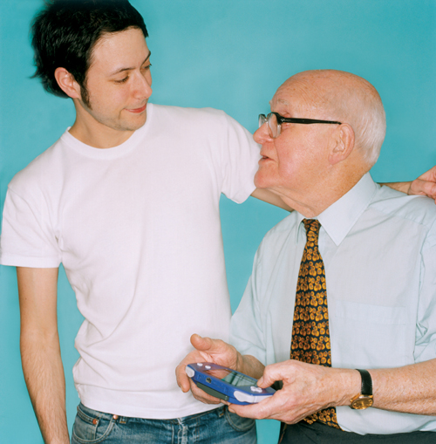


Demographic
Ageing
Societal Challenge
Major Opportunity
Dependency Ratio
  From 1:4 to 1:2
  80+ doubles by 2025
Empowerment
Active Ageing
New Care Models
Home based
Growth and Markets
3000 B€ wealth
85 Million Consumers - and growing
Major Efficiency gains
Integrated care
Consumer products
Cost of Care
  Up by 4-8 % of GDP by 2025
Human Resources
  Shrinking work force
  Lacking 20 million carers by 2020
••• 2
Notes:
Demographic Ageing is a major challenge for Japan and the EU.
Demographic ageing affects our quality of life: More people will be dependent on others to care for them, less people will be productive and active in the economy. We expect a dramatic shortage of 20 million care-workers in the EU by 2020.
Ageing is disruptive to our society, it distorts our budget balance. The costs of care are expected to go up by 4 to 8 percent of our European GDP by 2025. The costs of chronic care will probably more than double. We can't solve this by austerity measures or pension reform.
We will have to turn this challenge into an opportunity.
The citizens / patients should be empowered to manage their own health and stay active, healthy and independent as long as possible.
Our systems for health and care must change fundamentally: more people-centred, home based integrated care.
Our economy should adapt to new categories of clients and their needs: with ICT-driven innovation we can tap into the growing Silver economy of 85 million consumers over 65 and € 3000 billion

Slide 3
Transforming Health and Care
Acute care
Long-term-care
Single Diseases
Multiple chronic
conditions
Passive Patient
Active consumer
Institutional care
Home care
Generic Approach
Personalised
Care

Slide 4
How to get there
Smarter, innovation friendly Policies
Creating scale, partnerships and return of investments
Investing in Research and Innovation
(H2020)
European Innovation Partnership on Active and Healthy Ageing
Digital
Single
Market
eHealth Action plan 2012-2020
mHealth Green paper and follow-up
1.9 Billion €
2014-2020

Slide 5
A scalable EU Silver Economy
The Consumer Market
The Public Market
3000 B€ Wealth by people over 65
85 Million Consumers over 65 and growing
<15% ICT use
Care costs
~1000 B€ /year in Europe (8 % GDP)
10% for innovation
~100 B€ /year

Slide 6
Health and Ageing Well – the EU picture
EIP on Active and Healthy Ageing
New Knowledge
Proven Ideas
New solutions
Evidence and innovation guidelines
Deployment support
Horizon 2020, SC1
JPIs
Horizon 2020
Health
Public Health Programme
Alzheimer’s
More Years Better Lives
Structural Funds
European Investment Bank
European Social Funds
SME
Measures
eHealth
n
AAL JP2
PCP
PPI
ICT & Ageing
EIT-KIC
Research
Innovation
Deployment
Notes:
6

Slide 7
European Innovation Partnership on Active & Healthy Ageing
crosscutting, connecting & engaging stakeholders across sectors, from private & public sector
specific actions
Pillar I
Prevention
screening early diagnosis
Pillar II
Care & cure
Independent living & active ageing
Pillar III
Improving prescriptions and adherence to treatment
Better management of health: preventing falls
Preventing functional decline & frailty
ICT solutions for independent living & active ageing
Age-friendly cities and environments
Integrated care for chronic conditions, inc. telecare
+2 HLY by 2020
Triple win for Europe
health & quality of life of European citizens
growth & expansion of EU industry
sustainable& efficient care systems

Slide 8

European Innovation
Partnership on Active and Healthy Ageing
1,000 regions &
municipalities
> 500 commitments
3,000 partners
32 Reference Sites
1 billion euro mobilised
Marketplace
>100,000 visits
30 mio citizens,
>2 mio patients

Slide 9
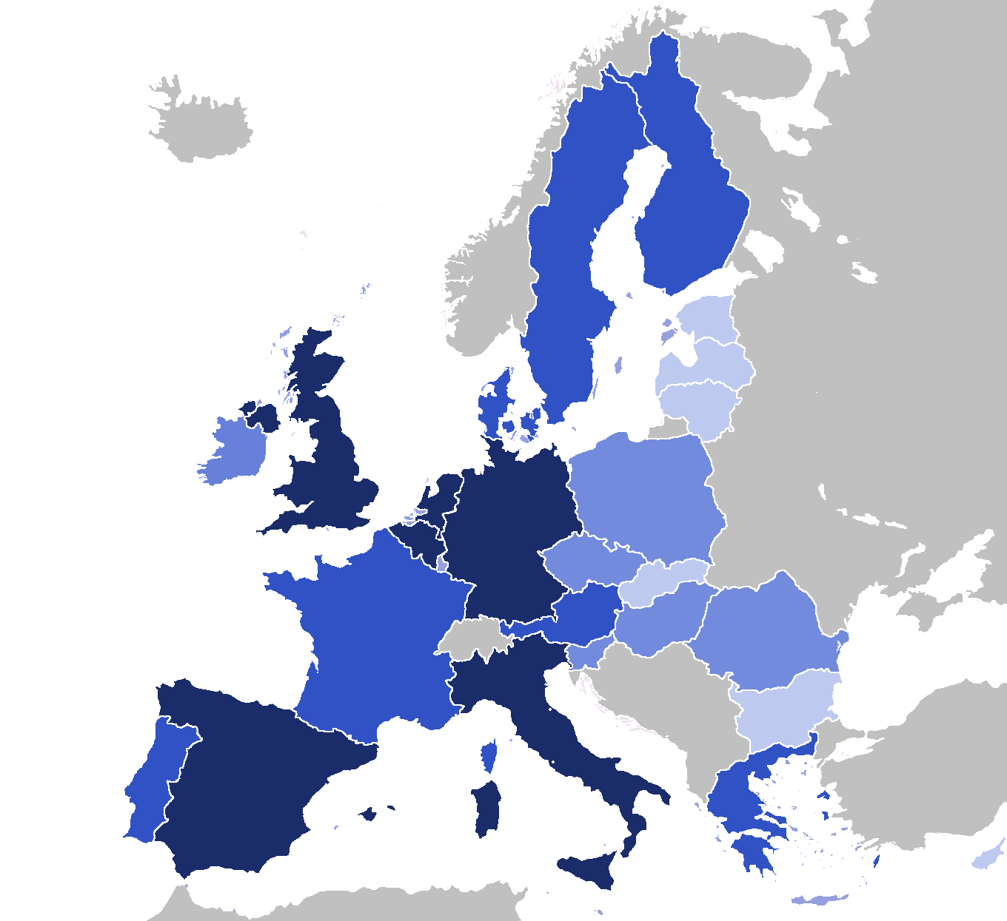
Reference Sites - coverage
32 RSs =>12 MSs
selected for self-assessment and peer-review
(innovation, scalability, outcomes)
150+ good practices of care innovation-based impact on the ground
1 July 2013 – Star Ceremony
announcement of best RSs with stars, ready for replication and coaching
City of Oulu (3)
Northern Netherlands (3)
Twente (1)
Province of Gelderland and Overjssel
South Holland
Eindhoven (3)
Liverpool (1)
Scotland
Northern Ireland (3)
Wales (1)
Yorkshire (1)
Southern Denmark (1)
Region Skane
Collage (3)
Saxony
University Hospital Olomouc
Ile-de-France (2)
Pays de la Loire
Lower-Rhine Council Languedoc-Roussillon (3)
13 Reference Sites
Liguria
Campania
Friuli Venezia Giulia
Emilia-Romagna Piemonte
12 Reference Sites
7 Reference Sites
Coimbra
Basque Country
Galicia (2)
Madrid (2)
Catalonia3)
Valencia Andalusia

Slide 10
EIP-AHA Outcome
Indicators
Headline Target
+2 HLYs
Triple Win
Quality of Life
Sustainability
Innovation & Growth
HRQoL
Mortality
Incremental change in resources used
Nr. of implemented technologies
Nr. of users of new technologies
Outcome Indicators on intervention / commitment level
x
Risk factors
Physical Activity
Nr. of created jobs
Nr. of new SMEs
Adherence
Frailty
(Local) unit cost for resources
Functional status
Falls
Some frequent resource categories:
Nutrition
Mental health
Hospital (re-) admissions
Length of hospital stay
Emergency visits
Primary care visits
Specialist visits
Institutionalisation
Cognitive decline
Notes:
HrQoL and Mortality are primary indicators (i.e. general enough to be relevant across all Action Groups of the EIP on AHA, but also sufficiently specific and sensitive to capture the impact of particular interventions within each Action Group)
Greyed indicators are Secondary indicators (i.e. they require a more elaborate approach for linking outcomes to the EIP on AHA objectives and the headline target and they could either be relevant for several Action Groups, or targeted at particular Action Groups)

Slide 11
ICT solutions for Active and Healthy Ageing
Overview
Exploring new opportunities
Catalyse Silver Economy
IoT for Smart Living Environments
(with ICT-LEIT)
Scale up Innovative Care Services
Complementing previous calls
Smart Living Environments Large-scale pilot
(2016)
Ground-
breaking R&D
in Personalised Coaching (2017)
EU – Japan
Cooperation
(2016)
PPI for deployment
and scaling up
(2016)
CSAs Standards & Silver Economy
take-up
(2016)
Stimulate
research and growth
in SMEs
(2016-17)
Notes:
SME-Instrument H1+H2: 1 activity: SMEInst-06-2016-2017 - Accelerating market introduction of ICT solutions for Health, Well-Being and Ageing Well
IA:1 activity: Focus Area Activity, "Pilot 1: Smart living environments for ageing well" of the topic IoT-01-2016: Large Scale Pilots
PPI:1 activity: SC1-PM-13–2016: PPI for deployment and scaling up of ICT solutions for active and healthy ageing
CSA: 2 activities: SC1-HCO-11–2016: Coordinated action to support the recognition of Silver Economy opportunities arising from demographic change and SC1-HCO-16-2016: Standardisation needs in the field of ICT for Active and Healthy Ageing
RIA: 2 activities: SC1-PM-15-2017: Personalised coaching for well-being and care of people as they age
and SC1-PM-14–2016: EU-Japan cooperation on Novel ICT Robotics based solutions for active and healthy ageing at home or in care facilities

Slide 12

Smart living environments for ageing well
Prevention
Wellbeing
safety & security
Social Inclusion
Health/care monitoring
Daily
living

Slide 13





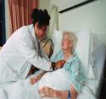



Integrated care
What this means for patients
Hospital
Long-Term Care Homes
Home Care
Common principles for coordinated care plans so all complex patients will have the same experience
Help for patients and families to navigate the health system
Listening to and involving the patients, families and caregivers in all stages of the care design process
Specialists
Community and Social Services
Primary Care Practitioners
Allied Health Professionals
13
Notes:
Care is often duplicated, or sometimes there are significant gaps in care. Patients don’t get the care they need or deserve. This inefficiency costs the system and taxpayers with overuse of emergency room visits, hospital admissions, conflicting and overlapping prescriptions (with all the resulting dangers)…we know the story all too well…
In a Health Link, providers work together to develop a coordinated care plan for each complex patient, they share information, eliminate duplication and provide better care for the patient. For example, if a Health Link patient goes to their local emergency room, his/her care coordinator is informed. The coordinator then alerts the appropriate providers in the “circle of care’, especially the patient’s family physician, who can follow up as needed.
Patients get faster access to family health care, they stay healthier, get connected to the right care and are less likely to require hospitalization.
A system focused on wellness and integrated care works most effectively where primary care providers work as members of interdisciplinary teams that can wrap services around the patient and prevent patients from falling through the cracks.
Every provider is accountable for the full patient journey. There is increased collaboration, communication and integration across the spectrum of health care providers and services that patients encounter.
Integrated care is about everyone in the system working together, sharing their expertise and helping to strengthen partnerships, so that care can be organized around the patient.

Slide 14
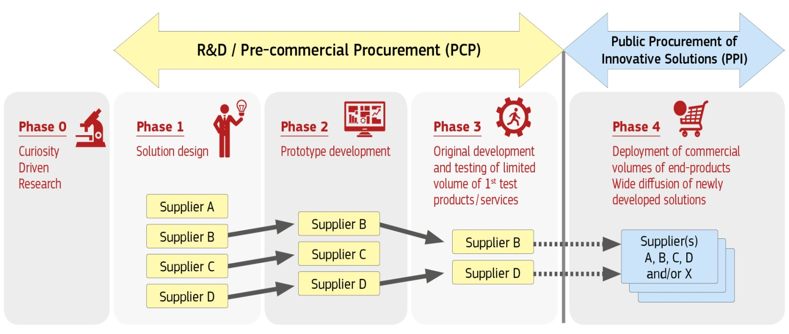
Call - Personalised Medicine
1.4 Active ageing and self-management of health
About Public Procurement of Innovation (PPI)
The PPI instrument can stimulate innovation by bringing innovative commercial end-solutions earlier to the market.
Public Procurement of Innovative solutions (PPI) is used when challenges can be addressed by innovative solutions that are nearly on the market (or already in small quantity in the market) and don't need new Research & Development (R&D). PPI acts as launching customer / early adopter / first buyer of innovative commercial end-solutions newly arriving on the market

Slide 15
SC1-PM-13–2016
PPI for deployment and scaling up of ICT solutions for active and healthy ageing
Scope
Call - Personalised Medicine
1.4 Active ageing and self-management of health
Target deployment of active and healthy ageing solutions at large scale across different regions in Europe
Specify, purchase and deploy ICT based solutions for active and healthy ageing
  Must contribute to:
  Scaling Up Strategy of the European Innovation Partnership on Active and Healthy Ageing
  Boosting the Silver Economy and Digital Single Market in Europe
  Proposals requesting a contribution from the EU of between EUR 2 and 5 million would allow this specific challenge to be addressed appropriately through PPI

Slide 16
SC1-PM-13 Expected Impact
Call - Personalised Medicine
1.4 Active ageing and self-management of health
Growing awareness and successful use of public procurement to boost ICT innovation applied to active and healthy ageing,
Contribution with data and experiences to regulatory and legislative process development
Contribution of open and comprehensive socio-economic evidence base for ICT investments in the field that can support the development of sustainable business models
Support initiatives on interoperability and standardisation that can contribute to defragmentation of the market
Creation of economic boundary conditions that can support long-term sustainability of health and care systems and emergence of new business models
Support forward looking, concerted public-sector investment strategies that benefit from joint approaches across different regions;

Slide 17
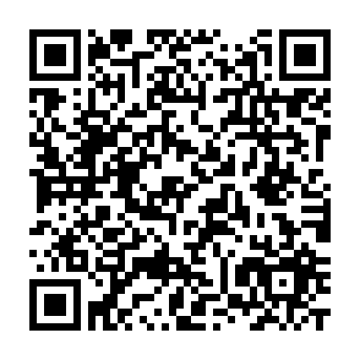
SC1-PM-13 Deadline, Budgets, Thresholds
Call - Personalised Medicine
1.4 Active ageing and self-management of health
Submission Deadline: 16 February 2016, 17:00:00 (Brussels local time)
Budget: EUR 10.5 million funded by SC1
Funding rate: up to 35%
Cumulative threshold: 10 (3/3/3)
Link to Participant Portal:
http://ec.europa.eu/research/participants/portal/desktop/en/
opportunities/h2020/topics/2447-sc1-pm-13-2016.html

Slide 18
Webinar
Public Procurement of Innovation for Active & Healthy Ageing
13 November 2015 from 10:30 to 12:00
Register by sending an e-mail to
EC-EIP-AHA@ec.europa.eu
Please e-mail your questions ahead of the event!

Slide 19
Recent DG CNECT innovation policy documents closely related to SC1 and overview of EU-funded projects
  Digital Social Platforms Unit (H2):
    EU Silver Economy Strategy http://ec.europa.eu/research/innovation-union/index_en.cfm?section=active-healthy-ageing&pg=silvereconomy
    European Scaling-up Strategy in Active and Healthy Ageing https://ec.europa.eu/research/innovation-union/pdf/active-healthy-ageing/scaling_up_strategy.pdf
    European Innovation Summit on Active and Healthy Ageing http://ec.europa.eu/research/innovation-union/index_en.cfm?section=active-healthy-ageing&pg=2015-summit
    ICT for Active and Healthy Ageing http://ec.europa.eu/digital-agenda/en/policies-ageing-well-ict
    European Innovation Partnership on Active and Healthy Ageing http://ec.europa.eu/research/innovation-union/index_en.cfm?section=active-healthy-ageing
    Active and Assisted Living Joint Programme http://www.aal-europe.eu/
    EIT KIC on Healthy Living and Active Ageing https://eithealth.eu/
    Joint Programming Initiative More Years – Better Lives http://www.jp-demographic.eu/
    Overview of the EU-funded projects in ICT for Ageing Well https://ec.europa.eu/digital-agenda/en/news/overview-eu-funded-running-projects-area-ict-ageing-well

Slide 20
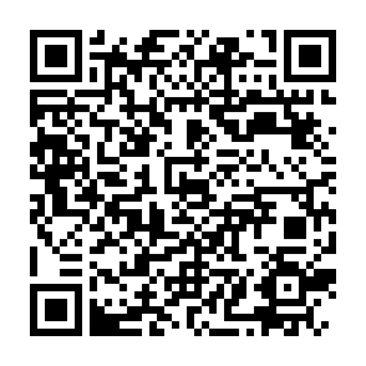
Contact and more info
Horizon 2020 Work Programme 2016-2017:
http://ec.europa.eu/research/participants/portal/desktop/en/funding/reference_docs.html#h2020-work-programmes-2016-17
Digital Social Platforms (H2): CNECT-ICT4ageing@ec.europa.eu
Twitter: @EIP_AHA
Website: ec.europa.eu/digital-agenda/en/ageing-well-ict
Newsletter: ec.europa.eu/information_society/newsroom/cf/dae/login.cfm

Slide 21
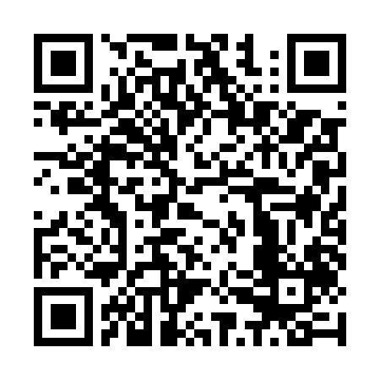
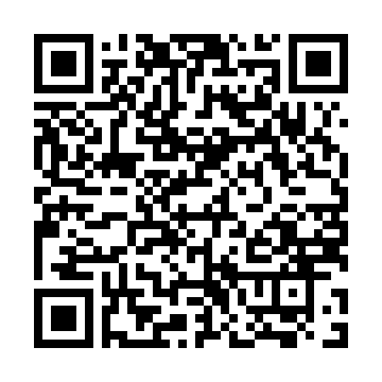
Questions?
Email to CNECT-ICT4AGEING@ec.europa.eu
EC Participant Portal:
http://ec.europa.eu/research/participants/portal/desktop/
en/home.html
H2020 National Contact Points:
http://ec.europa.eu/research/participants/portal/desktop/
en/support/national_contact_points.html

