Slide 1
Using Innovation Procurement to Develop a Sustainable Solution for Bed Washing at Erasmus Medical Centre
Ashley Stewart, Optimat Ltd
eafip, Paris, 28th October 2015

Slide 2
Overview
About EcoQUIP
Innovation Procurement
Case example: Sustainable Bed Washing Facility at Erasmus Medical Centre, The Netherlands
Project approach
Project outcomes

Slide 3
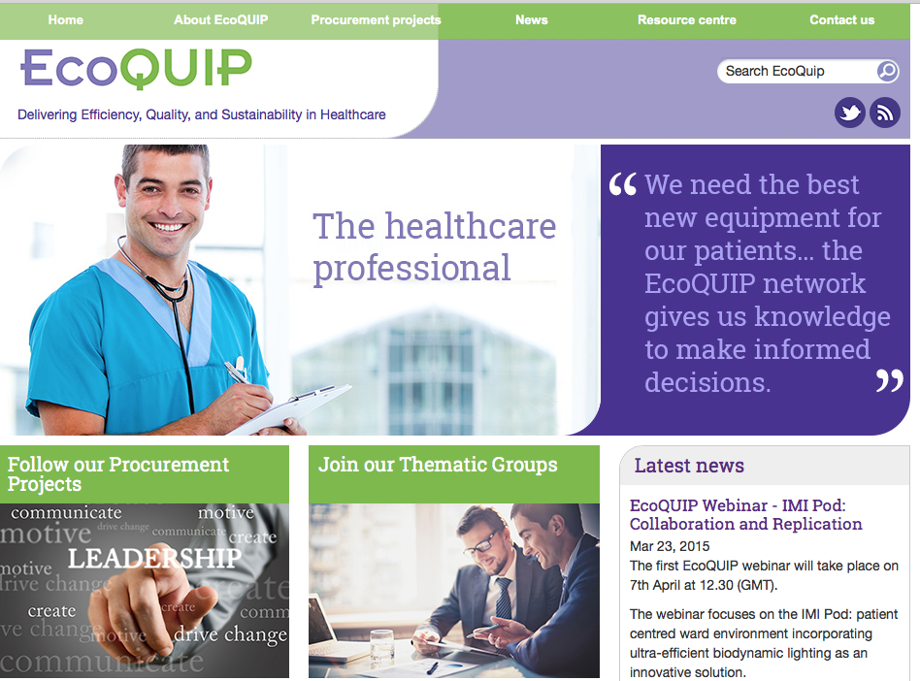
About EcoQUIP
Demonstrating that new approaches to procurement can deliver Efficiency, Quality and Sustainability in the healthcare sector
http://www.ecoquip.eu
@ecoquip
#ecoquipnetwork
Notes:
European Commission funded project in the field of innovation procurement
EcoQUIP began in 2012 and will end in October 2016.
The aim of EcoQUIP is to demonstrate that new approaches to …..
More information and resources are available on our project website or you can follow us on Twitter.

Slide 4
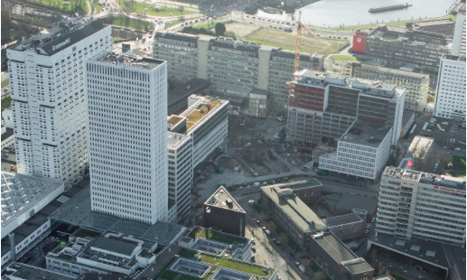
Project Partners
Department for Business, Innovation and Skills (Coordinator)
Bologna University Authority – St. Orsola-Malpighi Polyclinic
Erasmus University Medical Centre
Nottingham University Hospitals NHS Trust
Sucha Beskidzka Hospital
Semmelweis University Health Services Management Training Centre
The Rotherham NHS Foundation Trust
Department of Health England
European Health Property Network
Heath Care Without Harm Europe
Optimat Ltd
JERA Consulting Ltd
Notes:
We have 12 project partners consisting of hospitals, innovation agencies and innovation procurement experts.

Slide 5
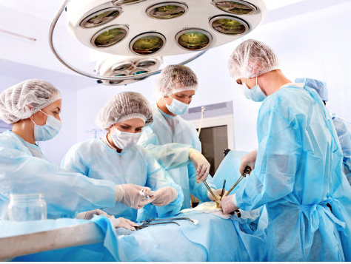
Why Innovation?
Across Europe, healthcare systems are facing major challenges:
Upward pressure on the costs of providing care
Downward pressure on budgets, as public finances remain constrained
An unresolved gap between the service on offer and the healthcare needs of populations
Increased expectations that healthcare budgets and provision must be sustainable
Increasing hygiene and infection control issues
Notes:
So why is innovation important?

Slide 6
Innovation Procurement
Challenging times need an innovative response
Innovation is the key to some of the biggest challenges facing society, and the healthcare sector
Changing demographics and aging populations
Climate change mitigation and adaptation
Sustainable development and resource efficiency
Financial pressures
Better services for lower cost - “More for less”
BUT
The ‘usual’ approaches to procurement stifle innovation in the supply chain and lock in old solutions
New ‘pro-innovation’ approaches are needed………
Notes:
However, these challenges need an innovative solution.

Slide 7
Innovation Procurement
But, what is it?
Buying goods and services in a way that stimulates the supply chain to invest in developing better and more innovative goods and services to meet the unmet needs of an organisation
Innovation
What is desirable for customers
What is viable in the market place
What is possible with technology
Notes:
But what do we mean by innovation procurement?

Slide 8
Notes:
However, a buyer supplier paradox exists. On the one hand suppliers say that if demand existed they would develop more innovation greener products and on the other hand, buyers say that if cost effective innovative solutions existed they would buy them. But how do we overcome this paradox?

Slide 9
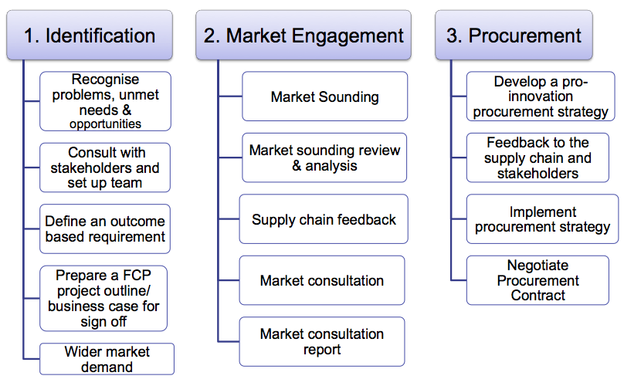
Innovation Procurement
The Forward Commitment Procurement Method
Notes:
One innovation procurement approach to enabling innovation is the Forward Commitment Procurement method.
The FCP method derived in the UK and provides a framework of actions that together can change the market situation to one that supports the delivery of the outcomes the customer requires.
The method distinguishes three main phases of innovation procurement:
Identifying unmet needs and embed in the organisation
Engage the market by presenting a credible demand
Implement pro-innovation procurement process

Slide 10
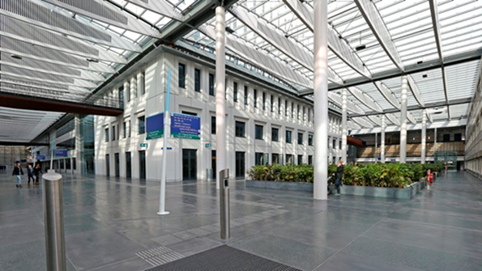
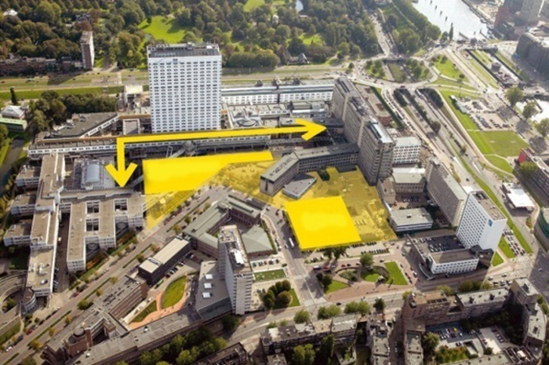
Case Example – Erasmus MC
One of the Netherlands University Hospitals
Situated in the heart of Rotterdam
Major on site hospital build in progress
circa 1350 beds
Notes:
The case example that I would like to present today is the innovation procurement project undertaken by Erasmus Medical Centre in Rotterdam.

Slide 11
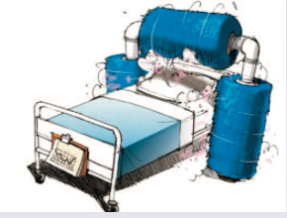
1. Identification
The need and opportunity?
New hospital being built
Old bed washer?
End of life
Energy and resource intensive
No longer available
Internal drivers
Energy efficiency
Carbon reduction
Resource efficiency
Auditable process
Notes:
Erasmus MC followed the FCP approached. As a result of a new hospital being built they realised that the existing bed washer was reaching its end of life, it was resource and energy intensive and was no longer available on the market, so a simple replacement was not an option. There was also a number of internal drivers impacting on the procurement of a new solution namely; energy efficiency, carbon reduction, resource efficiency and audibility.

Slide 12
Identification
Defining the ‘unmet need’
“Erasmus University Medical Centre (Erasmus MC) is renewing its bed washing facility to provide enough clean and disinfected beds for its daily operational needs. This currently exceeds 70,000 beds per annum and is expected to increase. The existing machine is labour intensive and uses a large volume of water and energy to operate. In brief, it is expensive and out of step with the hospital’s sustainability policies and objectives”.
The project team identified an unmet for ‘a sustainable and low carbon solution to deliver 70,000 clean beds and mattresses per year’.
Notes:
They identified an unmet need for ‘a sustainable and low carbon solution to deliver 70,000 clean beds and mattresses per year’.

Slide 13
2. Market Engagement
Market Sounding Prospectus
70,000 beds need cleaning and disinfected each year
Solution wanted in 2013
Lowest Total Cost of Ownership/Carbon Footprint
Announcement was launched in September 2011
Notes:
The second phase of FCP is market engagement. Erasmus MC conducted a number of activities to engage the market. They published a market sounding prospectus which outlined the unmet need.

Slide 14
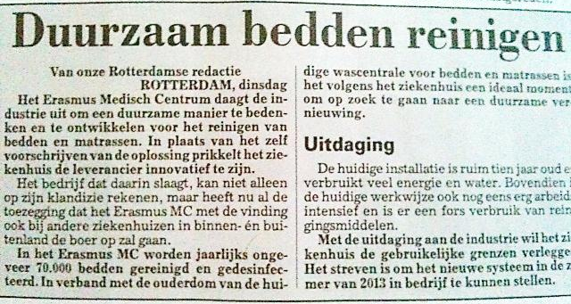
Market Engagement
Communication is vital – tell the story, get it out there!
Notes:
They also worked hard to communicate there unmet need to the market and supply chain. They communicated with several media outlets and promoted the project.

Slide 15
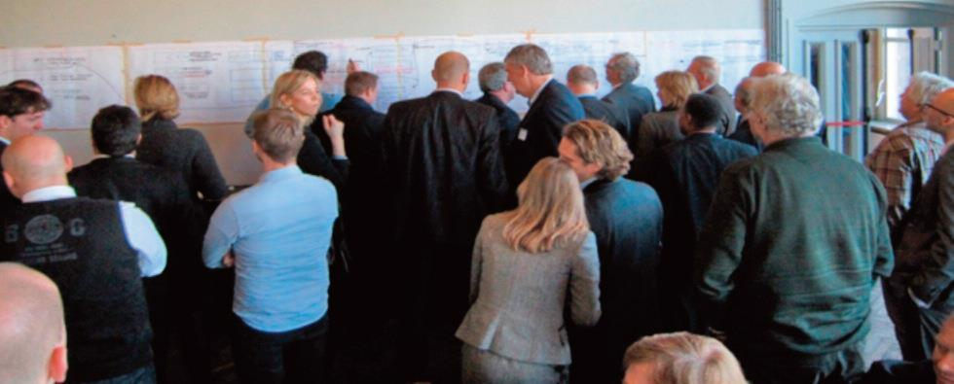
Market Engagement
Market Open Day
Notes:
They also held a market open day in January 2012 which attracted almost 60 participants.

Slide 16
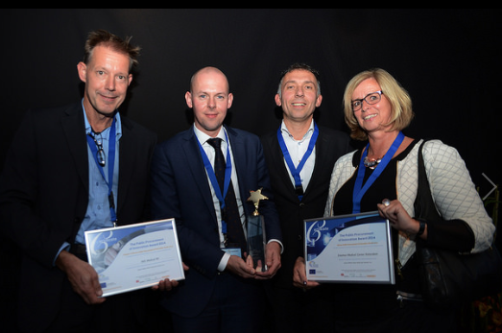
3. Procurement
Outcome
Auditable bed cleaning
Resource efficiency
Carbon reduction (- 63%)
Lower Total Cost of Ownership (-35%)
Innovation
Robotic bed washing solution
Steam jets patented
Cross fertilization across supply chains
Replication and wider application
Technology can be applied to other cleaning and hygiene needs
Winner 2015 PPI Award
The Public Procurement of Innovation (PPI) recognises successful public procurement practices that have been used to purchase innovative, more effective and efficient products or services.
Notes:
Finally, having identified their unmet need and engaged with the market, they were able to procure a solution to meet their needs.
The outcome of the FCP approach was an auditable bed cleaning facility that was resource efficient, reduced carbon and provided a lower TCO. The innovative solution was a robotic bed washing facility. This solution recently won the 2015 PPI award.

Slide 17
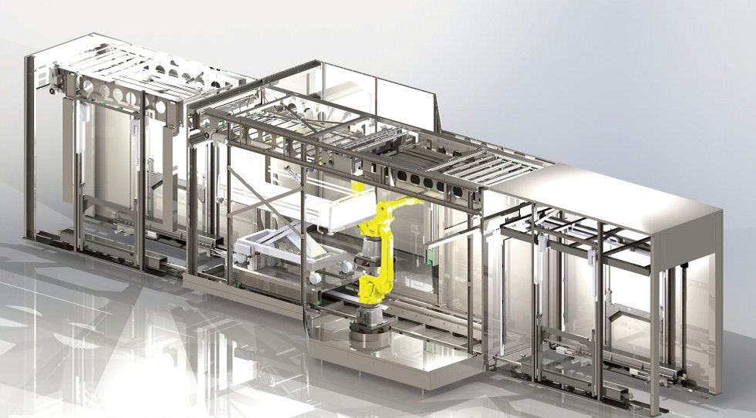
Robotic Bed Washing Facility
Notes:
The outcome of the innovation procurement project is a robotic bed washing facility.

Slide 18
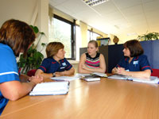
Success Factors
Cross-departmental project team
Early identification of unmet need
Stakeholder engagement
accurately defined the problem unmet need
Outcome based not technical specification
allows scope for innovation in the supply chain
Early Market Engagement
Determined current ‘total cost of ownership’ and carbon footprint
Balanced evaluation criteria
Notes:
The Erasmus team have identified a number of success factors including:

Slide 19
Thank You! ashley.stewart@optimat.co.uk www.ecoquip.eu
Notes:
To conclude, the Erasmus MC case example shows that by following a methodology such as FCP innovative solutions can be found and implemented.

