Slide 1
Hydrography 2.0
Project proposal ICT-34 call
2015 EU Innovation Procurement event
28 October 2015, Paris

Slide 2
Need for Digital Elevation Models (DEMs)

Slide 3
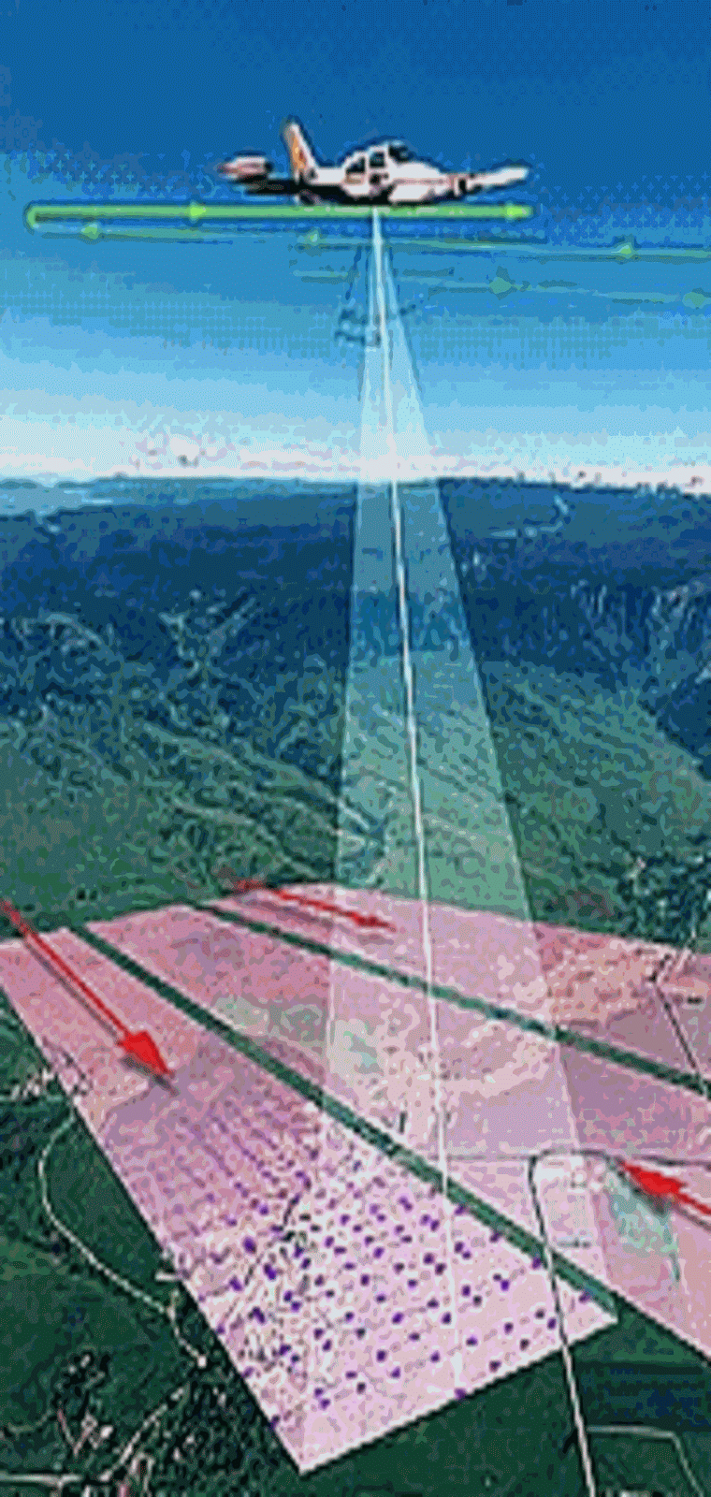
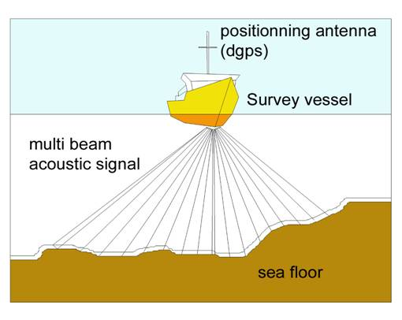
Current practice
Echosounding (SONAR)
5-6 vessels sail out every day in Flanders
Airborne laserscanning (LIDAR)
yearly surveys
Merging of data is needed to produce Digital Elevation Models (DEMs)

Slide 4
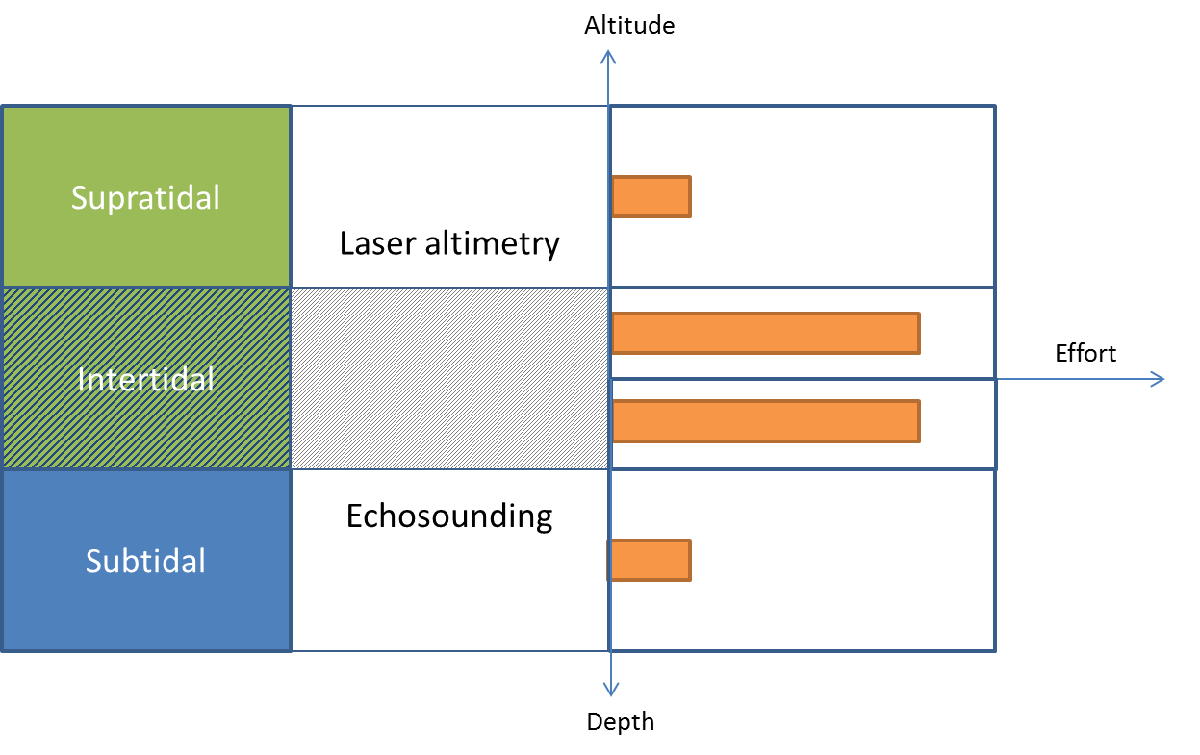
Current practice
Limitations
Survey areas are limited by what is feasible in 1 day
Low revisit frequecy
Data acquisition and processing are costly and labour intensive
High efforts are needed to adequately cover intertidal areas
Combining surveys into a single map covering the area of interest is complex

Slide 5
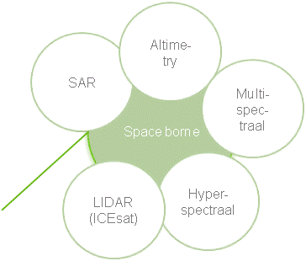
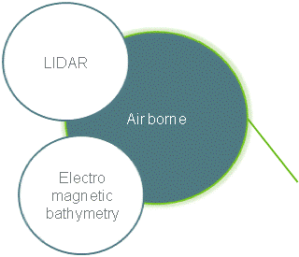
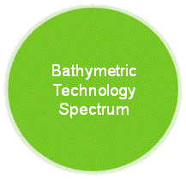
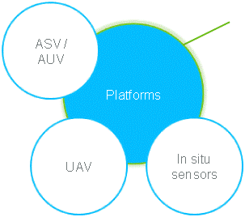
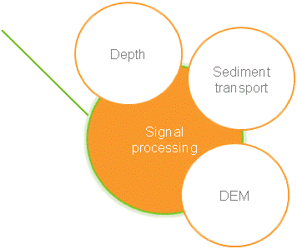
Technological developments do not offer a suitable solution
Linking remote sensing data with existing LIDAR & ES surveys to advanced modelling techniques

Slide 6
Goal of PCP project proposal
Design & develop an innovative technique to produce a DEM/DTM of entire coastal areas integrating (existing) multi-sensor data and making use of advanced signal processing methods

Slide 7
We aim for breakthrough innovation
We need to reinvent the survey strategy and think of a breakthrough system
We need to develop novel processing techniques
It is assessed that a high level of R&D is needed
Even though considered very complex, there is a strong believe among stakeholders that a major leap forward can be made

Slide 8
State of play
Potential procurers can join consortium as partner or user group
Hydrographic institutes
Management authorities of coastal areas
Port authorities
Partnership (evolving)
Private company: innovation and project management
PCP experience on board
Preliminary definition of work packages and tasks
We are looking for a small consortium with motivated partners
Budget estimation: 2,5 M euro overall
Partnership wants to invest more than required minimum

Slide 9
Interested?
Frederik Roose
Department of Mobility and Public Works, Maritime Access division
Tavernierkaai 3, B-2000 Antwerpen, Belgium
frederik.roose@mow.vlaanderen.be

