Slide 1
Innovation Strategy and Public Procurement
dr. Ramona Apostol
Paris conference – 27th & 28th October 2015

Slide 2
Agenda
What is Europe’s 2020 strategy ?
Why is innovation important ?
What is the role of public procurement ?
How can the eafip initiative support you ?

Slide 3
Agenda
What is Europe’s 2020 strategy ?
Why is innovation important ?
What is the role of public procurement ?
How can the eafip initiative support you ?

Slide 4
Europe’s 2020 Strategy
“I think that the experience of the crisis has taught us that, while we need an economy that grows and provides jobs and respects environmental goals, we also need a resilient economy:
an economy that has solid foundations, not one built on sand.
an economy that generates sustainable growth, not growth fueled by debt, speculation and greed...
What strikes me again and again is how central innovation is to achieving all this.”
Maire Geoghegan-Quinn,
European Commissioner responsible for
Research, Innovation and Science

Slide 5
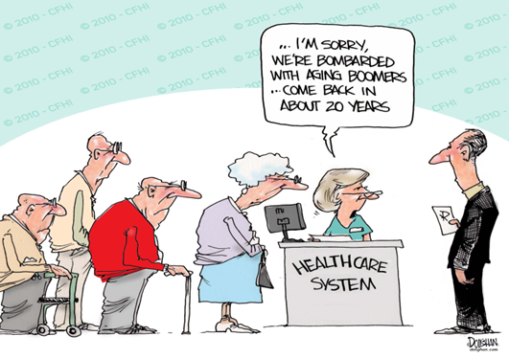
Europe’s 2020 Strategy
LONG-TERM CHALLENGES:
CHOICE:
Regain competitiveness, boost productivity;
Slow uncoordinated pace of reform --> high levels of unemployment and social distress.
Notes:
Globalisation (competition): Countries such as China or India are investing heavily in research and technology in order to move their industries up the value chain and "leapfrog" into the global economy. This puts pressure on some sectors of our economy to remain competitive, but every threat is also an opportunity. As these countries develop, new markets will open up for many European companies.
Resources: Strong dependence on fossil fuels such as oil and inefficient use of raw materials expose our consumers and businesses to harmful and costly price shocks, threatening our economic security and contributing to climate change. The expansion of the world population from 6 to 9 billion will intensify global competition for natural resources, and put pressure on the environment. The EU must continue its outreach to other parts of the world in pursuit of a worldwide solution to the problems of climate change at the same time as we implement our agreed climate and energy strategy across the territory of the Union.
Ageing: pressure on the welfare system, on the health care system.

Slide 6
Europe’s 2020 Strategy
Smart
Sustainable
Inclusive
Innovation
Education
Climate/energy
Employment
Social inclusion
Notes:
Interrelated targets:Europe 2020 – A strategy for a smart, sustainable and inclusive economy.
invest 3% of the EU’s GDP in R&D
Education: 40% of the younger generation a tertiary degree;
Climate/energy: reduction of greenhouse gas emissions by 20 - 30% (as compared to 1990); share of renewal energies 20%; 20% increase in energy efficiency;
Employment: 75% of the population employed;
Social inclusion: 20 million less people at risk of poverty;
EU states → very divers

Slide 7
Agenda
What is Europe’s 2020 strategy ?
Why is innovation important ?
What is the role of public procurement ?
How can the eafip initiative support you ?

Slide 8
What is innovation?
”connecting knowledge and technology with the exploitation of market opportunities for new or improved products, services and business processes ” (2006)
“when an invention is introduced commercially as a new or improved product of process” (Maclaurin, 1953)
”invention implemented and taken to market” (Chesbrough, 2006)

Slide 9
Why is innovation important?
Overcome the limitation of physical resources
New markets
New employment opportunities
Solution to challenges
Notes:
Innovation is about finding new and better ways of doing things.
It increases productivity by overcoming the limitation of resources.
US team - solar-powered system
Carbon nanofibres are already used in high-end applications such as electronic components and batteries, and if costs came down they could be used more extensively - improving the strong, lightweight carbon composites used in aircraft and car components, for example.

Slide 10
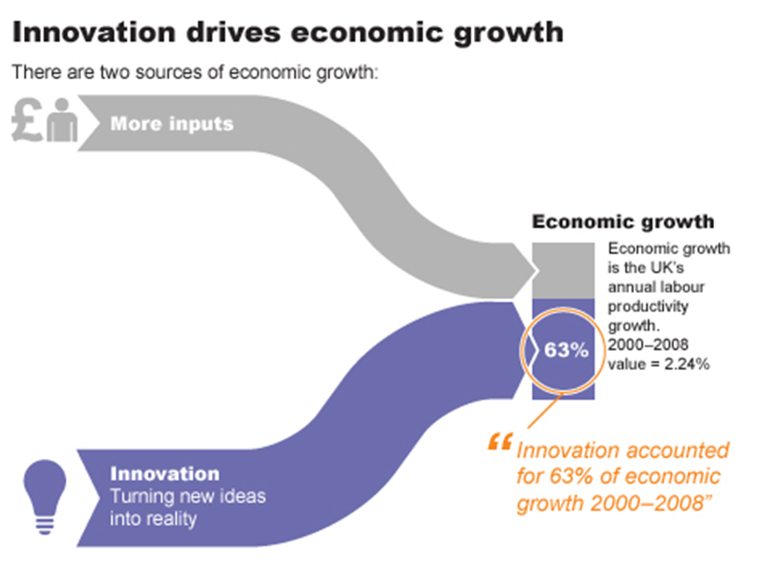
Why is innovation important?

Slide 11
Why is innovation important?
”The companies that invest most in innovation tend to grow faster than ones that don’t; and the countries that invest most in innovation do as well.”
Source: NESTA, UK

Slide 12
Europe’s 2020 innovation strategy
TARGETS
Invest 3% of GDP by 2020 in R&D
COORDINATION
Coordinate EU and national research & innovation systems
European Research Area (ERA)
REFORM
Modernize education systems
Get more innovation out of our research

Slide 13
Agenda
What is Europe’s 2020 strategy ?
Why is innovation important ?
What is the role of public procurement ?
How can the eafip initiative support you ?

Slide 14
Role of Public Procurement
Innovation Nation Flagship
“The challenge is to use public procurement and public services to lead the way, shape the market for innovative solutions and equip society to meet the challenges of the future”.

Slide 15
Innovation Union Flagship
“From 2011, Member States and regions should set aside dedicated budgets for pre-commercial procurements and public procurements of innovative products and services. (…)
This should create procurement markets across the EU starting from at least €10 billion a year for innovations that improve the efficiency and quality of public services, while addressing the major societal challenges.”

Slide 16
Role of Public Procurement
National processes:
- Administrative task;
- Small scale;
- National competition.
European coordination:
- Integrate the EU public markets;
- Improve value for money;
Smart use of procurement:
- Professionalization;
- Economies of scale;
- Innovation;
- Sustainability.

Slide 17
Strategic objectives & Procurement
Innovation Procurement
Legislation
Policy
Funding

Slide 18
Innovation Union
Barriers to innovation procurement:
Lack of knowledge and capabilities
Disconnection between public procurement and innovation policy objectives
Risk aversion

Slide 19
What is the role of procurement in innovation
Funding:
https://www.youtube.com/watch?v=qQNzJBPcyB0
Early adopter:
Notes:
Funding from the government, very costly prototyping ; competition to fossil fuels;
Strategic use of the massive procurement budgets (€2 trillion per year; 19% GDP)
Early adoption of emerging innovative or green products will provide companies with early revenues which can be invested in further refining the product up to the point when it is competitive compared to established technologies available on the market.
Public procurement can boost the market share of innovative products (provide credibility)

Slide 20
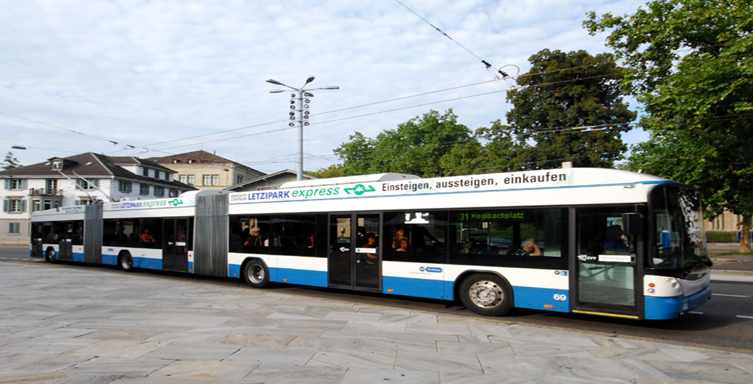
Example
Photocatalytic concrete – Detmold, Germany
Notes:
Used by 2,3 mil. Passengers each year;
800 busses pass through it each day;
Needed to renovate and redesign in order to improve traffic flow and accessibility.
Reduce nitrogen oxide levels by up to 40% in the area.
Variants were submitted (conventional concrete was 3,6% cheaper on average.

Slide 21
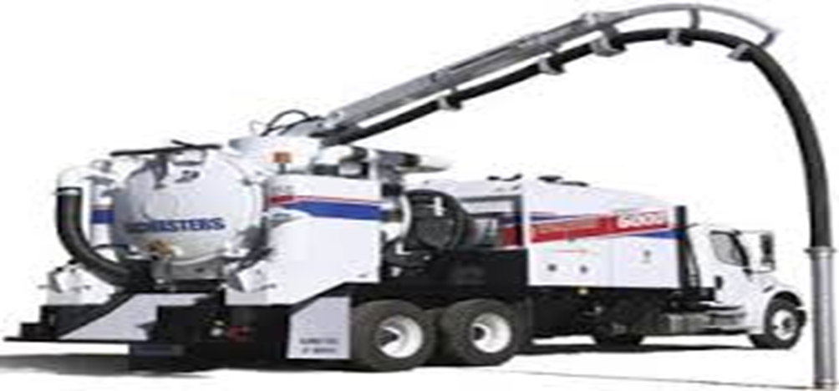
Example
Example – Oslo Municipality - Trenchless solution
Notes:
Problem:
Connecting houses to (or repairing) municipal water lines consists of digging up roads and sidewalks, excavating, connecting pipes, refilling and treating the surface after the connection is done;
Laborious, costly polluting (noise and dust);
Required solution:
Trenchless solution that does not disturb the surface;
https://www.youtube.com/watch?v=KtbXv1wBFl4
Government procurement:
Feasibility;
Lab prototype;
Field test.

Slide 22
Agenda
What is Europe’s 2020 strategy ?
Why is innovation important ?
What is the role of public procurement ?
How can the eafip initiative support you ?

Slide 23
eafip INITIATIVE
Toolkit
Free assistance
Workshops

Slide 24
eafip TOOLKIT
Toolkit
MODULE 1
Policy maker
MODULE 2
Public procurer
MODULE 3
Legal expert

Slide 25
eafip TOOLKIT – MODULE 1
Section 1: Introduction
Section 2: Definitions
Section 3: Understanding innovation procurement
Section 4: Defining an innovation procurement policy
Section 5: Available funding under Horizon 2020, the new Research and Innovation Program and synergies with the European Structural and Investment Funds (ESIF)

Slide 26
Defining an innovation procurement policy
Political commitment
OFFICIAL
GOVERNMENT
DECISION
Preparation
- understand;
- Involve stakeholders;
- Integrated policies;
- Analyze framework conditions;
- Address obstacles.
Action Plan
- starting situation;
- vision, mission & objectives;
- Implementation (pilot, timeframe, budget, resources and roles allocation etc.)
- Monitoring evaluation and review

Slide 27
Periodical assessment
evaluation
review
monitoring

Slide 28
Dr. Ramona Apostol
Corvers Procurement Services BV
Email: r.apostol@corvers.com

