Slide 1
Public procurement policy in Flanders: an integrated approach
EAFIP, 27th October 2015, Paris

Slide 2
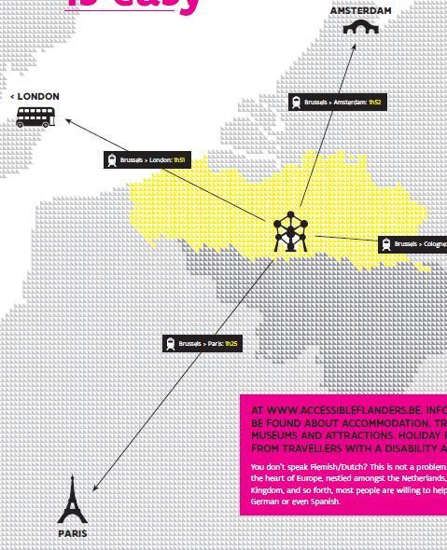
Flanders: autonomous northern region of Belgium

Slide 3
Public Procurement - context
Action plan on innovation procurement
Actionplan e-procurement
Action plans on sustainable public procurement
Paper on prevention of fraud and abuse in public procurement
Vision on the use of a central purchasing agency and framework agreements

Slide 4
Innovation Procurement - context
Knowledge Centre on PoI/PCP: Innovation agency IWT
2008-2010: Start-up of a PCP pilot
2011- : roll-out of PCP/PoI in all policy domains
Financial support program:
10 MEUR available from innovation department
Supplemented with cofinancing from entity taking the procurement initiative.

Slide 5
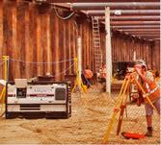
Achievements
16 PPI- PCP finalised, launched, in preparation or stopped:
PPI’s :
Life-cycle-cost tool for the health care sector (Health care)
Personal Developing Plan for each citizen (Employment Servicing).
The eye-screener for young babies (Health);
Monitoring systems for excavations (Public Works);
…..
PCP:
e-book platform (Cultural heritage/public libraries)
Automatic subtitling of television programmes (Media)
Hydrographic three-dimensional measurements (Public Works)
Zero energy Social Housing without additional cost (Social housing/energy efficiency)
Towards a more sustainable greenhouse horticulture in Flanders (Agriculture/ energy efficiency)
….
One EU- PCP Project :Smart@fire
Coordinator of 1 EU PCP- Project (DG Connect): Smart@Fire (Fire fighting/civil work) 11 partners (2,2 M €) www.smartatfire.eu

Slide 6
Challenges
Risk aversion
Innovative market supply is not sufficiently known
public procurement function
….
Need for mind switch towards "think innovation"
Need for more permanent and visible commitment and overall umbrella

Slide 7
Public procurement policy

Slide 8
Strategic objectives (2015-2020)
Professionalisation of public procurement
Focus on SPP and innovation procurement
Increasing SME participation in public procurement
Achieving end-to-end e-procurement
Enhancing integrity in public procurement
Using procurement as a tool for strategic projects

Slide 9
Professionalisation
Pooling of purchasing power as a leverage
Investigate and rethink the procurement needs
Market consultation before tendering
culture of using new procurement approaches
Functional specifications as much as possible
Focus on SPP and innovation procurement
Use TCO & LCC costing models
Circular and biobased procurement
Communication
…

Slide 10
Innovation procurement
Government will act as a launching customer, first buyer or early adopter + invest in PCP
Commitment to:
encourage public procurers to buy 'innovative‘
provide financial means and capacity .
a target for a specific percentage (3%) of the overall public procurement spending to go to innovation procurement
organizing market consultations
use the increased support offered by Horizon 2020
Monitor and evaluate best practices
Annual report

Slide 11
Questions or remarks?
,
Frederik Claerbout
DEPARTEMENT OF PUBLIC GOVERNANCE AND THE CHANCELLERY
T 0032 (0)2 553 60 12
Frederik.claerbout@dar.vlaanderen.be
Boudewijnlaan 30 bus 20, lokaal 7A16, 1000 Brussel

