Slide 1
PRO-LITE
Procurement of Lighting innovation & Technology in europe
October 2015

Slide 2
Background
Funded by the European Commission
Engage more effectively with manufacturers
to procure better products and services
(Communication)
Case study is Lighting

Slide 3
Internal Demand Analysis
(Asset & Category Strategy)
State of the Art
(Leading edge technologies)
Early Market Engagement
(Understand the Market)
Requirements Development
Procurement of Products
(Innovation)
Process
Procure products that demonstrate the best
Whole Life Cost and Performance

Slide 4
Internal Demand Analysis
(Asset & Category Strategy)
State of the Art
(Leading edge technologies)
Early Market Engagement
(Understand the Market)
Requirements Development
Procurement of Products
(Innovation)
Process
Procure products that demonstrate the best
Whole Life Cost and Performance

Slide 5
Design Idiom
Bringing good design to the forefront of the London Underground
Chapters
Opportunities
Improve Customer Satisfaction
Meet demands of an expanding business
Increased feeling of security
Live up to the legacy

Slide 6
Create Ambience with Lighting
Good lighting can change the way a space feels
Principles
Design for the individual environment
Use multiple layers of light
Guiding light
Save energy
Make it interesting

Slide 7
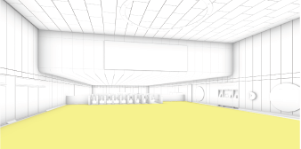
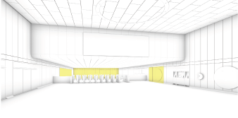
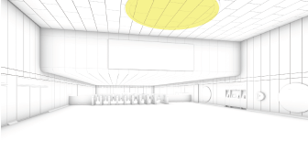
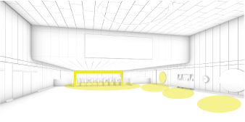
Layers of Light
Use layers to aid passenger flow, define important areas
and make way finding intuitive
Ambient
Accent
Feature
Orientation

Slide 8
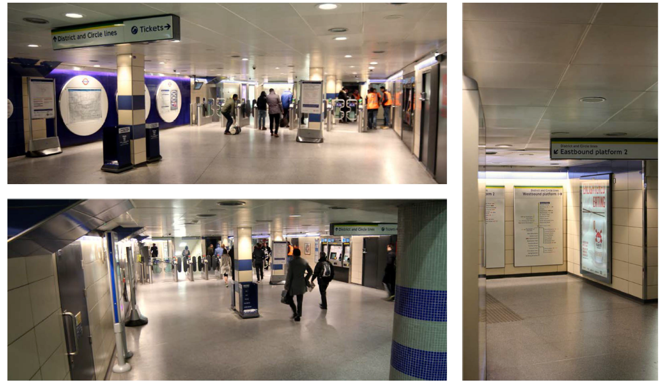
Cannon Street Station Trial

Slide 9
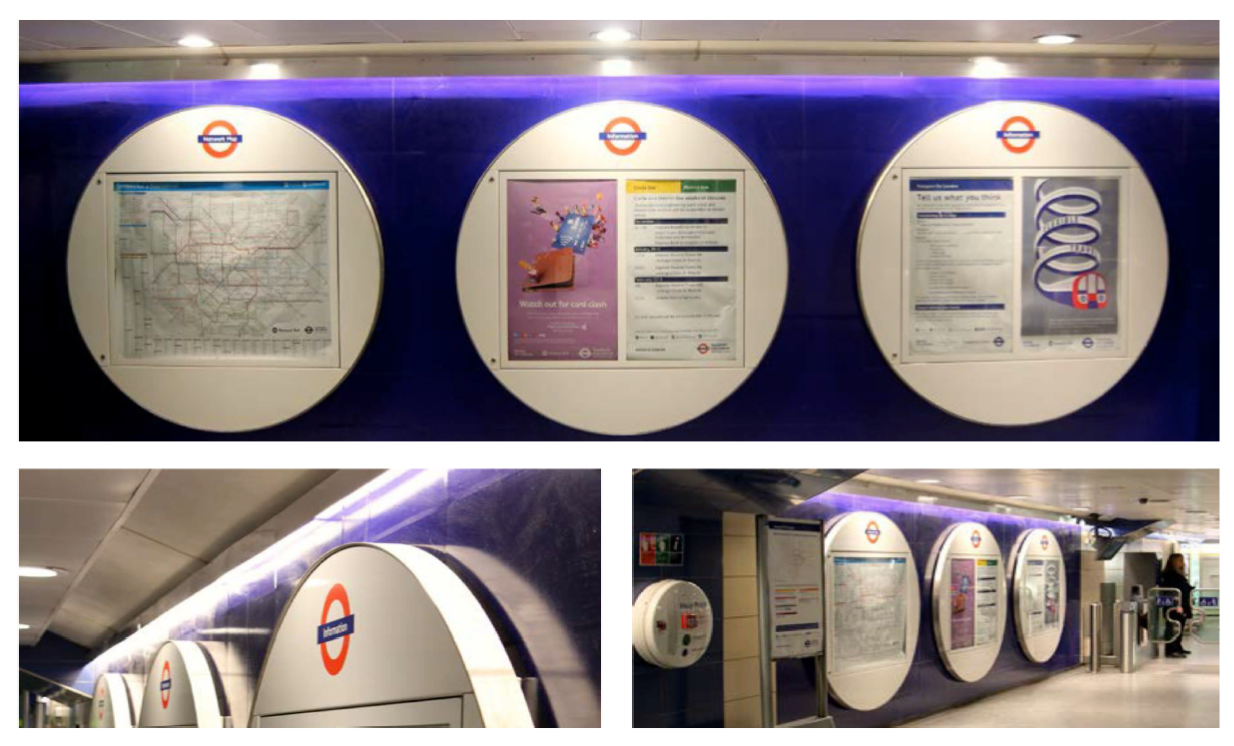
Cannon Street Station Trial

Slide 10
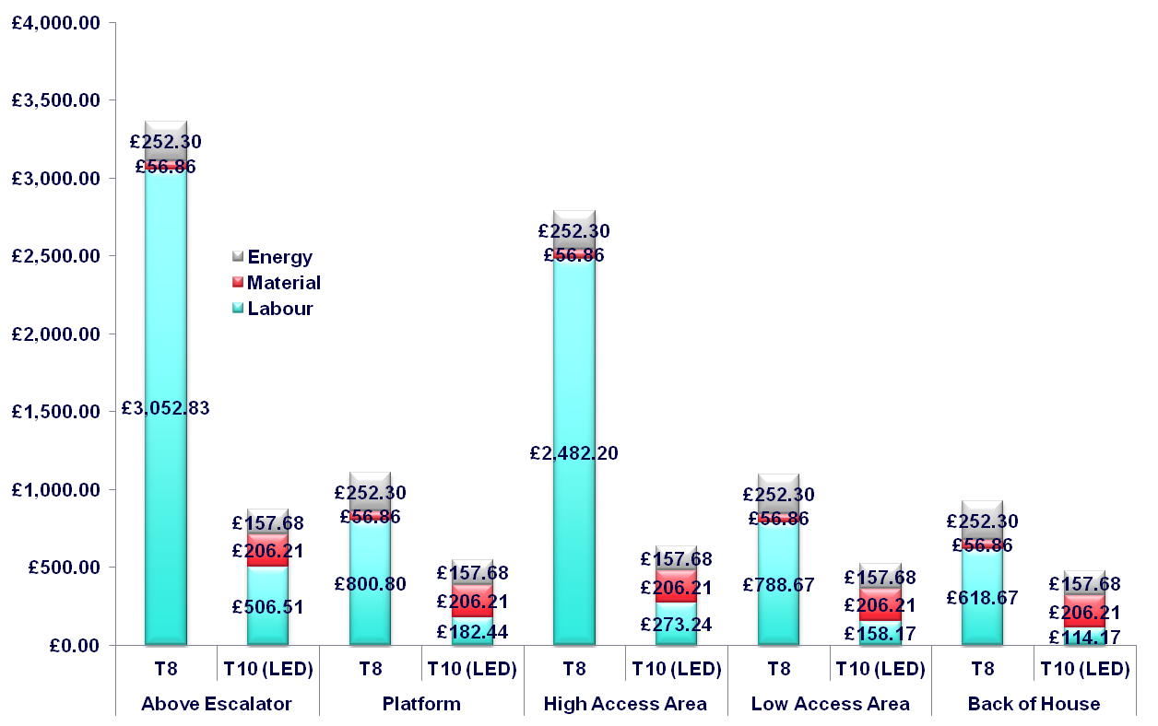
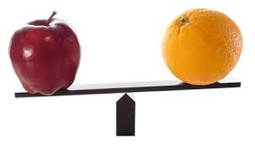
Internal Demand Analysis
- Whole Life Cost Comparison

Slide 11
Internal Demand Analysis
- Where to target for savings
IMPORTANCE
Capital vs. Operational expenditure
Maintenance Costs
Installation Costs
Products Unit Costs
Cleaning Costs
Energy Costs

Slide 12
Internal Demand Analysis
(Asset& Category Strategy)
State of the Art
(Leading edge technologies)
Early Market Engagement
(Understand the Market)
Requirements Development
Procurement of Products
(Innovation)
Process
Procure products that demonstrate the best
Whole Life Cost and Performance

Slide 13
State of the Art
What could we ask for?

Slide 14
Internal Demand Analysis
(Asset & Category Strategy)
State of the Art
(Leading edge technologies)
Early Market Engagement
(Understand the Market)
Requirements Development
Procurement of Products
(Innovation)
Process
Procure products that demonstrate the best
Whole Life Cost and Performance

Slide 15
Early Market Engagement
- Who, where, what

Slide 16
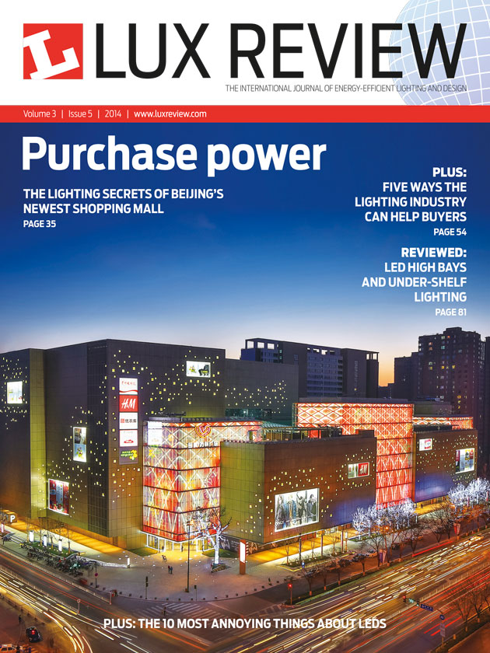
Europe's Lighting Industry Association
Communication
Lux Review
Lux Live

Slide 17
Highlights

Slide 18
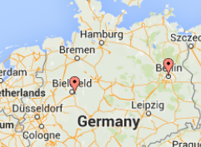
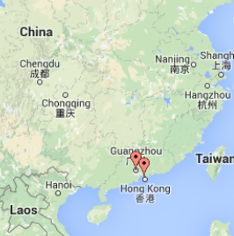
Received information on over 350 lighting products from over 70 different manufacturers and suppliers (equivalent to approximately 25% of the known European suppliers)
Reponses received from
UK
Europe
Asia
North America
Notes:
Represents around 25% of the lighting manufacturers and suppliers ‘known’ to Europe’s largest lighting association

Slide 19
Good information received on all Product Types of interest to TfL

Slide 20
The annual turnover of organisations that responded ranges from £0 – 4 billion per year

Slide 21
35% of the market sampled have been trading for less than 10 years, and over 75% less than 50 years

Slide 22
Information on LED technologies dominated the response (97%)

Slide 23
Two-thirds of LED products are sold with 5 years warranty or more, and 90% are sold with 3 years or more.

Slide 24
70% of LED products are sold with the CE marking, and just under 30% have both the CE and ENEC markings

Slide 25
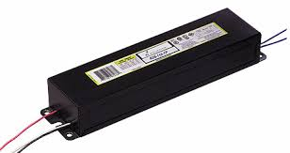
79% of manufacturers rely on other suppliers/manufacturers for parts
Ballasts
Drivers
Emitters
etc.

Slide 26
90% of manufacturers registered for ISO9001

Slide 27
93% of manufacturers believe their products are eligible for the UK governments Enhanced Capital Allowances Scheme (and registering product where possible)

Slide 28
90% of manufacturers would be willing to develop a bespoke lighting technology for TfL for which TfL would own the Intellectual Property Rights

Slide 29
Lighting Suppliers Morning – April 2015

Slide 30
Summary of Market
Engagement
Presented – just some of the key findings
Broad representation from the market
LED technologies dominated responses
Much more informed view on quality and limitations of the technologies available on the market
Strengths and weaknesses of products & organisations

Slide 31
Internal Demand Analysis
(Asset & Category Strategy)
State of the Art
(Leading edge technologies)
Early Market Engagement
(Understand the Market)
Requirements Development
Procurement of Products
(Innovation)
Process
Procure products that demonstrate the best
Whole Life Cost and Performance

Slide 32
Requirements Development
- Technical Specification and Procurement Documents

Slide 33
Procurement
- 3 Steps
Next Steps
STEP B
Invitation to Tender
Paper Assessment
(Late 2015)
STEP C
Invitation to Tender
In Situ Assessment
(Early 2016)
STEP A
Pre-qualification
50+ Suppliers Responded
Procure products that demonstrate the best
Whole Life Cost and Performance
Contract(s) up to ~8 years

Slide 34
Procurement
- Lamps and Luminaries
Lamps:
Bayonet Screw
Edison Screw
Linear
PL
Luminaries:
Bulkhead
Column head
Down
Flood
High Bay
Indoor Linear
Outdoor Linear
Square Ceiling
Wall Washing
~50 Products Contract Award
Early 2016
Procure products that demonstrate the best
Whole Life Cost and Performance

Slide 35
Procurement
- Other Products for Stations
Within Transport for London
Lighting
Signage
Tiling
Ceilings
Flooring
Other Station Assets
Early 2018
Catalogue of products for London Underground Stations

Slide 36
Other Procurements (PRO-LITE):
*2
Italy & Germany

Slide 37
Thank you!
Dr Leon Smith
www.prolitepartnership.eu
www.prolitepartnership.eu/news/

