Slide 1
EO and PCP in a Space Cluster Perspective
2015 EU Innovation Procurement event
28 October 2015, Paris
Fiorella Coliolo, DTA

Slide 2
The Regional Space Strategy
Smart Specialisation: pillar of “Europe Strategy 2020”
SmartPuglia 2020, Regional Strategy of R&I for Smart Specialisation
A new model of regional economic development for a growth:
Smart, Inclusive and Sustainable
Space -> Innovation Driver in the Puglia 3S strategy
Notes:
Messaggio : La strategia 3S in puglia ed il fatto che lo spazio e uno degli innovazion driver

Slide 3
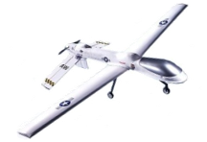
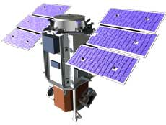
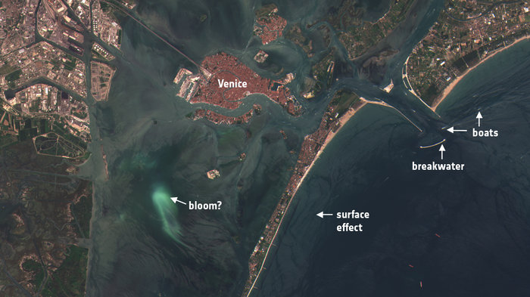
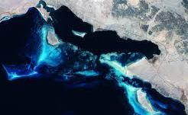
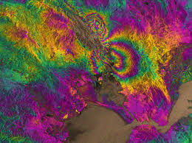
Regional Competences - Services & Applications
Aerial platforms
Space Data
Ground sensors
Emergency
Land
Climate
Sea
Atmosphere
Agriculture
3

Slide 4
PCP Regional Pilot Actions
1. Health and social inclusion - Multi-stage procedure
Results : 16 bids received, 8 awarded to reach the prototype phase, 4 under evaluation for Phase 2
2. Water resources - Multi-stage procedure
Results: increased problem description quality; call for expression of interest, 80 Enterprises and Research centers involved, 2 days of collective hearings & 1 forum for data gathering

Slide 5
The Regional Actors
Puglia Region
Strongly committed in innovate procedure & to adopt space solutions
DTA (Apulia Aerospace Cluster), no-profit consortium society
Propose suitable space solutions in response to the user needs
InnovaPuglia
Regional company for ICT innovation and strategic programmes

Slide 6
Challenges PCP approach – H2020 Space
1. Peculiarity of needs, space services and applications
2. A PCP process has a neutral technology approach for innovative solutions
3. Difficulty to communicate benefits from space solutions for users
4. Diversity of culture/history/economy – Multiregional approach
Notes:
Se arliamo di PCP, in pglia ne abbiamo gia 2 portati avanti con successo

Slide 7
Living Lab: mapping the needs of the end users
Apulia Project to test new approaches for innovation activities
Players: Research laboratories, Associations, Public Bodies, SMEs companies and citizens
Approach: Users take part in researching and testing innovative solutions
Rationale: Via Ideas/knowledge exchange build prototypes to test innovative technological solutions
http://livinglabs.regione.puglia.it/en/home
Notes:
Per rispondere alla sfida di trovare tecnologie per risondere ai bisogno proponiamo i living lab…

Slide 8
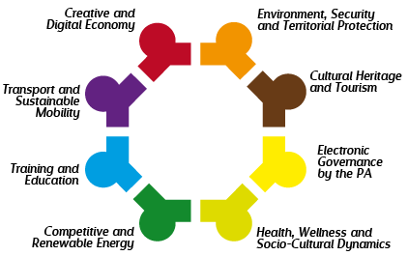
Living Lab: Current Topics

Slide 9
Building Interregional Networks
DTA - carrying out actions to foster intercluster/interregional cooperation
Cooperation Agreements: Aerospace Valley (Midi Pyrenée & Aquitane);
si-Cluster (Attica), WFB (Bremen)
Ongoing discussions: Madrid, Bavaria
European Regional networks : Nereus, ideal platform for interregional cooperation
Notes:
Per la sfida della cooeraizone interregionale

Slide 10
Preliminary Potential Applications
Monitoring Coasts , Water quality, Territory planning, Agriculture
Emergency
Land
Climate
Sea
Atmosphere
Agriculture

Slide 11
PCP & Regional Scenario set-up
What – PCP SPACE (EO)
How – Space Living Lab regional experience
Why – To answer public needs for the benefits of end users; to develop the regional dimension of space

Slide 12
Merci
Fiorella Coliolo, DTA
Fiorella.Coliolo@dtascarl.it
www.apulianaerospace.it

Slide 13
Copernicus
6 main thematic areas:
Land monitoring
Marine monitoring
Atmosphere monitoring
Emergency management
Security
Climate change
Notes:
Per me non da presentare

