Slide 1
ICT-34: Capitalising on the achievements of FIRED-uP
FIRE SERVICES DEVELOP INNOVATIVE PROCUREMENT
Wednesday, 28 October
2015 EU Innovation Procurement

Slide 2
Why FIRED-uP?
LFB needed and still needs to meet targets to clean London’s air
Competitiveness and Innovation programme provided the Brigade with an opportunity to:
Research innovation
Engage with private sector providers
Find innovative solutions in our niche area
FIRE SERVICES DEVELOP INNOVATIVE PROCUREMENT

Slide 3
What did we do?
Market research with our partner from the City of Ghent Fire Brigade
Market engagement with suppliers to investigate solutions in the market to support reducing the environmental impact of fire service fleets
An exercise to procure data telematics and equipment monitoring systems
FIRE SERVICES DEVELOP INNOVATIVE PROCUREMENT

Slide 4
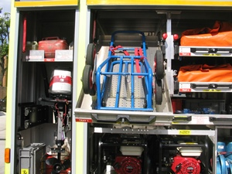
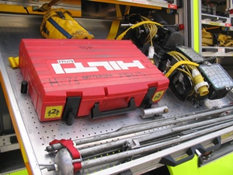
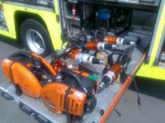
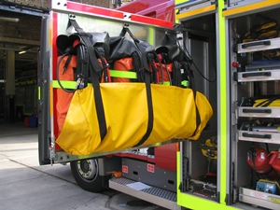
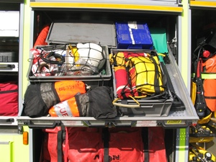
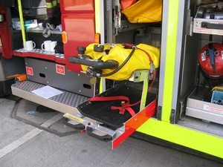
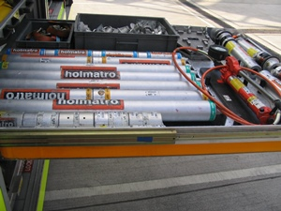
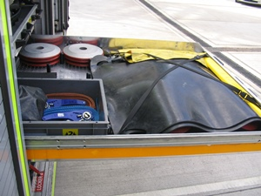
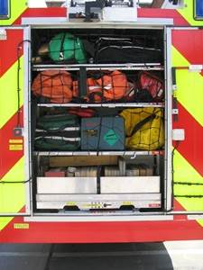
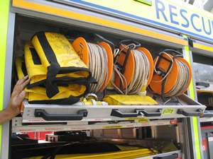
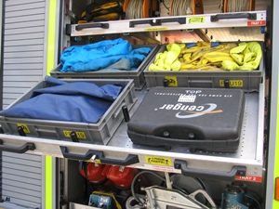
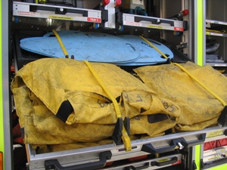
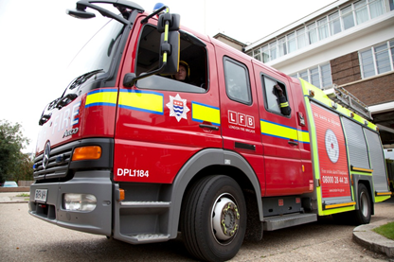
Why telematics and equipment monitoring?
To benchmark what we are actually doing to see if we can do less of it!
How much fuel do we use, can we use less?
Can we use less water?
Less battery power?
When do we use all this equipment?
The ultimate financial and environmental savings are in reducing our maintenance burden
FIRE SERVICES DEVELOP INNOVATIVE PROCUREMENT
Notes:
WHY ARE WE DOING IT: Lots of vehicles, lots of equipment, lots of cost, lots of maintenance, lots of weight, lots of fuel

Slide 5
The future: ICT-34?
FIRED-uP lets us measure our emissions, can ICT-34 let us reduce them?
Hybrid drive fire engines
Fire service vehicles have a diesel engine and use a PTO (power take off) to disengage the drive wheels and engage other functions including lighting and water pumps
Does this have to be done with a PTO?
Could a hybrid of electric motor provide these functions?
FIRE SERVICES DEVELOP INNOVATIVE PROCUREMENT
Notes:
We both did the top stuff in a similar, divergence in our procurement.

Slide 6
Expected benefits of hybrid drives
Reduced emissions
Reduced fuel and maintenance costs
Safer working environment
Reduced noise
Reduced moving parts
Reduced weight
FIRE SERVICES DEVELOP INNOVATIVE PROCUREMENT
Notes:
We both did the top stuff in a similar, divergence in our procurement.

Slide 7
Our challenges?
ICT Solutions?
24/7/365 availability:
Range anxiety
Down time to recharge batteries
Robust enough to meet power demand
High pressure water pumping
High powered lighting
Hydraulic grabs
Water relaying and challenging fire fighting situations
Equal of reduced weight to existing fire engine
ICT modelling?
Nanotechnologies?
System management?
Can a hybrid solution become a cost effective product for a supplier in our niche area ?
Replicable in construction, agriculture or refuse?
FIRE SERVICES DEVELOP INNOVATIVE PROCUREMENT
Notes:
We both did the top stuff in a similar, divergence in our procurement.

Slide 8
FIRE SERVICES DEVELOP INNOVATIVE PROCUREMENT
www.fired-up.eu
Nicole.fletcher@london-fire.gov.uk
Nick.brennan@delavale.com

