Slide 1
Procuring the EIT Data-Driven Learning Platform
Davor Meersman, 28 October, 2015

Slide 2
EIT KICs
The EIT achieves its mission by fully integrating all three sides of the ‘knowledge triangle’, i.e. higher education, research and business, in Knowledge and Innovation Communities (KICs).
Climate KIC
EIT Digital
KIC InnoEnergy
EIT Health
EIT Raw Materials

Slide 3
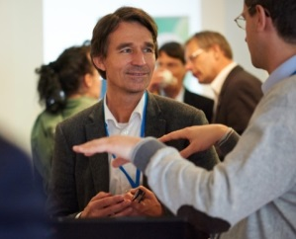
EIT Digital partners

Slide 4
Business Model
Select
from our ecosystem and beyond
Grow
through our ecosystem
Succeed
In world markets
Cyber-Physical System
Talents
Future Cloud
Innovation Activities
Startups
Future Networking Solutions
Technologies
Health & Wellbeing
European
Success
Stories
Privacy, Security & Trust
Research
Results
Smart Energy Systems
Smart Spaces
Business Strategies
Urban Life & Mobility
By bringing together the leading corporations, the best research institutes and top universities in ICT with SMEs and startups, EIT Digital boosts innovation in 8 thematic areas.

Slide 5
Data-Driven Learning Platform
Each KIC has the task to deliver education in an innovative digital format. For this purpose EIT is considering the procurement of services that allow to define, build and implement the digital learning platform of the future. EIT has the ambition to lead the digital transformation of education with "data driven education".
For this purpose the 5 KICs will collaborate in a cross-KIC initiative where they will rely on the best-in-class approaches and solutions from their partner in academia, industry and from edtech startups. The goal of this procurement of services will be to allow them to contribute their latest innovations to this new EU platform.

Slide 6
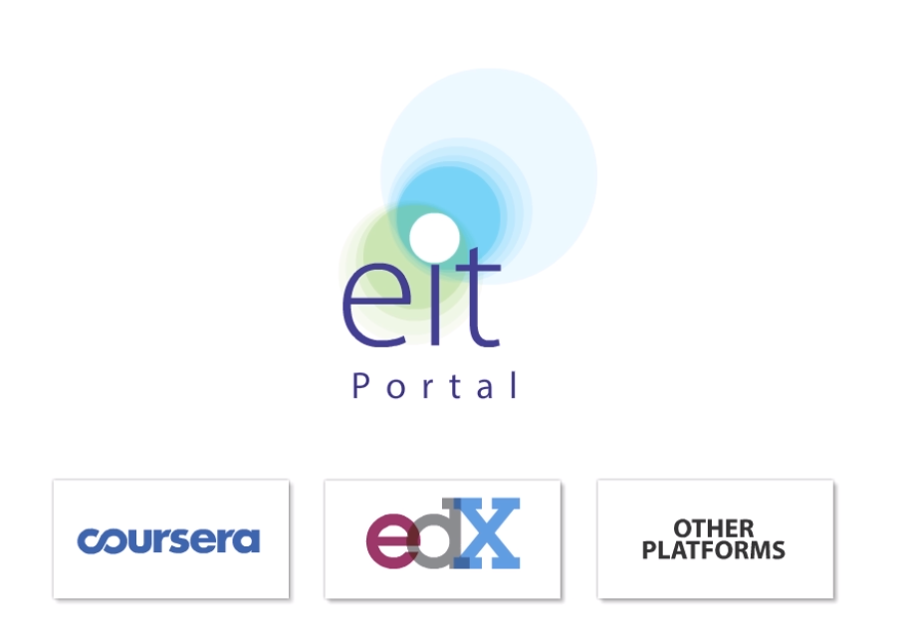
Data-Driven Learning Platform

Slide 7
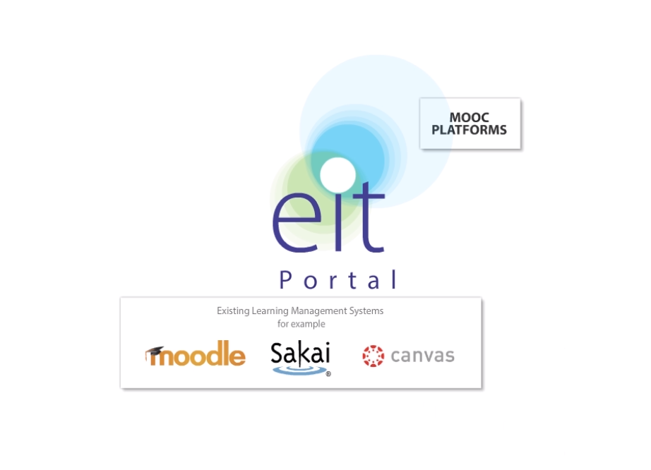
Data-Driven Learning Platform

Slide 8
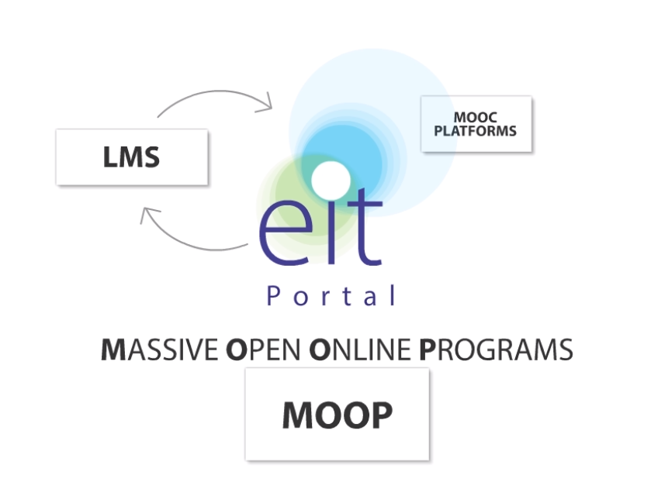
Data-Driven Learning Platform

Slide 9
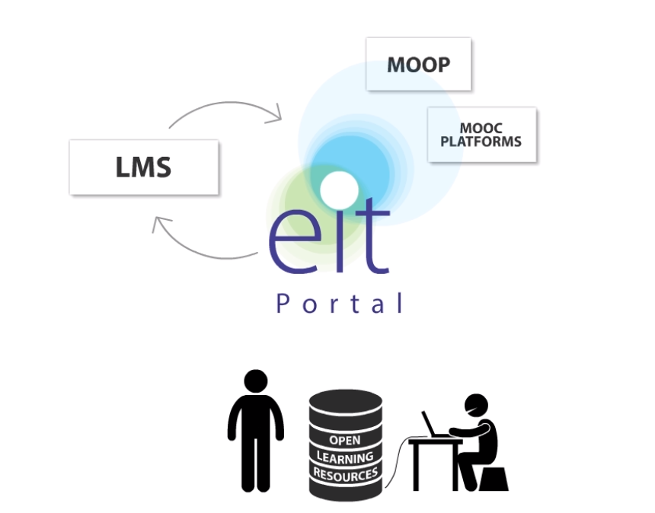
Data-Driven Learning Platform

Slide 10
Data-Driven Learning Platform

Slide 11
Dr Davor Meersman
iMinds Institute
davor.meersman@iminds.be
+32477514581

Slide 12
Health & Wellbeing - Prevention through the Quantified Self
Reduce the demand for expensive healthcare by detecting small physical and mental health issues early and avoiding larger health problems by suitable lifestyle interventions.
Notes:
Health & Wellbeing – Prevention through the Quantified Self
Mission: Reduce the demand for expensive healthcare by detecting small physical and mental health issues early and avoiding larger health problems by suitable lifestyle interventions.
Motivation: EIT Digital partners own “quantified self” and “activity of daily life sensing” technology and especially the large core industrial partners have access to the world market.
Achievements 2016
Physical Wellbeing / Cardio Vascular: Productisation and commercialisation of a B2C Cardio Fitness solution via start-ups and transfer of sensors, smart algorithms and applications to existing companies; Evidence for effectiveness of solution; At least three solutions (e.g. for lifestyle / health, sports and high risk jobs) introduced.
Mental Deterioration: Stress / Burn-out: Solutions commercialised in B2C and B2B markets (initial annual revenue plan of €6M), Dementia: Solutions commercialised in B2C and B2B market; In total at least three solutions introduced, via start-ups and transfer of activity of daily life sensing, smart algorithms, (big) data mining and applications to existing companies.
Societal Impact: Improve quality of life through early treatments and by avoiding life-threatening health issues as well as through early treatments and extended labour participation & independent living due to reduction of burnout & early development of dementia.
Economic Impact: Lower healthcare costs due to less hospitalisation and due to less residential care. The combined markets are estimated at ~1 B€ in 2020 and EIT Digital partners will gain a significant share.

Slide 13
Cyber-Physical Systems – European Leadership in Production and Infrastructures
Increase the efficiency and reliability of industrial production systems and critical infrastructures by combining embedded systems, sensors, control systems, and data aggregation and analysis technology into smart systems-of-systems.
Notes:
Cyber-Physical Systems – European Leadership in Production and Infrastructures
Mission: Increase the efficiency and reliability of industrial production systems and critical infrastructures by combining embedded systems, sensors, control systems, and data aggregation and analysis technology into smart systems-of-systems.
Motivation: Improved efficiency and robustness (through the deployment of Cyber-Physical Systems) assures European industrial competitiveness at the global level. In addition, European industry vitally depends on good functioning critical infrastructures. EIT Digital core industrial partners are well positioned and EIT Digital can link technology providers with system integrators to realise most effective solutions.
Achievements 2016
Production Systems: Feasibility study demonstrating economic value of augmenting existing production processes with Cyber-Physical Systems (CPS) technology; Reference architecture with harmonised process and data interfaces; An integrated engineering environment covering the complete product life-cycle: design, simulation, production, operation, maintenance, evolution; New start-ups and new business within existing companies implementing new business models.
Critical Infrastructures: Matured and validated technology components for communication and information aggregation; Larger-scale demonstration of the federated deployment and management of heterogeneous CPS infrastructures; At least four companies (start-ups, SMEs) exploiting new market opportunities as component/system suppliers or providers of (Cloud-based) information and management services.
Societal Impact: Competitive and expanding manufacturing industry in Europe providing a broad range of leading edge employment opportunities; Enhanced quality of life as well as excellent preconditions for industry due to high quality critical infrastructures.
Economic Impact: Competitive, cost-effective manufacturing; Accelerated market growth for providers of core CPS technologies and derivative solutions by common data formats; Emerging European CPS ecosystem boosting business creation along complete value chain: large manufacturing industries, SME tool providers, system integrators, and service providers; De-facto CPS engineering standards.

Slide 14
Smart Energy Systems – Defining Europe’s Future Energy Market
Contribute to the creation of an open European energy market by testing and deploying ICT solutions for decentralised power generation infrastructures and user-centric services for smart energy systems.
Notes:
Smart Energy Systems – Defining Europe’s Future Energy Market
Mission: Contribute to the creation of an open European energy market by testing and deploying ICT solutions for decentralised power generation infrastructures and user-centric services for smart energy systems.
Motivation: EIT Digital partners combine their strengths in energy and infrastructure to meet the needs of decentralised network elements (generation & storage), to support European consumers in optimising their energy usage and to create exportable concepts.
Achievements 2016
Infrastructure: At least one new technical high capacity virtual power plant set up; Creation of start-ups (e.g. derived from new regulated market roles) and support of SMEs which fulfil key roles in the Virtual Power Plant ecosystem; Relevant standards defined and adopted.
User-centric Services: Planning and simulation tools for user-centric infrastructures; SMEs supported and start-ups created; Test beds and living labs infrastructure usable by third parties; ICT solutions proven as a key building block to achieve the EU 2020 climate change objectives.
Societal Impact: Reduced environmental impact by reduced need for traditional power plants; More efficient use of renewables; Reduced consumer energy bills; User awareness on energy efficiency and measurable improvement in energy consumption behaviour.
Economic Impact: Reduced business risk; Business models for sustainable economic success; Thriving ecosystem for ongoing innovation; Virtual power plant export business opportunity; Acceleration of market development via large scale pilots.

Slide 15
Future Urban Life & Mobility – Informed Citizens and Revolutionised Urban Mobility
Turn ICT breakthroughs into new upscaled urban services to develop new mobility behaviours as well as citizen empowerment via the validation of new business models in the context of Smart Cities.
Notes:
Future Urban Life & Mobility – Informed Citizens and Revolutionised Urban Mobility
Mission: Turn ICT breakthroughs into new up-scaled urban services to develop new mobility behaviours as well as citizen empowerment via the validation of new business models in the context of Smart Cities.
Motivation: European technology and service companies are at the forefront of creating multi-modal solutions addressing the mobility challenges of European urban environments; Strong democratic traditions in many European countries are a catalyst for crowdsourcing initiatives and citizen engagement.
Achievements 2016
Mobility Paradigm Shift: Mobility marketplace application allowing stakeholders (citizens/users, urban service providers, governance bodies) to propose and access new mobility services and develop
new mobility behaviours; Urban services and mobility applications and services based on collaborative citizens generated data; Mobility marketplace platform that can be duplicated for dissemination in other urban areas.
Citizen Engagement and Empowerment: A trusted Big/Open Data platform in place for the development and deployment of collaborative services; Big/Open Data based products and services released on the market by new start-ups; Emergence of local communities and empowerment of cities’ governance bodies.
Societal Impact: Modal transfer increase; Reduction of CO2 emission from personal transport; Reduction of transport fatalities in European cities; Improved relation between citizens and governance bodies; More options for urban planning authorities; Open access to data and information as an emerging right for citizens.
Economic Impact: Reduced costs related to traffic congestion, pollution and accidents (~ 502 B€ per year in Europe); Innovation ecosystem around Big/Open Data platform; Reduced costs due to value created by engaged citizens.

Slide 16
Smart Spaces – Blending the Physical World and the Virtual World
Create comfortable experiences for users and efficient resource optimisation solutions for businesses via applying advanced ICT to everyday working and living environments.
Notes:
Smart Spaces – Blending the Physical World and the Virtual World
Mission: Create comfortable experiences for users and efficient resource optimisation solutions for businesses via applying advanced ICT to everyday working and living environments.
Motivation: EIT Digital partners own a variety of advanced interaction and blending technologies as well as market channels (e.g. large industrial companies, SMEs, start-ups) that are capable of installing and managing complex systems and can act as solution or component providers.
Achievements 2016
Smart Retail Experience: One or few SSP initiated companies offer analytics services globally to retail industry; A number of SSP originating SMEs provide smart retail services to consumers globally and to major retail brands.
Smart Urban Experience: Public interactive screens used by advertisers to reach customers, starting from malls and busy public areas; Content creation and user experience for augmented reality solutions proven and first commercial services starting; Outdoor gaming companies have launched their first games.
Smart Buildings: New SMEs or large system integrators providing ICT-based indoor analytics solutions and flexible asset management for facility operators and large corporations; SMEs with co-working tools for office workers.
Societal Impact: Mainstream solutions and services for multi / Omni-channel retail, open street spaces and private as well as public buildings; New, virtually enhanced experiences of interacting with physical environments; Revitalisation of public spaces; Healthier and more comfortable work and living environments; Productivity gains.
Economic Impact: European companies gain market share in the addressed areas; Differentiation opportunities for innovative companies (new entrants possible, growth takes place via new business creation and via additional transactions stimulated by the new solutions); Improved asset utilisation (e.g. work productivity in smart offices, resources in office spaces, etc.).

Slide 17
Future Networking Solutions – Building Europe’s Communication Infrastructure of Tomorrow
Help to ensure the European lead in solutions and standards based on cost-effective as well as energy-efficient networking technology, which supports the traffic demands resulting from an ever increasing and variable set of applications.
Notes:
Future Networking Solutions – Building Europe’s Communication Infrastructure of Tomorrow
Mission: Help to ensure the European lead in solutions and standards based on cost-effective as well as energy-efficient networking technology, which supports the traffic demands resulting from an ever increasing and variable set of applications.
Motivation: Establish global leadership of EIT Digital partners and secure participation in high growth (40% annually) market for network infrastructure. EIT Digital partners can utilise Software Defined Networks to disrupt the market, reduce overseas dominance and enable European stakeholders to benefit from a horizontal approach to Internet of Things technology to efficiently address diverse societal challenges.
Achievements 2016
Green Mobile Access Networks: Demonstrated capability to manage 1000-fold traffic increase by 2020 in an energy-efficient way; Successful standardisation initiatives, incl. energy metrics standards adopted by regulatory agencies; Simulation tools for energy metrics; Substantial technology transfer and knowledge adoption.
Software Defined Networks (SDN): Successful feasibility demonstrations; Initial market introductions of technology components; Portfolio of created and/or coached start-up companies; Deployment of SDN and virtualised networks prepared for 2018.
Internet of Things (IoT): Demonstration of generic IoT communications platform and its use in key application areas; Readiness for broad deployment by 2018; Active start-up network “surrounding” the platform; Standardisation to achieve M2M support in networks.
Societal Impact: High quality communication infrastructures such as green high bandwidth mobile services are crucial for a good functioning of society as a whole; Services demanded by users for a “Digital Europe” provided at affordable network costs; Potential of IoT unleashed for widespread deployment, addressing societal challenges and user demands.
Economic Impact: Global lead of European network system vendors secured; Head start of 1-2 years for European players for “5G”; Successful standardisation as a market creating activity, potential for significant licensing income; Increased market share for the European SDN vendors, e.g. due to evidence for decreased CAPEX and reduced OPEX for operators and due to improved support for novel services and applications; EIT Digital IoT communications platform recognised as leading (easy-to-adopt, attractive functionality, fast development for users), with a long list of active partners from several vertical segments.

Slide 18
Future Cloud – A Secure Data and Service Infrastructure for Europe
Drive European competitiveness in the area of Cloud services and Big Data via the deployment of trusted Cloud technologies and Big Data Analytics Cloud infrastructures.
Notes:
Future Cloud – A Secure Data and Service Infrastructure for Europe
Mission: Drive European competitiveness in the area of Cloud services and Big Data via the deployment of trusted Cloud technologies and Big Data Analytics Cloud infrastructures.
Motivation: Europe’s companies can benefit from a robust and efficient mission-critical Europe-based Cloud computing infrastructure that is established by leveraging Europe’s strong position as trusted Cloud service provider as exemplified by European solutions such as unique Stratosphere platform. This infrastructure requires real-time performance with the guarantee of the highest level of security and privacy and includes the establishment of a European value-driven ecosystem and a user community for Big Data in the Cloud.
Achievements 2016
Trusted Clouds: European multi-Cloud platform over Telco network; New innovative trusted real-time Cloud services are validated and several market introductions are under preparation.
Big Data Analytics in the Cloud: Ecosystem and user community for Big Data and Cloud is established; Start-up with 3-5 M€ sales; Number of successful Big Data / Cloud solution transformations in businesses across Europe.
Societal Impact: Solutions are trusted by businesses and end-users; Security, privacy and persistence of European citizen and business data will be preserved; Enhanced access to and value generation on Big Data results in better services for public sector, healthcare, traffic, etc. used by the European citizens.
Economic Impact: New profitable innovative European businesses have been built around trusted multi-Cloud platforms and Big Data analytics services in the Cloud and are recognised, trusted and deployed in global markets.

Slide 19
Privacy, Security & Trust – A Protected Blended Life
Mission: Support users and businesses in protecting their digital assets and transactions, promoting robust and safe products and services that realise data privacy and security.
Notes:
Privacy, Security & Trust – A Protected Blended Life
Mission: Support users and businesses in protecting their digital assets and transactions, promoting robust and safe products and services that realise data privacy and security.
Motivation: Strong need (with continuously rising awareness) for cyber-security solutions currently not met by existing market offers, often due to fragmentation of solutions and regulations or due to lack of trust of current (e.g. US-based) providers. A perceived lack of safety slows down business operations and requires extensive and expensive risk management. EIT Digital’ partnership (e.g. with mobile operators, technology providers) has suitable expertise and can place service offerings on the market and the European providers have trust advantage over US-based providers.
Achievements 2016
Digital Identity Management: Europe-wide federated identity platform; Privacy-aware and cost-effective EIT-ICT-Labs-endorsed e-authentication and identity management services and products to be commercialised; Real-world testing in selected application scenarios, including e-payment, e-government, e-health, and smart spaces.
Data Privacy: Creative Commons licenses incorporating data privacy; Concrete technical solutions, in terms of software & hardware security tokens, for data privacy in selected application scenarios, including user profiling, e-voting, smart energy, and Cloud computing; Feasibility studies of end-to-end protection in data communications; market preparation and first commercially successful products and services.
Mobile Cyber-Security, addressing malicious software in mobile and online applications: Demonstrate problems with existing solutions; Innovative and cost-effective solutions for anti-malware protection, especially for mobile devices, e.g. by combining efficient client agents and Cloud-based services; Feasibility study of massive and privacy-aware anti-malware scanning of devices connected to the Internet.
Societal Impact: European citizens protected via authentic and more trustworthy mobile services and products; Less abuse of sensitive data; Less cyber-crimes; More trust among people and organisations in Europe; More trust in digital technology, applications and services; Raised social awareness.
Economic Impact: Successful (European) businesses with significant market share (digital identity management, online and mobile privacy solutions, anti-malware products and services); Less economic damage due to cyber-crimes (online identity theft, fraud, fake services and products); Lower costs for effective protection compared to proprietary protection solutions; Lowered obstacles catalyse business transactions; Safer environment supports growth of European mobile operators.

