Slide 1


Improving Healthcare with PCP
A Galician public health system (SERGAS) Initiative
1st Major EU Innovation Procurement Event
Parallel Session PM-19 / PM-12 on e-Health
Oct 28th 2015, Paris
Javier Quiles del Río
Program Manager of Innova Saúde and Hospital 2050 ERDF Innovation Programs
IT Department. Galician Health Service-Galician Regional Ministry of Health
http://www.sergas.es/h2050-innovasaude
jquirio@sergas.es

Slide 2

Improving Healthcare with PCP
General Objective
Improve the quality and cost-effectiveness of healthcare on two challenging diseases:
Dementia (ageing is key objective in Galicia)
Rare Disease: Glycogen Storage Disease
The clinical pathways of these two diseases have been defined by SERGAS and it has been considered by clinical experts that they can be improved by guiding the patient self-care when he is out of the hospital.
Thus, these two pathologies have been considered as feasible challenges in the project.

Slide 3

Improving Healthcare with PCP
Primary Objectives:
Enhance the ICT skills and increase adherence of patients and care givers.
Increase the role and the responsibility of the patient and families, supported self-management with connection to clinical professionals for guidance. Key indicators are:
  Reduce the number of severe episodes and complications;
  Reduce the number of unproductive visits to the hospital while increase control and support of the patient from the Healthcare Services.
Build a crossborder experience, key in rare disease management to get a critical mass of patients, as regional population is low.

Slide 4
Improving Healthcare with PCP
Secondary objectives:
Provide early and predictive data about patient disease;
Strengthen the evidence base on health outcomes and management of comorbidities.
Contribute to a standard based architecture that allows integration of solutions with EHR and healthcare information systems for market expansion.
Revision of legal issues regarding crossborder PCP procedures, including IP models and royalty sharing of developed products and solutions among public and private stakeholders
Introduce SMEs innovation capabilities in problem-solving scheme.

Slide 5

Improving Healthcare with PCP
Main tasks
Agreement in a common pathway for patients with
    Dementia
    Glycogen Storage Disease
    Identify and get consensus on the stages where patients guidance at home is recommended.
Develop through PCP and using Market Consultations two Health Apps or alternately innovative solutions on each Challenge to improve patient empowerment, to be performed by SMEs.
Test the developed standard based apps and solutions it in crossborder real environment.

Slide 6

Improving Healthcare with PCP
Ideal Partners
3 Public Healtcare Services to perform these tasks:
Project Coordination
Market consultation
Implementation of new solutions in crossborder scenario.
Clinical advice and definition for pathways.
Evaluation protocol
Legal and Economical Department of Public Administration. – Legal assessment on crossborder PCP and Market consultation.
Technical partner for standardization of ICT framework
SME funding enabler and SMEs to implement new and innovative solutions through cascade funding.

Slide 7
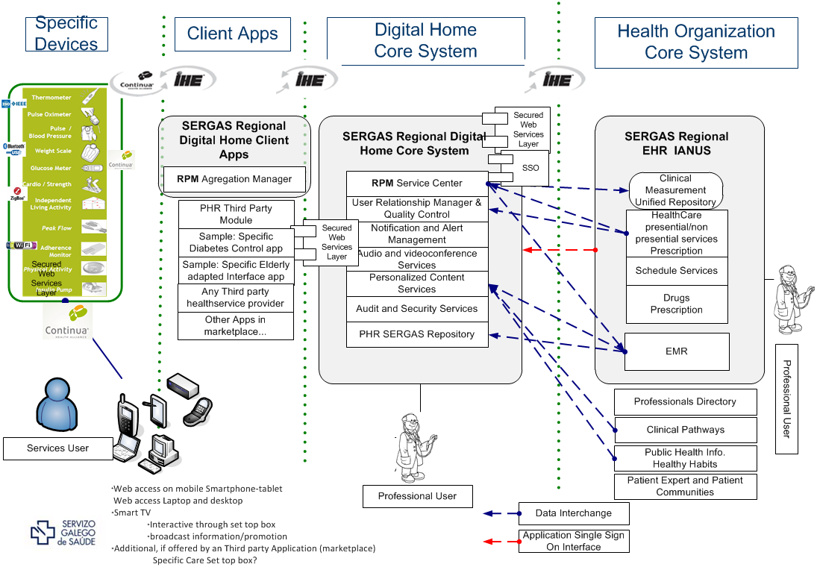

GALICIAN EXPERIENCE IN PPI-PCP 2011-2015
1
5
7
2
3
6
4
14
8
12
9
10
13
13
11
Galician EHR System: Regional Complete deployment: 2012
23 ERDF funded Projects using PPI and PCP in 2011-2015: 27,5 M€
Market Consultation and Public procurement of Innovation
Digital platform to communicate with patients: Available nov 2015.
EU PPI ongoing Project: 2015-2017: EMPATTICS PHC-27-2015

Slide 8

Thank you for your attention and
… let’s talk! jquirio@sergas.es
Notes:
How to increase acceptance in all stakeholders:
Improving ERDF mechanisms
Public deficit effects of ERFD financial model
Ease hard-close deadlines to ALL actions. They fix a barrier and produce collapse

