Slide 1
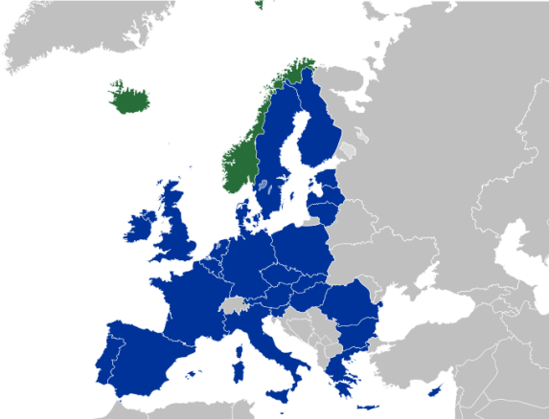
Adam Matthews
UK BIM Task Group
Head of International Affairs
Introducing Building Information Modelling (BIM) into Procurement models to save cost and stimulate innovation

Slide 2
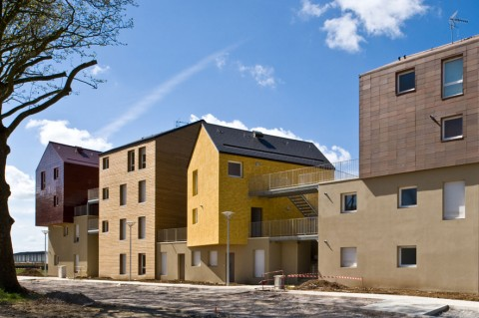
European infrastructure and construction challenges
Critical need for infrastructure
Reducing budgets
Environmental and energy demands
Stimulate innovation

Slide 3
€ 1.2 trillion & 9.9%
14.9 million
3.1 million & 95%
35%
Misunderstanding of client needs
Miscommunication
Rework and recreation of data
Poor or no information management
La diversité et de l'industrie fragmentée
Notes:
€ 1.2 trillion = The value of the construction sector in the European Union. This represents 9.9% of Gross Domestic Product and 51.4% of gross-fixed capital formation.
14.9 million = jobs provided by the construction sector, representing 7.1% of total employment and 29.1% of industrial employment.
3.1 million = Number of enterprises which make up the construction sector. Of these 95% have less than 20 workers.

Slide 4
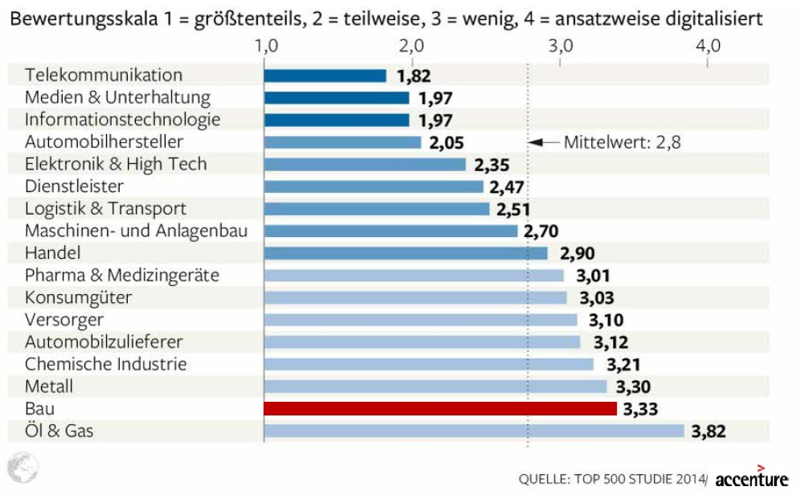
Under-investment in technology
Construction sector

Slide 5
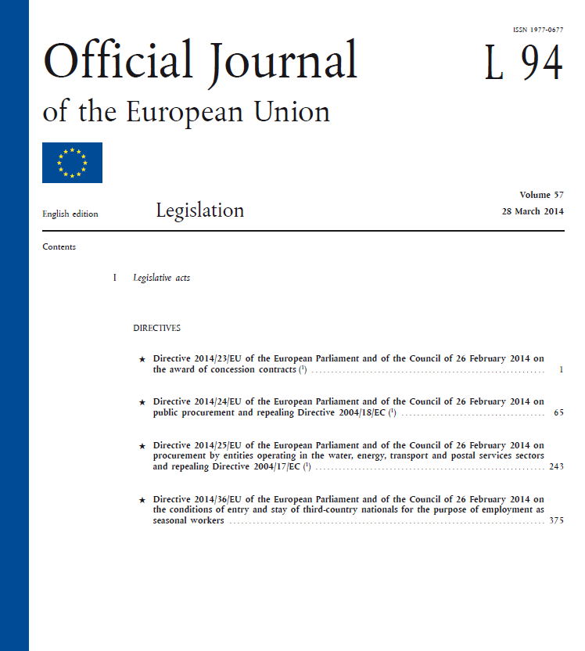
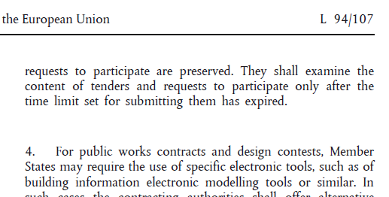
EU Public Procurement Directive 2016/2018
BIM
Notes:
There is a timescale compelling action from the public sector….. The EU directive is….
It is implemented to each member state in 2016 or defer to mid-2018.
Therefore we have a reason to create a common framework for introducing BIM – for those member states that wish to do so.

Slide 6
European national digital programmes
Germany
Finland
France
Netherlands
Norway
Spain
UK
Plan Transition Numérique dans le Bâtiment
esBIM
Many BIM policies and programmes; and BIM Task Groups
Beaucoup politiques et programmes BIM; et BIM groupes de travail

Slide 7
European Public Purchasing Power
Combinant européenne sur les achats publics
Notes:
Public procurers, public estate owners, policy makers & advisers
15 members states so far supporting, and we aim to attract all member states

Slide 8
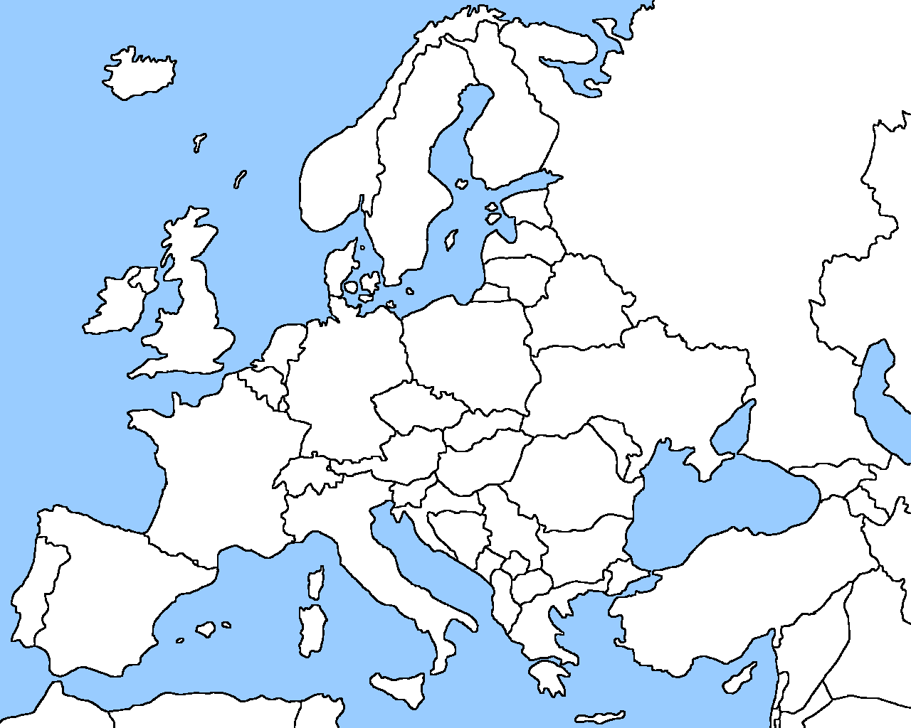
Introducing BIM to procurement models to;
Reduce waste
Improve social outcomes
Value for money
Whole-life thinking
Stimulate competitiveness
Demand
Public procurers
Enablers
Standards bodies
Supply
Industry actors
Public estate owners
Industry associations
Academia
Supply chain
Policy units
Software producers

Slide 9
Thank you
Stimulating innovation through public procurement; a digital single market for construction
BIM Task Group
adam.matthews.eu@outlook.com
+44 7980 756 684

