Slide 2
Pre Commercial Procurement
Trenchless house connections to main water lines

Slide 3
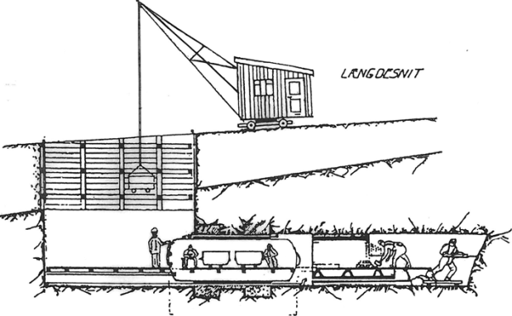
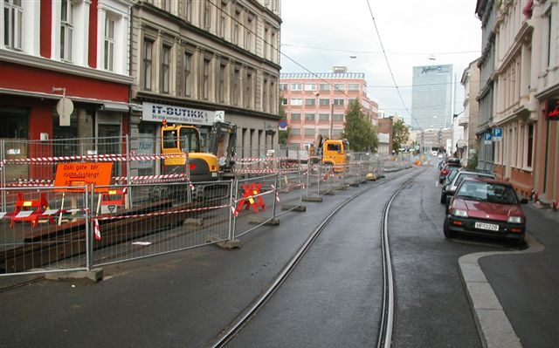
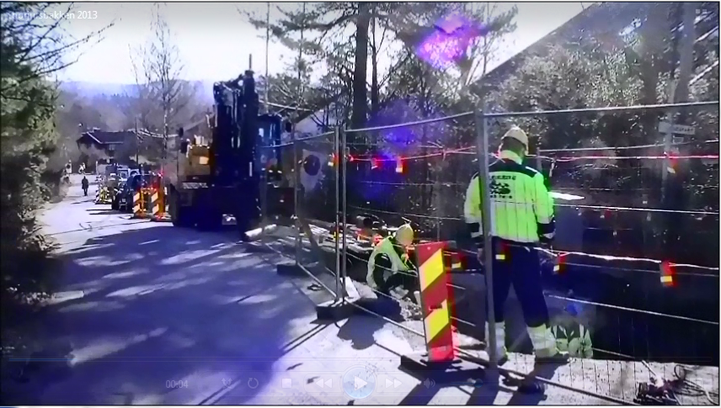
Initial idea
Vision: New technology that will revolutionize the rehabilitation process for main water lines
Present solution for connecting houses to municipal water lines requires digging
Our goal is to find a satisfactory and technologically feasible trenchless solution that will implement a higher renovation rate for the municipal water lines

Slide 4
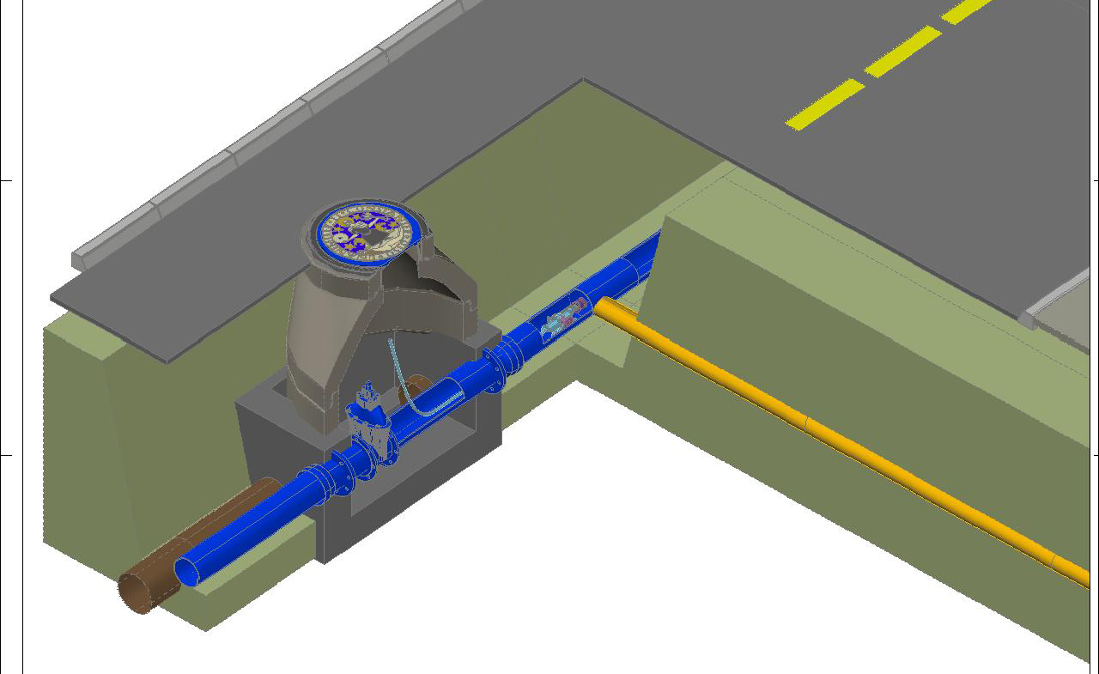
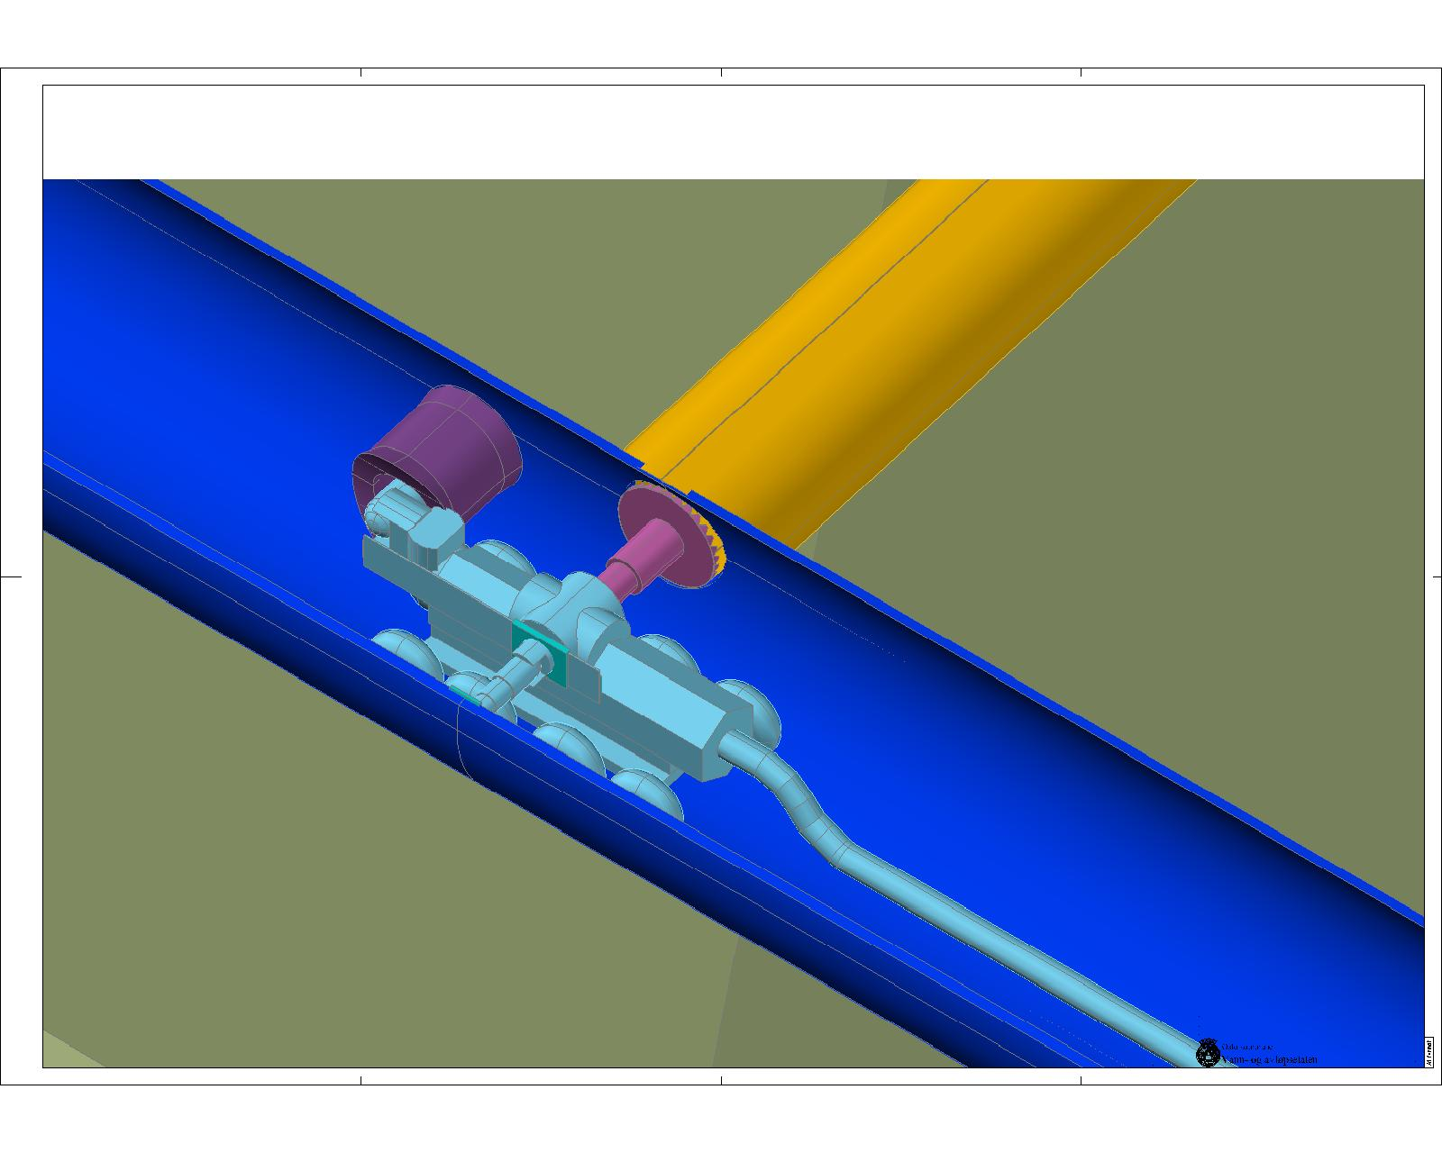
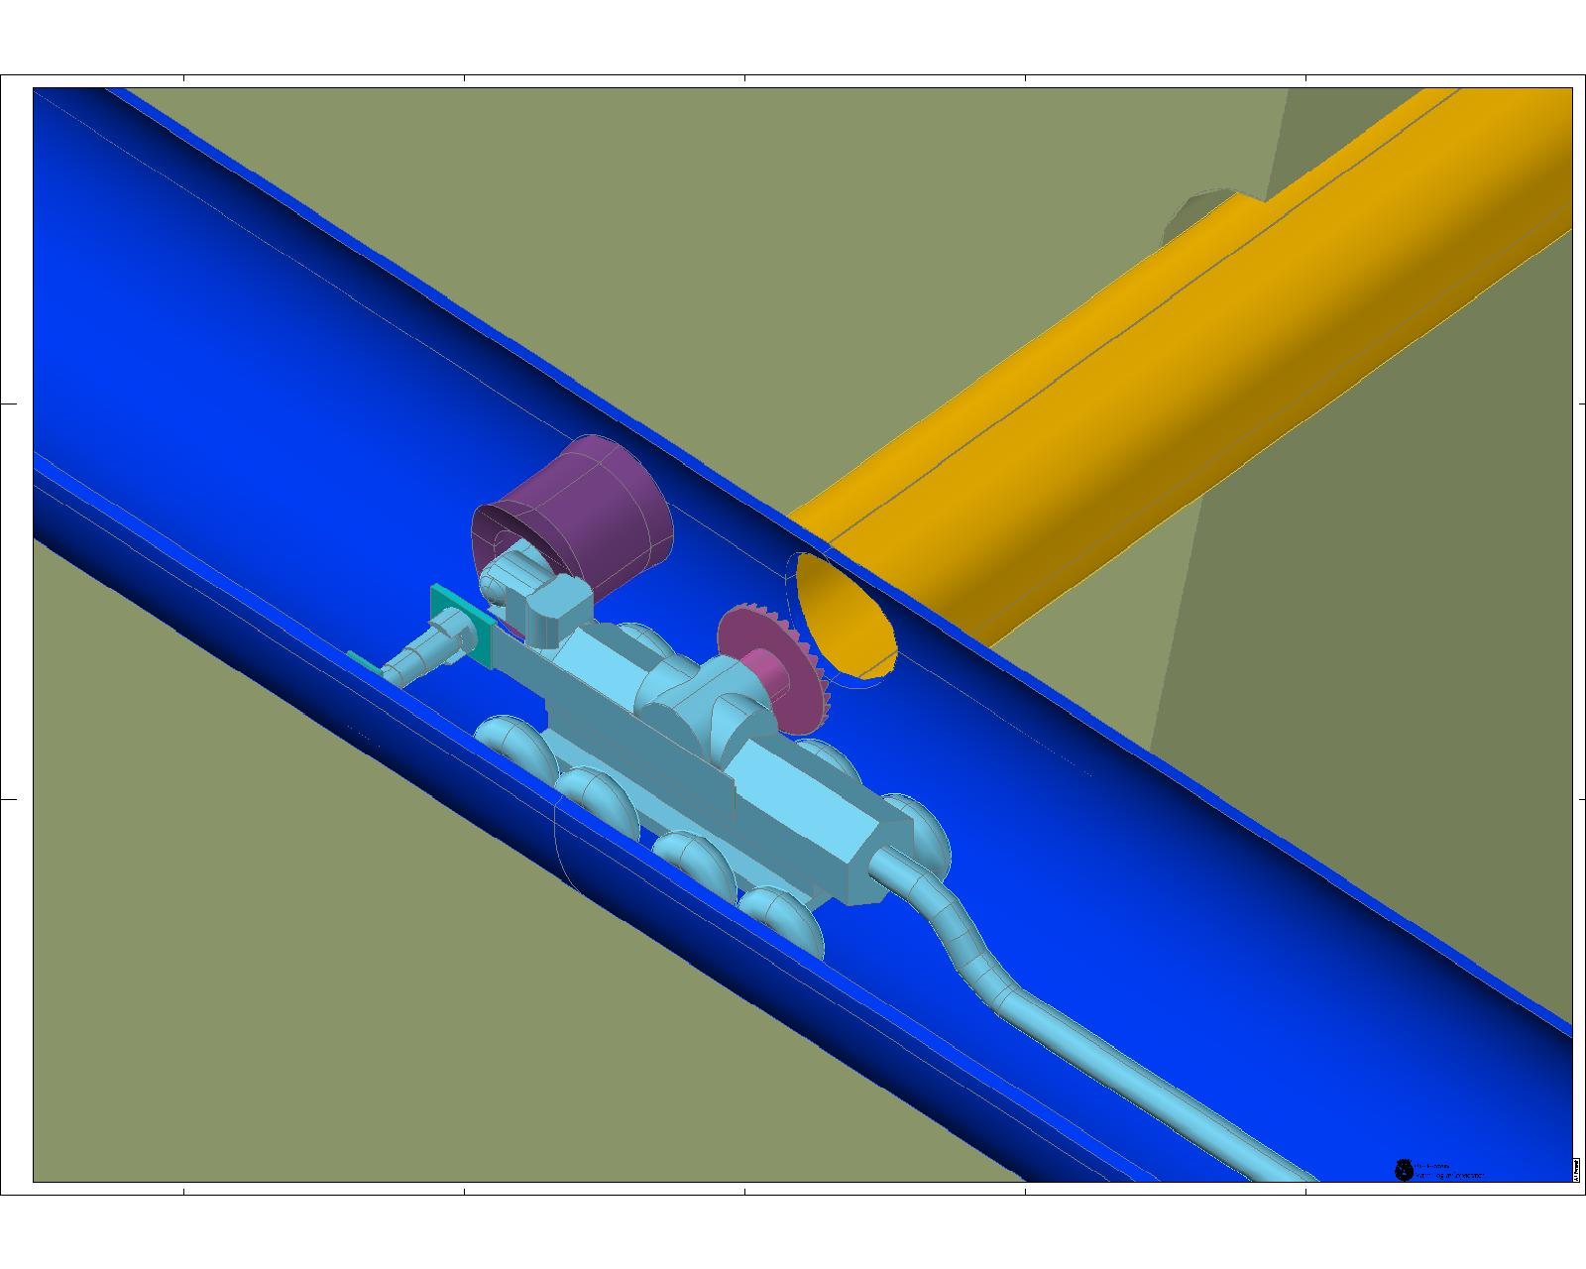
Our suggestion
How we envisioned one possible solution for a trenchless connection to main water lines

Slide 5
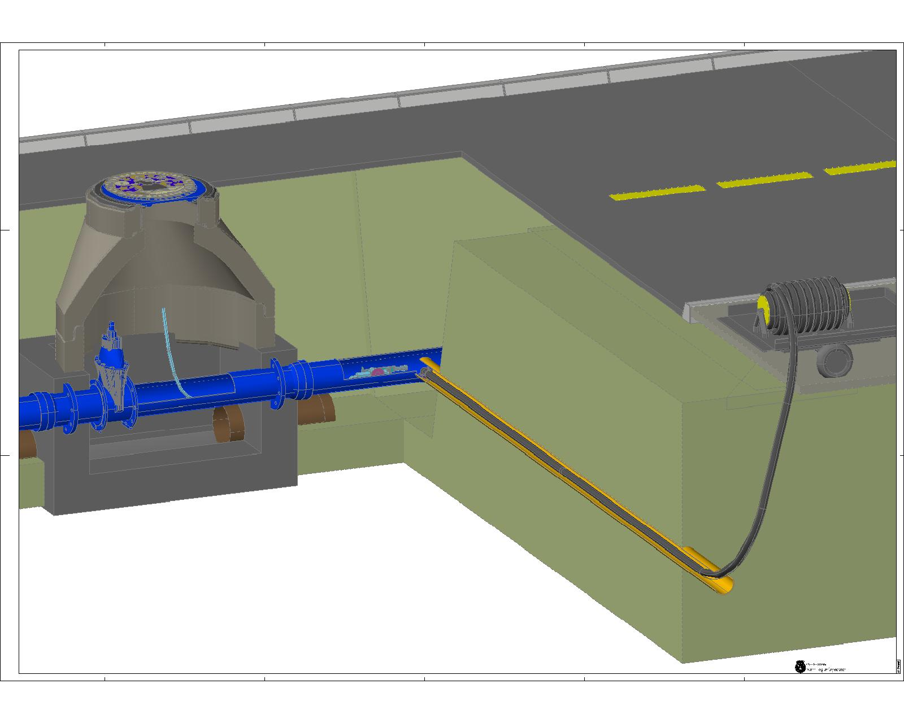
Connection point,
house to municipal water lines

Slide 6
No dig challenge animation

Slide 7
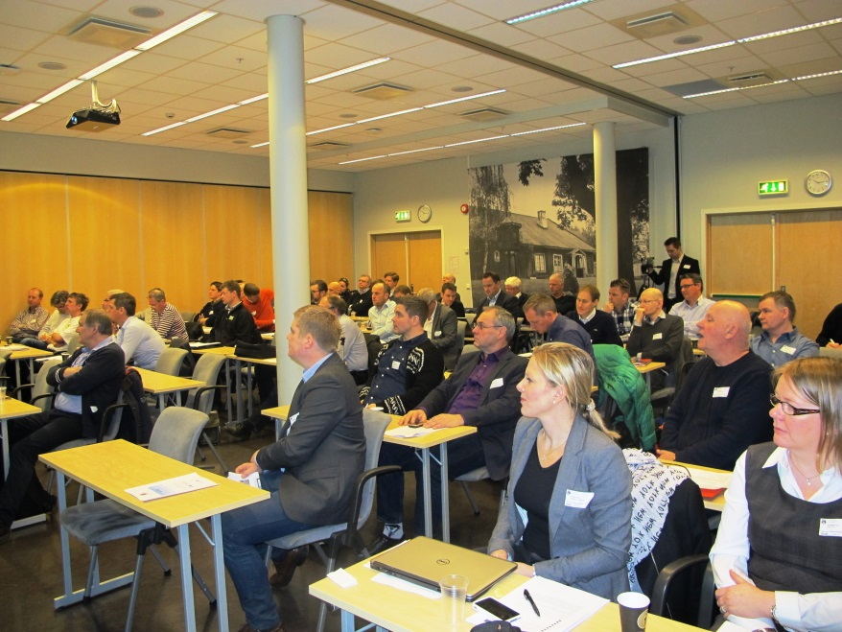
Planning the PCP
Description of our need and idea – Consept note («Pilotnotat»)
Dialouge with market
Public anouncement
One on one meetings with potential suppliers
Supplier «speed-dating»
Questback

Slide 8
Project organization
Advisory
Oranizatons
Project Management
Technical Experts
Directing Comittee

Slide 9
PCP Process
Mar 2014
Sep 2014
Oct 2014
Dec 2014
May 2015
May 2016
2016/17
Phase 0
Product concept
Phase 1
Investigating solutions
Phase 2
Prototyping
Phase 3
Field tests
Dialogue with market
Supplier A
Public tender
Supplier A
Supplier A
Supplier A
Supplier B
Supplier B
Supplier B
Supplier B
Information conference concerning the tender
Supplier X
Evaluation and award of framework contract
Evaluation and
award of call off contracts
Evaluation and
award of call off contracts
Pre Commercial Procurement
Ordinary Procurement

Slide 10
To find out more please visit our website: www.nodigchallenge.com

