Slide 1
Presentations of VIVERACQUA proposal idea in view of the call ICT-34 for PCPs in any area of public interest that requires new ICT based solutions The TLC network for the Integrated Water Service VIVERACQUA – Italy - Veneto Region
2015 EU Innovation Procurement event 27-28th October 2015, Paris

Slide 2
VIVERACQUA
Type of organization: consortium of water company (public body - 100% publicly-owned = public procurer).
Sector of the organization: Integrated Water Service (water and wastewater management)
Key data management:
530 municipalities;
17.000 km² territory;
4,2 milions inhabitants served;
681 milions euro/ year total revenues;

Slide 3
A CASE-STUDY: Telemanagement Multiutility Project
On September 19th, 2013, AEEGsi has indicated its willingness to finance pilot projects proposed by gas providers aimed at testing the remote management in multi-service contexts.
Has launched a project for the sharing of the communication infrastructure in a multi-service logic.
We have started a pilot project concerning the installation of smart meters for drinking water joint to gas and district-heating”.
The project concerns a small urban areas in one of the towns we cover (about 500 users just for water).
The total cost is estimated in about 50,000 euro

Slide 4
A CASE-STUDY: Telemanagement Multiutility Project
Services
- GAS - Water
- district heating - Other public utilities
Actors
Viveracqua;
Local gas district heating company;
Other technological partner (Digicom, Terranova, ...)
Area
The test area was chosen in the City of Verona, with particular reference to two urbanized areas of different typology.
Total points to manage
About 4.700 points.

Slide 5
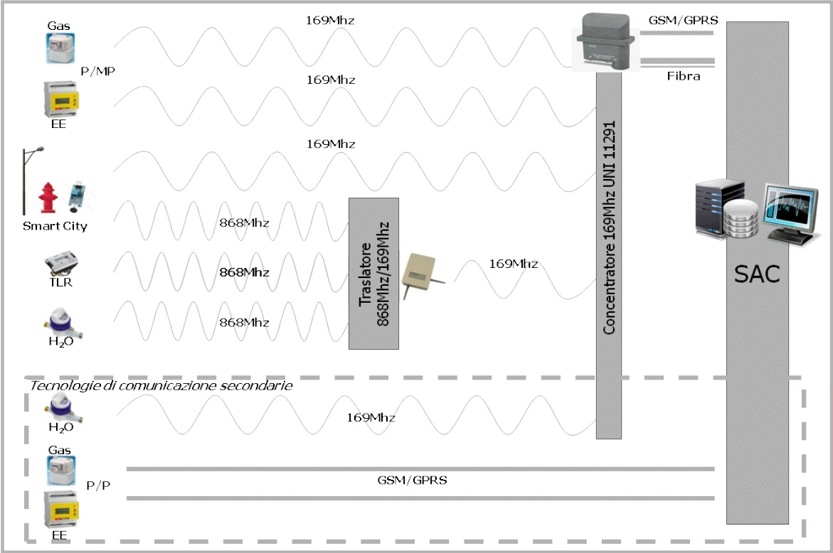
A CASE-STUDY: Telemanagement Multiutility Project
Layout of the telecommunication network

Slide 6
A CASE-STUDY: Telemanagement Multiutility Project
Market search - available solution:
In order to purchase the meters needed in the pilot project, we carried out a market survey to identify technology providers which had already developed suitable solutions.
Concerning water meters, we initially found out that available devices were working on a 868 MHz frequency.
Therefore, we have shaped the pilot project according to this feature.
Only more recently, some providers have started selling devices that can already work on a 169 MHz frequency.

Slide 7
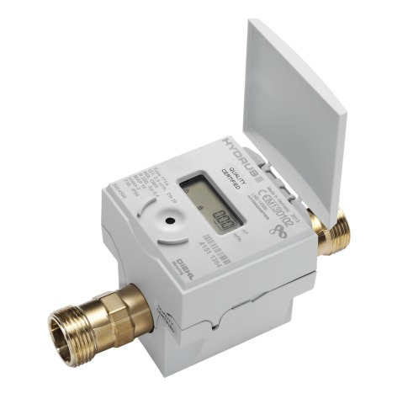
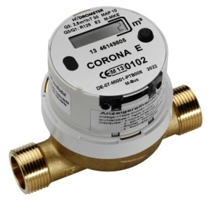
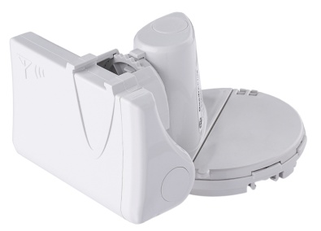
A CASE-STUDY: Telemanagement Multiutility Project
Market search - available meters:
In Italy there’s not currently a regulation that defines the protocol transmission.
Each provider has thus developed a product derived from its own know-how and market strategy.
In order to select the product to be adopted in the piloting, we requested each provider to provide a sample to be tested.
Those products that appeared to be «readable» in a simple way by network system were subsequently effectively adopted in the project
The network-architecture for signals «capture» was mainly developed drawing on the technical regulation that already existed for the gas sector.

Slide 8
VIVERACQUA proposal idea in view of the call ICT-34
The development of the experimentation:
We would like now to extend the project to areas with other characteristics (mountain, countryside, etc.) an on a bigger regional scale.
This network must be capable of sending information related to:
consumption;
pressures;
flows.
We want to test in this way a new way of managing the IWS in which the user and the Manager "dialogue" more stringently to reach the widest synergies possible.

Slide 9
VIVERACQUA proposal idea in view of the call ICT-34
The proposal:
Viveracqua will install in some areas different by characteristic (mountain, countryside, etc.) the smart meters for drinking water, characterized by " open technology platforms " in order to avoid a situation of long-term dependency by technology providers.
The proposal wants to share a number of managers of the Water Service to make a " pre-commercial procurement " program to develop an open platform for the management of data collection of advanced measurement and processing (ICT interface , common standards for the frequencies , etc.) .

Slide 10
VIVERACQUA proposal idea in view of the call ICT-34
The project idea has been discussed also:
within Aqua Publica Europea – European Network of Public Water Operators
In the framework of WaterPiPP – FP7-funded project promoting innovative-oriented public procurements in the water sector
Singificant interest showed by several water operators across Europe in the project idea and, more generally, in carrying out a joint public procurement of innovation (interest from Belgium, France and Nederlands)
Meeting with potentially interested water operators scheduled on the 19 of November in Paris (organised by WaterPipp)

Slide 11
VIVERACQUA proposal idea in view of the call ICT-34
Expected benefits:
Environmental benefits: saving the water resource in case of breakages;
Management benefits: reduction of losses, parameter optimization management;
Administrative benefits: availability of updated information on the consumption of users;
Economic benefits: lower operating costs.
Notes:
Controllo mischi

Slide 12
VIVERACQUA proposal idea in view of the call ICT-34
Remarks:
Problem of risk management: The public water company needs to be sure that the technology «works» («risky» investments in innovative technologies are outside the mandate of public operators)
The only alternative to «standard public procurement» is that public water companies resort to «Project financing», where the supplier (private) has the incentive to invest/develop innovative technologies. However, with this mechanism, the water company binds itself to the supplier, by giving away to him the management and control of the new technology.
There is the need to identify new mechanisms to connect the piloting phase with the full scale public procurement

Slide 13
...a proposal idea in view of the call ICT-34 for PCP:
“The TLC network for the Integrated Water Service” VIVERACQUA – Italy - Veneto Region
please refer to:
diego.macchiella@viveracqua.it

