Slide 1
The perspective of the users – medical staff and patients:
We need to create a safe and stressreduced operating theatre.
Maren Geissler & Teija-Kaisa Aholaakko & Louis Potel

Slide 2
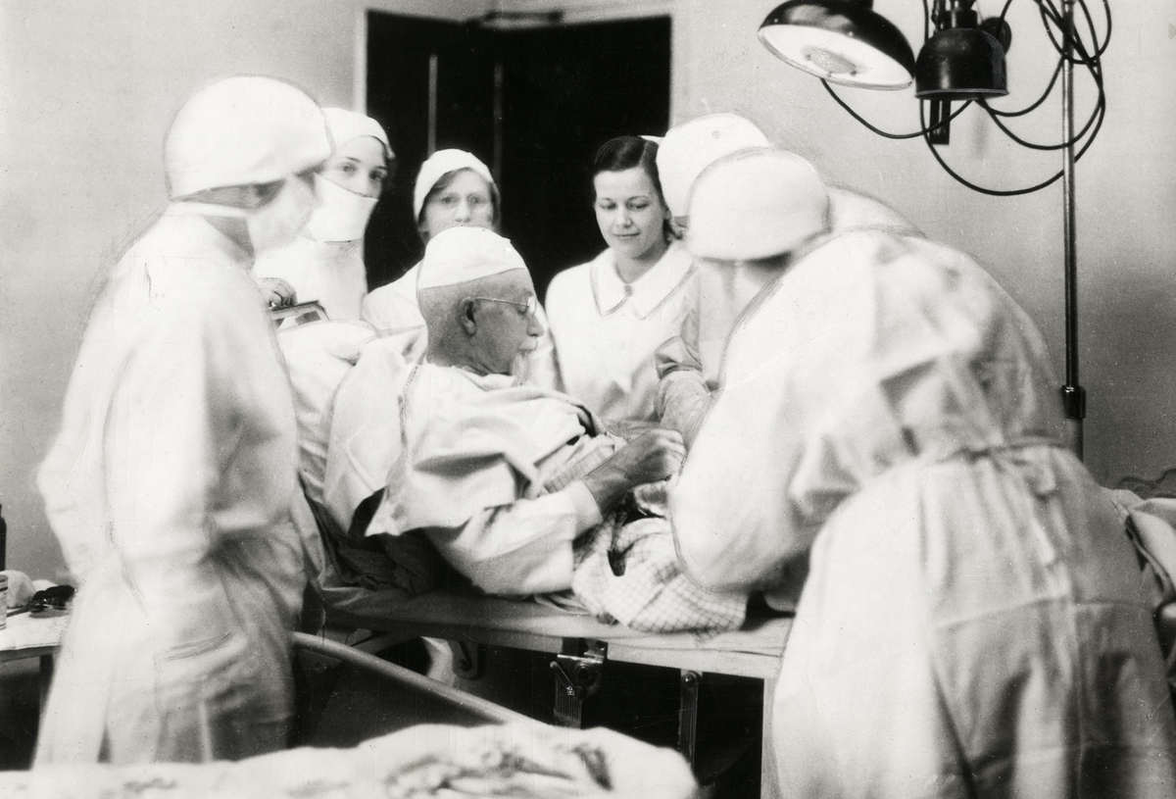
1. The needs of the patients to reduce stress in the operating theatre

Slide 3
Hankela, Sirpa (1999). Intraoperatiivinen hoitotyö : empiiriseen aineistoon perustuvan teorian kehittäminen. (Intraoperative nursing. Development of nursing theory based on empirical data). University of Tampere. Dissertation. Acta Universitatis Tamperensis: 664. According to Hankela the experiences of hip operated patients revealed feelings of threat varying individually from minimal to panic. It affected the experienced of unsafety in terms of both the quantity (safety-chaos) and content (internal, external and interpersonal). Patients were concern about enduring and controlling their emotions (emotional coping), as well as behaviour (functional coping). The experiences of `panic´, horror and `hysteria` reflected a lack of coping resources and self-control during operation. In supporting personal coping the identification of stress-related factors is essential. Situational coping was linked to patients’ expressions of lasting and limited resources in controlling the intra-operative context-related situation, environment and care. It is important to enhance also the situation-related patient coping-mechanisms in the future. Stress prevention and management are shared responsibilities and an ethical challenges for all personal groups working in operating theatre.

Slide 4
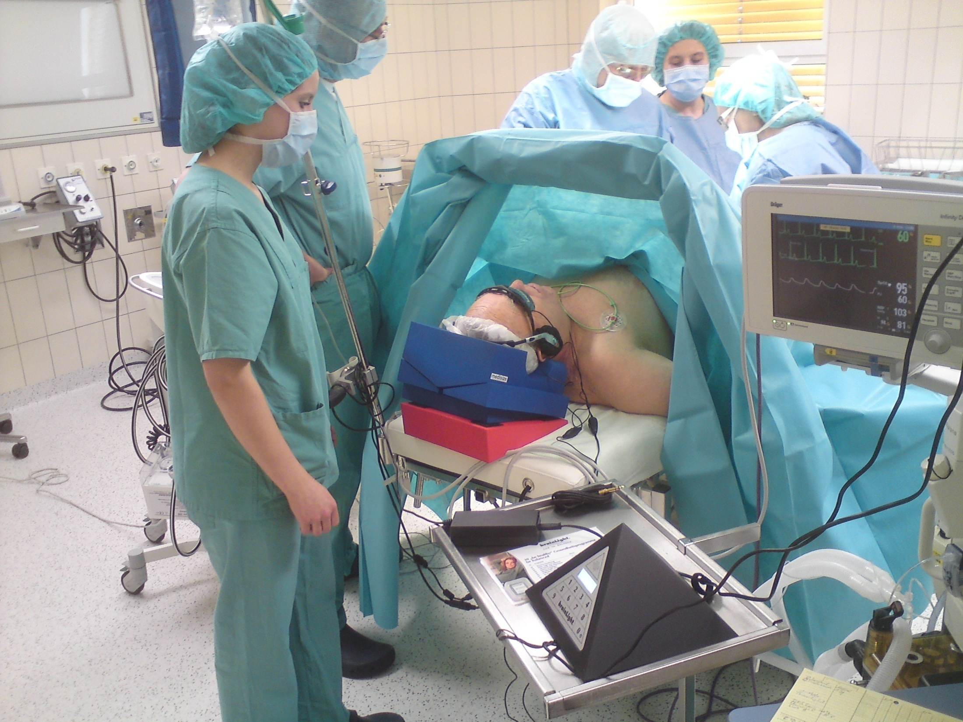
2. The needs of medical staff to reduce stress in the operating theatre

Slide 5
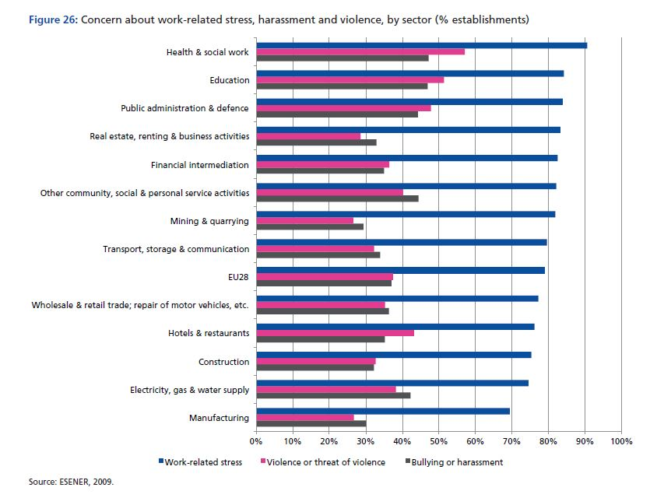
The needs to provide strategies for prevention about work-related stress in Europe
The STREAM is linked to other programs of the EU, e.g.: Eurofound and EU-OSHA (2014), Psychosocial risks in Europe: Prevalence and strategies for prevention, Publications Office of the European Union, Luxembourg.

Slide 6
outcomes
Staff
Better quality of process-outcomes
Improved occupational safety
Improved teamwork
improved wellbeeing in work
Patients
Lower cost due to shorter hospital stay and improved care
Fewer work absent days
Improved emotional, functional, personal, situational coping
Public
Lower cost due to reduce in absent days
Increased cost effectiveness due to automatical wireless dataprocessing and integrated solution
Common
Quality of care treatment improves
Increased stress related knowledge
anti-stress-actions to prevent
Data
A
B
C
D
Support in clinical
decision making on
Anti-stress-actions
Different stress
measurement tools
Needs of the patients and staff:
„a safe and stressfree operating theatre“ based on „non-soft-measurement-factors“

Slide 7
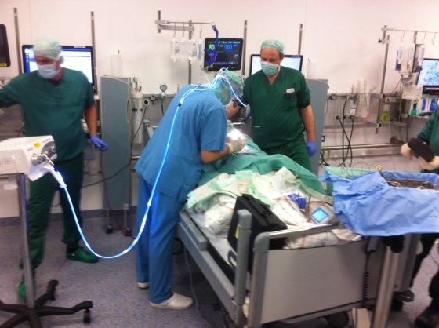
What does the current situation mean for our pourchasing?
We need a solution which consits of 4 elements in one new product
€
1. missing data
2. no adaption in the applied field
3. Subjectiv parts of required data
4. Elaboratory and timeconsuming part-solutions
5. „Horror szenario“ for patients and medical staff (shortage of manpower)
_____________________________
a lot of money & deficient quality of the part-solutions
€
€
 
€
+   
€
€
 
€
€
€
€
 
€
Identified same problems in different clinics
Identified in different countries
→ Same time-consuming efford for each of us (hospitals)

Slide 8
What would a PCP enable for the hospitals in our consortium?
- € the need to invest
(own contribution 90%)
Shared efford and expenditure for R&D (e.g. correlation analysis)
We need to put efford in the R&D necessary anyway
We can do it with shared time and personal efford in a faster time
Purchasing pool first having the pilot
We need the new solution
With more capability for care processes
Adopted to the applied field
Satisfaction of patients and medical staff

Slide 9
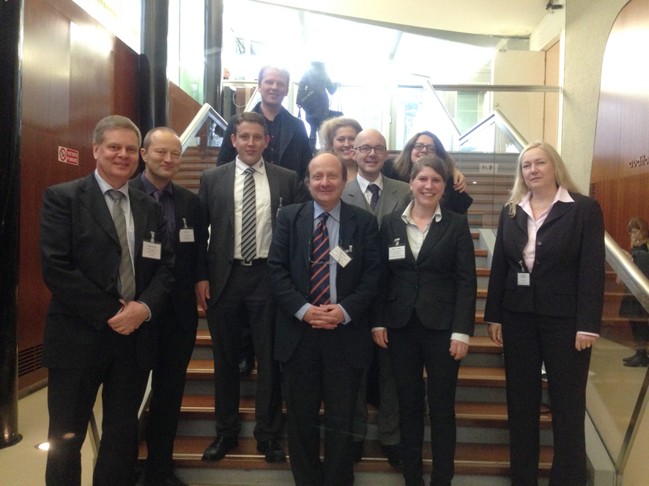
Our consortium: France, Greece, Germany, Austria, Finland, Italy, Denmark, Netherlands
Milan, 26.11.2014 Meeting with Lombardy Region
We need hospitals interested to find new solutions and test prototypes in the applied fields!
Maren.geissler@klinikum-westfalen.de
0049 (0) 15775344359
Klinikum Westfalen, Germany

