Slide 1
ICT-34-2016 AND C-ITS CORRIDOR BETWEEN ROTTERDAM AND VIENNA A MATCH?
October 28, 2015
FOR A STRONG PUBLIC SECTOR

Slide 2
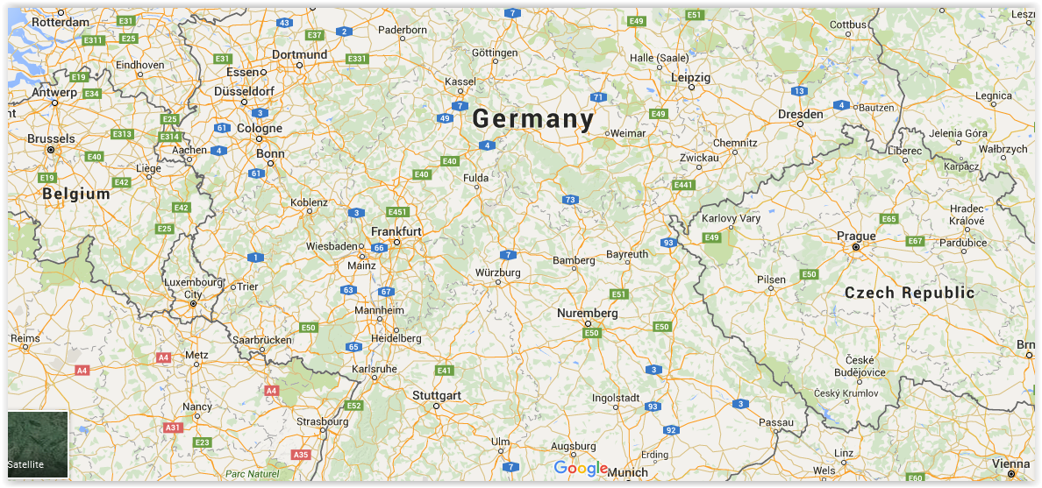
MAP OF C-ITS CORRIDOR
GOOGLE SCREENSHOT OF THE CORRIDOR
MANY NATIONAL AND LOCAL ROADTRANSPORT AUTHORITIES /PROCURING ENTITIES ALONG THE CORRIDOR ROTTERDAM VIENNA

Slide 3
BUSINESS CASE (1)
AN AGREEMENT BETWEEN 3 COUNTRIES TO REALIZE A COOPERATIVE TRANSPORT SYSTEM CORRIDOR BETWEEN ROTTERDAM AND VIENNA.
FOCUS ON (HEAVY) TRANSPORT TO LIMIT ACCIDENTS, ENHANCE TRAFFIC INFORMATION, DIMINISH TRAFFIC JAMS AND REDUCE POLLUTION.

Slide 4
BUSINESS CASE (2)
TWO MAJOR DEPLOYMENT TECHNOLOGIES AVAILABLE AT THIS TIME. DSRC (Wi-Fi-P) AND 4G/LTE (cellular).
BOTH NOT 100 % FULLY DEPLOYABLE AS OF YET. BOTH NEED FURTHER DEVELOPMENT (TECHNICAL, LEGAL, STANDARISATION, SECURITY, AVAILABILITY, ETC.). -> PCP.
SERVICE CONCESSION CONTRACTS ARE FEASIBLE AS OF 2018-2020 (DEPENDING ON THE TECHNOLOGY).

Slide 5
IS ICT-34-2016 A MATCH? (1)
MANY NATIONAL AND LOCAL ROAD AUTHORITIES NEED TO BE INVOLVED.
A LOT OF FUNDING IS NECESSARY FOR DEPLOYMENT.
DSRC MORE LIKELY PCP -> INNOVATION-PARTNERSHIP 2018 – 2020.
4G/LTE MORE LIKELY PCP -> SERVICE CONCESSION 2018.
TECHNOLOGIES SO FAR COMPLEMENTARY UNTIL 2020.

Slide 6
IS ICT-34-2016 A MATCH (2)
AND IF SO TO WHAT EXTENT CAN ICT-34-2016 ASSIST IN THIS GREAT PROJECT AIMED AT:
PREVENTING ACCIDENTS AND THE OTHER GOALS (POLLUTION, LESS DELAYS AND SO FORTH) IN EUROPE.
PREVENT (A) EUROPEAN VENDOR(S) LOCK-IN.
CREATE ENOUGH INITIAL PROCUREMENT VOLUME TO REALIZE DEMAND PULL FROM SUPPLIERS, CARMAKERS, OBU PRODUCERS AND THE TELECOM INDUSTRY (NETWORKS,GEO GRIDS)?

