Slide 1




Paris, 27&28 October 2015

Slide 2
eafip INITIATIVE
Toolkit
Free assistance
Workshops&
Conferences

Slide 3

eafip TOOLKIT OBJECTIVES - THE “WHY WE DID IT”
Explain innovation procurement
Clarify and demonstrate the principles and the benefits of innovation procurement
Provide best procurement practices for the implementation of innovation procurement projects

Slide 4

eafip TOOLKIT BASIS - THE “HOW WE DID IT”
Legislative & policy review (EU directives, Commission Communications, policy documents, economic studies etc.)
Literature review
Information gained during conferences
Case studie and lessons learned from completed and/or on-going innovation procurement projects
Latest trends in innovation procurement methodologies and practical experiences

Slide 5

eafip TOOLKIT BASIS - THE “HOW WE DID IT”
User friendly
Clear
Concise
Checklists
Text
Images/diagrams
Text boxes including case examples
Cross references

Slide 6
eafip TOOLKIT - THE “HOW IT LOOKS”

Slide 7
eafip TOOLKIT - THE “HOW IT LOOKS”
STEP-BY-STEP PROCESS | CHECKLIST / TO DO LIST | QUESTIONS TO ANSWER | INSTRUMENTS
Needs identification and assessment | Start early Everything starts with a need Make sure it is an unmet need Recognize unmet needs and opportunities Make sure the need it clearly identified and it responds to a societal challenge Define outcome-based requirements | Did I identify the correct need? Is the meet unmet? Did I pull unmet needs and opportunities into focus? Does the need meet a societal challenge for which I am responsible? | WIGBI approach Workshops with customers Identify-Validate-Verify approach Methodology used to identify and assess needs Relevant section in the Toolkit
Constructing a business case | Plan wisely Allocate resources Calculate available budget | Did I carefully consider all resources needed for the implementation of the project? Is the business case viable and sustainable? Do I have the required resources? | Business case template Relevant section in the Toolkit
Conduct market consultations | This is the moment to validate the identified need Make sure to clearly differentiate the market consultation from the tender procedure Build trust between the public and the private sector Involve end users | Is there a solution ready available to meet the need? If not, is it possible to develop a solution to meet the need? Does the technology exist on the market or does it need to be created / developed? Is the business case viable? Is PCP the right procurement model or is PPI better? Did I secure transparency, equal treatment and non-discrimination for all parties? | Templates Best practices examples and fact sheets Relevant section in the Toolkit

Slide 8
eafip TOOLKIT BASIS - THE “HOW IT LOOKS”

Slide 9

eafip TOOLKIT - A “LIVING DOCUMENT”
To be updated during eafip
Feedback from:
  Workshops
  Assistance
  FAQ
  Your input
  Changes in legislation
  New case law from the ECJ
  Lessons learned and case examples

Slide 10
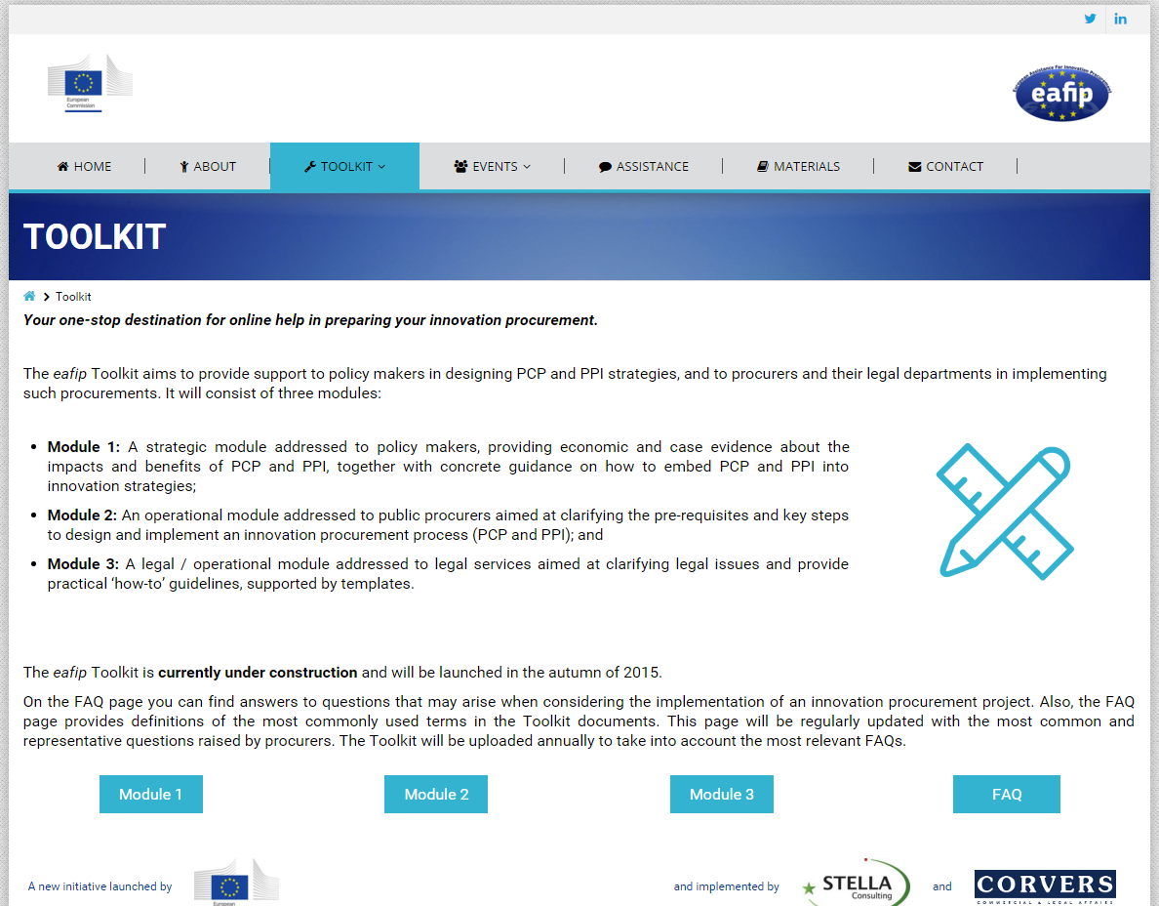
eafip TOOLKIT – WHERE TO FIND IT
eafip.eu

Slide 11
eafip TOOLKIT MODULES
Toolkit
MODULE 1
Policy maker
MODULE 2
Public procurer
MODULE 3
Legal expert

Slide 12

eafip TOOLKIT – MODULE 2 – THE “WHO WE DID IT FOR”
  the decision makers and the procurement officers involved in the procurement process
  those professionals responsible for the procurement planning and execution of related activities

Slide 13
eafip TOOLKIT – MODULE 2
Structure:
  Section 1: Introduction
  Section 2: A step-by-step approach to innovation procurement (PCP&PPI)
  Section 3: Joint procurement
Objectives:
  What form of innovation procurement a public procurer could choose
  What are the main steps that public procurers should consider when preparing and implementing an innovation procurement procedure
  Why each of these steps is important
  How to implement each of these steps
  How to implement joint procurement

Slide 14


eafip TOOLKIT – MODULE 2
Important issues clarified by Module 2:
  the pre-requisites for a successful implementation of Pre-Commercial Procurement (PCP) and of Public Procurement of Innovative Solutions (PPI);
  how to prepare and implement a PCP and/or PPI procurement, covering the activities before and during the procurement procedure up to the award of the procurement contract(s); and
  how to manage and monitor an ongoing PCP and/or PPI procurement, covering the activities to be undertaken after the award of the procurement contract(s) and during the implementation of the PCP / PPI contract.

Slide 15
eafip TOOLKIT – MODULE 2
  Covers all the phases in a procurement process, namely the steps required in the “before procurement”, “during procurement” and “after procurement” stages and explains how to address each step:
    Needs identification and assessment;
    Prior art analysis and IPR search;
    Drafting a business-case;
    Open market consultation;
    IPR and confidentiality strategies and setting the link to standardization;
    Drafting the tender documentation;
    Conducting the procedure;
    Monitoring and evaluating the contract performance.

Slide 16
eafip TOOLKIT – MODULE 2
  Covers all the phases in a procurement process, namely the steps required in the “before procurement”, “during procurement” and “after procurement” stages and explains how to address each step:
    Needs identification and assessment;
    Prior art analysis and IPR search;
    Drafting a business-case;
    Open market consultation;
    IPR and confidentiality strategies and setting the link to standardization;
    Drafting the tender documentation;
    Conducting the procedure;
    Monitoring and evaluating the contract performance.

Slide 17
eafip TOOLKIT – MODULE 2

Slide 18

eafip TOOLKIT – MODULE 2 – LINKS
  There is a particularly strong link between Module 2 and Module 1 and, respectively, between Module 2 and Module 3:
  Module 2 is based on and builds upon the content of Module 1, which sets the underlying rationale and benefits to undertaking innovation procurement, and explains the steps for the adoption of a national/regional innovation procurement policy
  Module 2 outlines the steps to be followed in the implementation of PCP and PPI, in full compliance with the legal framework detailed in Module 3

Slide 19

Stephan Corvers
Oana Pantilimon Voda
Corvers Procurement Services b.v.
Email: s.corvers@corvers.com
o.pantilimon@corvers.com

