Slide 1
Quantifying the Impact of PCP in Europe based on evidence from the ICT sector « 2015 EU Innovation Procurement Event» Paris, 27th October 2015 Sara Bedin European Expert on Innovation Procurement Author of the study SMART 2014/0009 PCP specialist and member of EAFIP initiative Executive Board Member of EuroCloud Italy

Slide 2
The study (SMART 2014/0009)
INTRODUCTION
OVERVIEW OF PCP
REVIEW OF THE LITERATURE
SUMMARY OF RESPONSES TO QUESTIONNAIRE
THE METHODOLOGY FOR PCP IMPACT ASSESSMENT
EMPIRICAL FINDINGS ON THE 9 AREAS OF RESEARCH
RECOMMENDATIONS
120 pages
https://ec.europa.eu/digital-agenda/en/news/quantifying-impact-pcp-europe-study-smart2014-0009

Slide 3
Objectives
Quantify the economic impact of pre-commercial procurement (PCP) in Europe, compared to other procurement approaches, based on detailed information from public procurers and awardees collected through questionnaires
>> analyze whether and how much the impacts observed in PCPs (panel 1) differ from the impacts observed in the panels 2 (R&D services contracts) and 3 (mixed R&D services and supply contracts) of the control group of procurements
Provide a series of recommendations for new actions to be undertaken at EU level and at national level to encourage the use of PCP and improve the link with potential follow-up public procurement of innovation (PPI).

Slide 4
Research key elements
Regression approach via Nearest Neighbor Matching (NNM) estimators
Regression approach via Ordinary Least Squares (OLS) estimators
Comparative economic impact of PCP
i) a dataset of procurements (with a variable indicating the sample)
ii) a collection of variables measuring how large the impact is when using PCP compared to other procurement methods
iii) “control variables” which allows to determine whether this impact was really achieved because of the use of the PCP
a dataset of procurements (with a variable indicating the sample)
Comparative ECONOMIC impact of PCP
ii) a collection of variables measuring how large the impact is when using PCP compared to other procurement methods
Recommendations
iii) “control variables” which allows to determine whether this impact was really achieved because of the use of the PCP
Notes:
a dataset of procurements for which we have a variable indicating whether each procurement is a PCP or not,
a collection of variables measuring how large the impact is when using PCP compared to other procurement methods,
a rich set of variables (defined as “control variables” and specified in chapter 6, which allows us to determine whether this impact was really achieved because of the use of the PCP method or not (to isolate the causal effect produced by the usage of PCP, conditional on other forces that concur to determine such outcomes).
Combining these three data elements, the effect of PCP on outcomes has been estimated through a regression approach via Ordinary Least Squares (OLS) and Nearest Neighbor Matching (NNM) estimators.

Slide 5
Methodology: main steps
Follow-up
Analysis of results for the nine research questions
Submission of the questionnaire
Design and elaboration of questionnaires
Identify suitable PCP cases according to a defined check-list
Characterize control groups and identify suitable cases
1
2
3
4
5
6

Slide 6
Methodology: main steps
Follow-up
Analysis of results for the nine research questions
Submission of the questionnaire
Design and elaboration of questionnaires
Identify suitable PCP cases according to a defined check-list
Characterize control groups and identify suitable cases
1
2
3
4
5
6

Slide 7
Step 1. Identify suitable PCP cases according to a check-list
PCP characteristics: check list
Tender object: R&D services (prevalence criterion)
Type of contract: procurement contract. Obligation of bidders: R&D services Obligation of contracting authorities: payment of the agreed price
Demand side driven approach (needs and requirements are defined exclusively by the procurer)
Development in phases
Multiple-sourcing contract, in the sense that there are multiple and competing firms along the whole trajectory of the PCP
Retention of at least two participating companies until the last phase to ensure a (future) competitive market
Separation between the PCP and the procurement of commercial volumes of end-product and no preferential treatment in the supply of the final products (the competition is re-opened and the awardee who has done the R&D and developed a working test series has no guarantee to win a follow-up contract for mass delivery)
Contractual arrangements, rights and obligations of the parties (including IPRs), are decided upfront and made available to all interested bidders in advance (published in the tender documents)
Absence of exclusive condition: the public purchaser does not reserve the R&D results exclusively for its own use, so that results are shared with or fully assigned to bidders with the public contracting authority retaining use licencing right
Award criterion: MEAT (competition also on price)

Slide 8
Step 1. Identify suitable PCP cases according to a check-list
There is a very limited number of (completed) PCP cases across EU.
Sometimes public authorities define their projects as PCP but, in fact, such tenders do not satisfy the EC definition of PCP specified in the Communication (COM 799) and the 2014 State Aid Rules on R&D&I (in compliance with the exemption in the 2014 Public Procurement Directives), which ensures the conditions for PCPs not to involve State aid.
In particular, we have frequently observed:
lack of multiple sourcing until the last phase,
lack of R&D effort required (incremental applied research or organizational innovation),
lack of definitions of IPRs allocation and contractual arrangements in the tender documents and admission of negotiation on that subject,
lack of definition and description of the procurement object that makes the procedure more similar to a call for ideas/proposals than a call for tender,
lack of description of the un-met need that makes the bids and resulting solutions not as easily objectively comparable as it should be in public procurements.

Slide 9
Methodology: main steps
Follow-up
Analysis of results for the nine research questions
Submission of the questionnaire
Design and elaboration of questionnaires
Identify suitable PCP cases according to a defined check-list
Characterize control groups and identify suitable cases
1
2
3
4
5
6

Slide 10
Step 2. Characterize the control groups (group of other R&D procurement approaches cases) and identify suitable cases
Control group characteristics
Panel 2 | Panel 3
Object of the procurements in panel 2: contracts that buy only Research & Development services (i. e. feasibility studies, preliminary or executive technical design services, prototyping services, testing services etc.). | Object of the procurements in panel 3: mixed R&D services and supply contracts (contracts that combine the purchase of R&D and supply of the resulting solutions in one and the same procurement) with a significant degree of innovation.
Both panel 2 and panel 3 cases are: Single-award/single source contracts – where only one awardee is chosen (for each lot, if the contract is split into lots) and (predominately)
Exclusive contracts - where intellectual property rights remain with the Public Procurer and not given to the awardee.

Slide 11
Datasets: dimension of the sample
Notes:
The total dataset with 'procurer' responses used for this empirical analysis contains 41 cases: 7 PCP cases (panel 1) and 1 (similar to, but not, PCP) multiple-sourcing case represented by NHS, 14 cases of non-PCP R&D services procurements (panel 2) and 19 cases of combined procurement of R&D services and supply (panel 3).
The total dataset with 'awardee' responses used for this empirical analysis contains 19 cases: 7 cases of PCPs (panel 1), 5 cases of non-PCP R&D services procurements (panel 2) and 7 cases of combined procurement of R&D services and supply (panel 3).

Slide 12
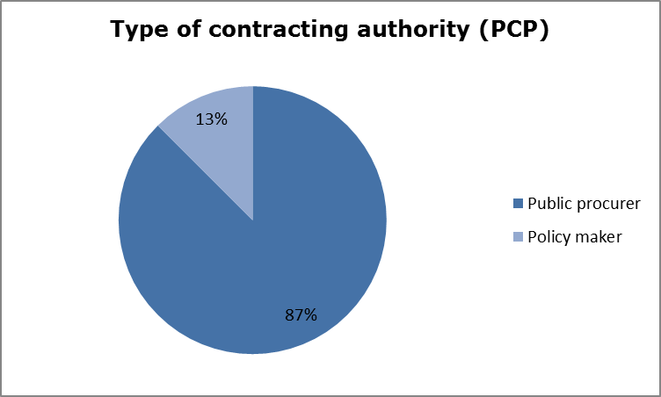
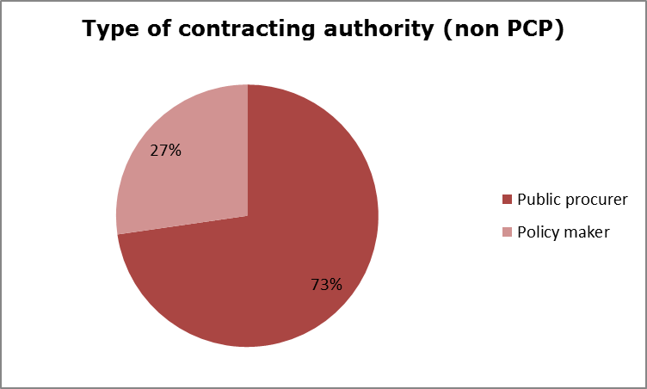
Datasets: type of contracting authority (1/2)

Slide 13
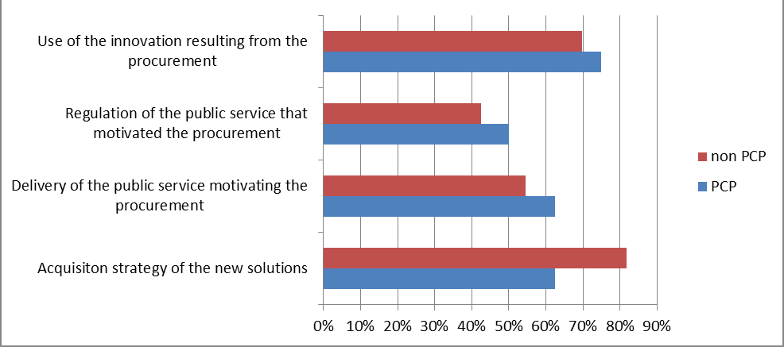
Datasets: type of contracting authority (2/2)
As the public body that conducted the procurement,
what are you responsible for?

Slide 14
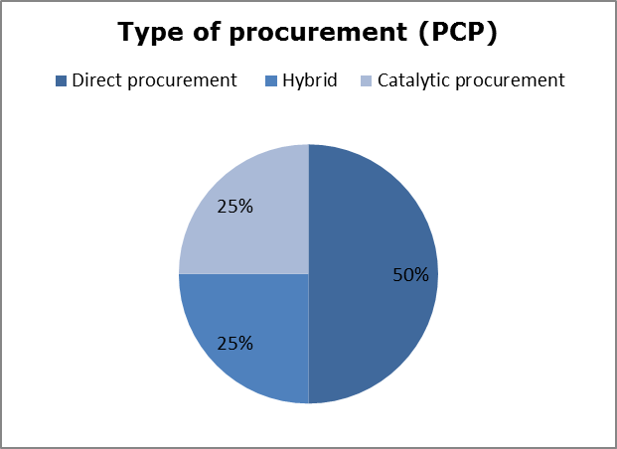
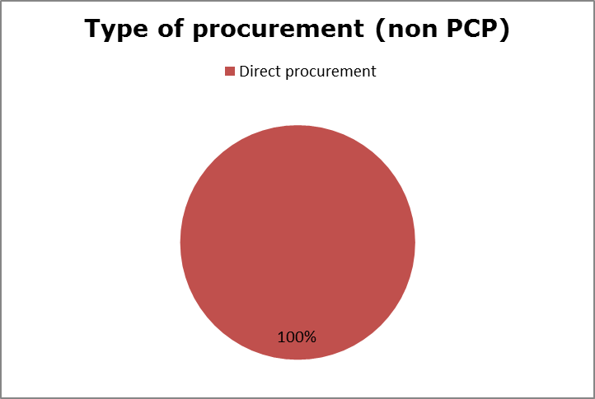
Datasets: type of procurement

Slide 15
Datasets: motivation for procurement
Why did you undertake this procurement?

Slide 16
Datasets: sector of public intervention
Sector of public intervention
 | PCP | non PCP
Education | 0% | 15%
Health | 37% | 24%
Environment & Energy | 25% | 12%
Space & Defence | 13% | 9%
Transport | 25% | 15%
ICT | 0% | 24%

Slide 17
Methodology: main steps
Follow-up
Analysis of results for the nine research questions
Submission of the questionnaire
Design and elaboration of questionnaires
Identify suitable PCP cases according to a defined check-list
Characterize control groups and identify suitable cases
1
2
3
4
5
6

Slide 18
Step 3. Design and elaboration of questionnaires
Designed to investigate the demand-side impacts and the supply-side impacts of both the PCP cases and the control cases.
non-PCP R&D services procurement, that were single-sourcing and exclusive development contracts (panel 2)
non-PCP procurements that combine the purchase of R&D services and supply of commercial volumes of resulting end-products into one procurement (panel 3)
Based on both objective measures and subjective information from respondents.
Aimed to obtain information on:
Tender design and process;
Motivation and expectation of public procurers;
Motivation and expectation of awardees;
Impact of PCP on public procurers and on public services;
Impact of PCP on awardees and on the market structure.

Slide 19
Methodology: main steps
Follow-up
Analysis of results for the nine research questions
Submission of the questionnaire
Design and elaboration of questionnaires
Identify suitable PCP cases according to a defined check-list
Characterize control groups and identify suitable cases
1
2
3
4
5
6

Slide 20
Step 6. Analysis of results for the nine research questions
Did the quality and/or efficiency of the public services improve by deploying the innovative solutions developed as a result of the PCP?
As a result of the highly competitive multi-sourcing phased procurement approach that distinguishes PCP from other procurement approaches, did quality increase and prices decrease?
Did PCP reduce the risk of failure in large scale follow-up PPI procurements?
Did PCP lead to an increase in the efficiency of R&D expenditures?
Did the PCP speed up time-to-market for firms and facilitate the access of SMEs to the procurement market?
Did the PCP attract financial investors to Europe?
Did the PCP lead to an increase in interoperability / impact on standardization / and to a reduction of supplier lock-in?
Was there a positive impact of PCP on market competition?
Did the PCP lead to an increase in the exploitation of IPRs and R&D results?

Slide 21
Improvements in the quality and/or efficiency of the public services
The analysis reveals a positive and statistically significant effect of PCP on improvements in the quality and/or efficiency of public services.
Moreover this effect will likely emerge more strongly as larger datasets of more completed PCP cases becomes available.

Slide 22
The cases of PCP-like procurement of supercomputing technologies (dating back to the 60’s) and semi-conductors in US
As reported in Rambøll (2008), the supercomputing R&D procurements lead to an improvement of the quality and effectiveness of a number of public service applications which required high-performance computing power and set the basis for industrial mainstream and commercial PCs.
As reported in Rambøll (2008), the cost / performance improvements that have been achieved in over 60 years of supercomputing procurements were significant. Sustained public demand for ever more performing computing power has reduced the cost per unit of computing power a trillion times over 60 year time. This has brought enormous cost savings to computing intensive government departments, as well as large spill-over effects to the affordability of personal computers for the private consumer segment.
Geroski (1990) reports how Governmental procurement of Semi-conductors is largely considered one of the most successful stories. Quality and standard setting for these projects proved to be more important than favorable purchasing prices for the final outcome. The large public demand supported the firms in the development phase, allowing projects to be profitable from the beginning, even before entering private market during the commercialization phase. This enabled the firms to establish a manufacturing expertise, very much needed to the following commercialization phase. The projects also forced contractors to share information and stimulate entries of newcomers which favoured the rapid diffusion of know-how and manufacturing expertise. ......

Slide 23
Increase in quality and decrease in prices of products resulting from the highly competitive multi-sourcing
The data does not indicate any significant difference between PCP and non-PCP procurements (no significant comparative effects) in terms of cost reductions.
Such evidence is not detectable at present, given that most PCP cases analysed have only been completed very recently or are still in progress.

Slide 24
The literature on multiple sourcing procurements (1/3)
Comparing single and multiple sourcing, Gansler, Lucyshyn and Arendt find that competition during research and development reduced development time by 33 percent, development cost by 42 percent and average per-unit cost of more than 50 percent (e.g. the Joint Direct Attack Munition (JDAM) procurement competition between two prime contractors (Martin Marietta and McDonnell Douglas)).
They observed that competition during sustainment operations has established dramatic improvements in material availability (above 95 percent), world class response times (2-4 days), significant reductions in inventory, and savings of 17 percent over the historic support methods. Finally, they argued that early competition in the system lifecycle is desirable, as sponsoring the concurrent development of two or more competing weapon systems represent potential substitutes for filling a presumed military need, the government can hedge against uncertainties. This reduces the risk of being committed to an unsatisfactory approach and increases the probability of obtaining an acceptable end product.
Learning effects reinforce the benefit of multiple sourcing. The evidence collected by Gansler, Lucyshyn and Arendt shows that the second supplier/source achieves a steeper learning curve: learning by the second source is between 2 percent to 9 percent greater than for the first source. The steeper second-source learning curve exerts price pressure on the original firm, whose learning curve becomes steeper because of the competitive pressure. Thus, competition drives both firms to more efficient pricing.

Slide 25
The literature on multiple sourcing procurements (2/3)
Competition is also found to lead to a lower cost growth of DoD programs. The cost growth factors on the programs with no production competition (based on actual cost incurred vs. program baseline) increased by 46 percent, on average. Of the 10 programs studied, most showed an increase between 25 percent and 104 percent. Instead, the cost-growth factors for commercial aircraft produced in a competitive environment showed a decrease of between 2 percent and 27 percent.
A number of other studies, cited in Gansler, Lucyshyn and Arendt (2009), have confirmed the cost saving of dual sourcing. Savings from dual sourcing in electronic programs have also been observed (see Birkler et. al. 2001).
For R&D contracts, the case for multiple souring to raise the risk of bid rigging at procurement stage is weaker. This is because the benefit for a firm from the award of the contract is not constituted solely by the monetary compensation but also by the IPR obtained on the solution proposed. Such IPRs provide incentives for firms to compete fiercely against their competitor so as to improve their position in the market.
We note, further, that with R&D services, bidders face more uncertainty on each other’s costs, than they do in the production of homogeneous and non-complex products. This cost uncertainty makes it difficult for bidders to agree on a coordinated collusive conduct. For this reason, we should expect greater potential gains from multiple sourcing in markets were multiple awardees are used for R&D services rather than for contracts for the supply/production of goods.

Slide 26
The literature on multiple sourcing procurements (3/3)
Grimm, Pacini, Spagnolo and Zanza (2006) summarize the benefit from dual or multiple sourcing as:
Simultaneously allows both winning firms to learn and to gain experience, resulting in a steeper overall product-specific learning curve.
Produces procurement cost savings to the government when it is followed by a winner-take-all tendering process, but this involves the danger of lock-in which increases cost in the future. Reducing long-term costs can thus make it optimal to allow for multiple awardees also in the final round of the tendering stage.
Reduces informational asymmetries between suppliers, which can lower procurement cost by inducing more aggressive bidding in subsequent tendering processes.
Gives the buyer more leverage over non-contractible dimensions of product quality: the buyer has additional disciplinary power with respect to product attributes that are difficult to specify in a contract.

Slide 27
Reduction in the risk of failure in large scale follow-up PPI procurements
The estimates reveal a positive association between PCP and the decline in the risk of failure of follow-up PPI.
PCP enables procurers to de-risk large follow-up deployment contracts by first comparing the pros and cons of competing solution approaches from different suppliers.
There are a number of risk reduction techniques used in PCP: (1) splitting the R&D (PCP) off from contracting for large scale deployment (PPI), (2) comparing/learning from several alternative solutions approaches in parallel before fixing the requirements/tender specs for deployment, (3) splitting the R&D in phases with evaluations after each PCP phase that stops further investment in non-viable solution approaches, (4) sharing the benefits/risks of commercialization/IPRs with the suppliers (5) reducing the perceived risks to buy from SMEs (6) encouraging the development of open interoperable solutions.

Slide 28
Increase in the efficiency/intensity of R&D expenditures by firms
There is a positive effect of PCP on increased R&D expenditure by participating firms after the PCP tender.
The study was not able to detect whether the company would have started the project absent the PCP procurement.

Slide 29
The literature on impacts of innovation procurement on R&D expenditure and sales results of firms
Guerzoni e Raiteri (2012) studied the impact of innovation procurement and R&D subsidies on firms’ private R&D investments and innovative output. They found that there is a positive and significant impact of innovation procurement on private expenditure on R&D: 12 percent more firms have increased their R&D expenditure in the treated group than in the control group. Instead, R&D subsidies incentivise only small amounts of additional firms’ private expenses in R&D. There is also a positive significant effect of innovation procurement on firm innovativeness: 9.3 percent more firms in the treated group than in the control group report that most of their sales are coming from innovative product or service. Furthermore, when they isolate the effect of each policy, the impact of R&D subsidies on private R&D investment is no longer significant. The impact of innovation procurement on private R&D investment remains significant.
The possibility that R&D subsidies mainly substitute (“crowd out”) private funds is an issue that has been largely analysed by the economic literature. We recall David et al. (2000) who review 35 years of econometric evidence on the impact of public R&D on private R&D. They find that 1/3 of studies report public R&D funding are substitute for private R&D funding: 5/6 of studies based on data of countries other than US report overall complementarity, while only 4/7 of studies based on US data report complementarity.

Slide 30
Speeding up time-to-market for firms and facilitating the access of SMEs to the procurement market
There is overwhelming evidence that PCP increases both the participation of SMEs to the tender procedure and the awarding of actual contracts to SMEs.
No sufficient data to assess the impact on the time to market of the solutions developed under the PCP.
The data also does not reveal any statistically significant difference on the level of subcontracting between PCP and non-PCP.

Slide 31
Attracting financial investors to Europe
The answers received from awardees was too limited to draw any statically significant conclusion on whether or not there is a difference between different procurement mechanisms in terms of increasing the ability of participating firms to attract financial investors. This effect will therefore need to be analysed further when larger datasets of more completed PCP cases will become available.

Slide 32
Increased interoperability / impact on standardization / reduction of supplier lock-in
The estimates reveal a strong, positive effect of PCP on the reduction of supplier and technology lock-in.
No statistical difference between PCP and the other forms of procurement is found in terms of increase in interoperability, but we note that the analysed PCP cases are either not finished yet or did not put specific interoperability requirements on solutions in their tender specifications. This latter finding is also because the cases analysed include only one joint procurement, that would naturally have more interoperability requirements.

Slide 33
Impacts on competition structure in the market
The EU funded PCPs show a clear effect on unlocking the internal market. The effect of joint cross-border PCP procurement is that 25% times more contracts (33%) than typically in national procurement (1,23%) are awarded to companies that are not from countries of the procurers. The PCPs are contributing directly to creating a Digital Single Market in Europe by offering concrete cross-border market/growth opportunities to companies.
The data was not able to detect an association between PCP and changes in the revenues, market shares, number of employees of firms (by checking whether the values reported as current values exceed those reported with regard to the pre-tender period).
As regards subcontracting, the estimates indicate a lack of significant association with PCP.

Slide 34
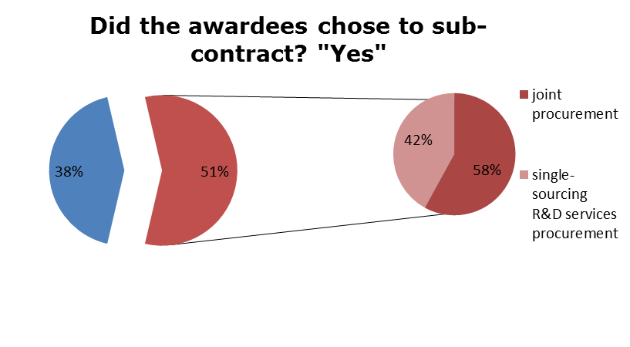

Slide 35
Increased exploitation of IPRs and R&D results
The data shows that there is some evidence of a positive association between PCP and increased exploitation of IPRs and R&D results, as PCP lead to an increase in the exploitation of IPRs.
Firms participating to PCP projects have additional incentives to exert research effort in order to develop solutions that have great potential in terms of subsequent commercialization.

Slide 36
9 research questions
Improvements in the quality and/or efficiency of the public services achieved by deploying the innovative solutions developed as a result of the PCP;
Increase in quality and decrease in prices of products resulting from the highly competitive multi-sourcing, phased procurement approach that distinguishes PCP from other procurement approaches;
Reduction in the risk of failure in large scale follow-up PPI procurements
Increase in the efficiency of R&D expenditures;
Speeding up time-to-market for firms and facilitating the access of SMEs to the procurement market;
Attracting financial investors to Europe;
Increased interoperability / impact on standardization / reduction of supplier lock-in;
Impacts on competition structure in the market;
Increased exploitation of IPRs and R&D results in general.

Slide 37
Recommendations for actions to be taken by the EU (1/3)

Slide 38
Recommendations for actions to be taken by the EU (2/3)

Slide 39
Recommendations for actions to be taken by the EU (3/3)

Slide 40
T h a n k y o u
For further info:
Sara BEDIN
sara.bedin@appaltoprecommerciale.it
mobile: +393470115010

