Slide 1
Ideas for „Broadening the scope of support to the demand side“ from PPPI Service Point Austria
Stefan Wurm
Notes:
Stefan Wurm

Slide 2
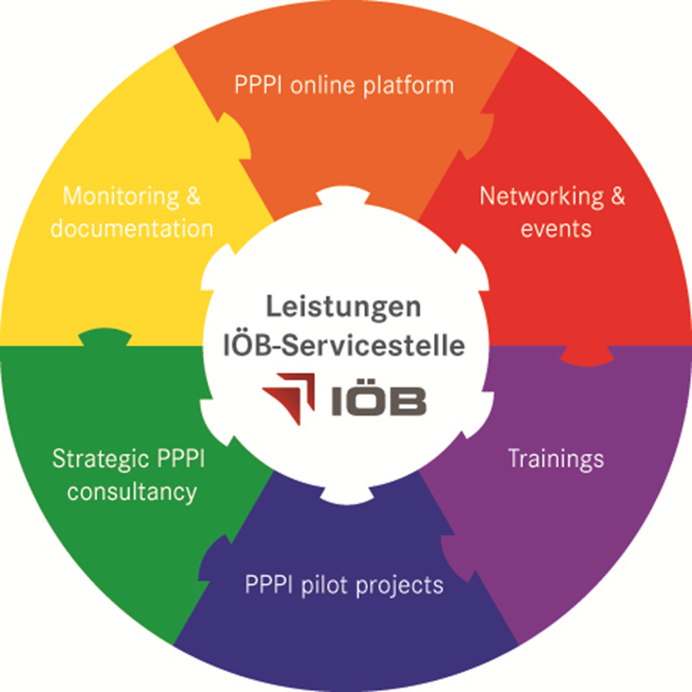
PPPI - Main services
Design and launch of an online platform that serves as a brokerage tool between procurers and innovative suppliers
Developing KPIs to quantify innovative procurement
Publishing of annual reports on the situation of PPI in Austria
Building a community of innovative procurers
Organisation of conferences and learning labs
Focus on different procurement groups
Supporting organisations in their innovation process
Consulting on the design and implementation of innovation strategies
Establishing a common body of knowledge on innovation amongst the public procurers
Internal and external trainings and workshops
Initiating and supporting PPI projects in Austria
Notes:
Pilotprojekte: Begleitung von IÖB-Pilotprojekten (kick-off, Experten,….)
IÖB-naBe-Konferenz = Inno-naBe

Slide 3
Online brokerage tool between procurers and innovative suppliers
www.innovationspartnerschaft.at
Market place for innovative products and services innovation-oriented public procurerers
Self assessment online – three easy steps
Expert Jury for assessing innovative products and services
Concrete challenges from the public sector
Workshops for public procurers to describe problems as challenges
Focus on problem based procurement
Political support

Slide 4
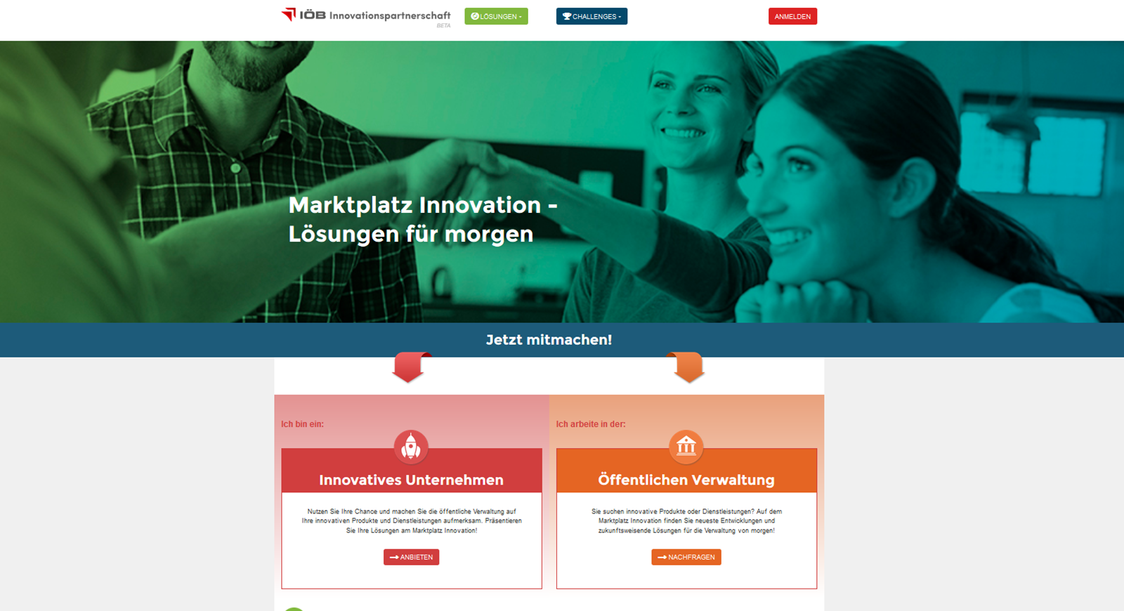
Screenshot www.innovationspartnerschaft.at

Slide 5
Community Building
Meetings, conferences and Workshops
Workshops and conferences focusing on specific topics
Bringing together demand and supply side by open calls for these topics (e.g. lightening, innovative facility management, e-mobility, IT, innovative working environment)
Usage of opinion surveys to identify relevant procurement groups and topics
Yearly planning and coordination with a broad stakeholder board
Governance structure

Slide 6
PPPI pilot projects
Initiation and support of PPPI pilot projects
Support of finding specific demand for innovation procurement
Call for proposals (every product group is welcome) two times a year
Jury decision in this regard focusing at degree of innovation, societal challenge and additional benefit
Assistance in project monitoring and project management
Contact for technical and organizational issues

Slide 7
Support in strategic planning
Direct support and consultation
Analysis of starting points and potentials for innovation procurement
Identification of approaches starting from demand from the past, current problems, needs
Including current projects, current strategies, focusing on specific topics
Priority matrix
Next steps: pilot projects and strategic innovation procurement plan

Slide 8
Your questions and remarks

Slide 9
Our Team
www.ioeb.at
IÖB-Serviceline: +43 (1) 245 70 817
Jasmin Berghammer, MSc
Junior Projektmanagerin IÖB-Servicestelle
jasmin.berghammer@bbg.gv.at
Tabea Reicher, BSc
Junior Projektmanagerin IÖB-Servicestelle
tabea.reicherl@bbg.gv.at
MMag. Manuel Schuler
Junior Projektmanager IÖB-Servicestelle
manuel.schuler@bbg.gv.at
MMag. Stefan Wurm, MBA
Leitung IÖB-Servicestelle
stefan.wurm@bbg.gv.at
Notes:
01/245-70817

