Slide 1
EPP-eHealth Project / Parallel Session PM-19
EAFIP MAJOR EVENT, Athens 19th October 2016
Laura Sánchez
BravoSolution

Slide 2
Key facts
“European Procurers Platform – eHealth Transforming the market for eHealth Solutions”/ CSA
Funded by the H2020 programme. GA: 644461
Consortium: 7 partners, 4 EU countries
Duration: 2 years
Started: 1st January 2015
Total budget: 771 k€

Slide 3
European Healthcare challenges
Upward pressure on the costs of providing care
Downwards pressure on budgets, public finances constrained
Unresolved gap between the service on offer and healthcare needs
New challenges in healthcare... Infection control issues, climate changes pressures
Changes in healthcare delivery, patient expectations and an aging population
Regulatory challenges
Strategic role of procurement not understood. Lack of awareness and capacity
Innovation is worrying ; risk is not rewarded; change is difficult
...No shortage of problems....

Slide 4
Context
Challenging times... need innovative responses
Innovation is the key to the challenges facing the healthcare sector
Healthcare is an ideal lead market for innovation
We need to create the market conditions where innovation can thrive:
Stimulating supplier innovation
Early adopt innovative goods and services
Collaborating to create market demand
replicating good ideas
Yet current procurement practices tend to stifle innovation and lock in old solutions
Collaboration and replication seem to be the exception

Slide 5
Public Procurement potential
Demand-driven innovation is considered to have huge untapped potential to grow the EU economy and help address environmental and social challenges
In 2010, in the EU the public sector spent over EUR 2 406 billion on goods, services and works – amounting to around 19.7% of EU GDP.
In 2010, over 160 000 invitations to tender were published for a value of EUR 447 billion

Slide 6
European Healthcare challenges

Slide 7
Change of paradigm

Slide 8
EPP-eHealth Specific objectives
Create a network of healthcare procuring organisations
Training in PPI schemes and practices
Identification and communication of common unmet eHealth needs
Development of a “Joint Statement of Unmet needs” as basis for launching the PPI Strategy to address these needs

Slide 9
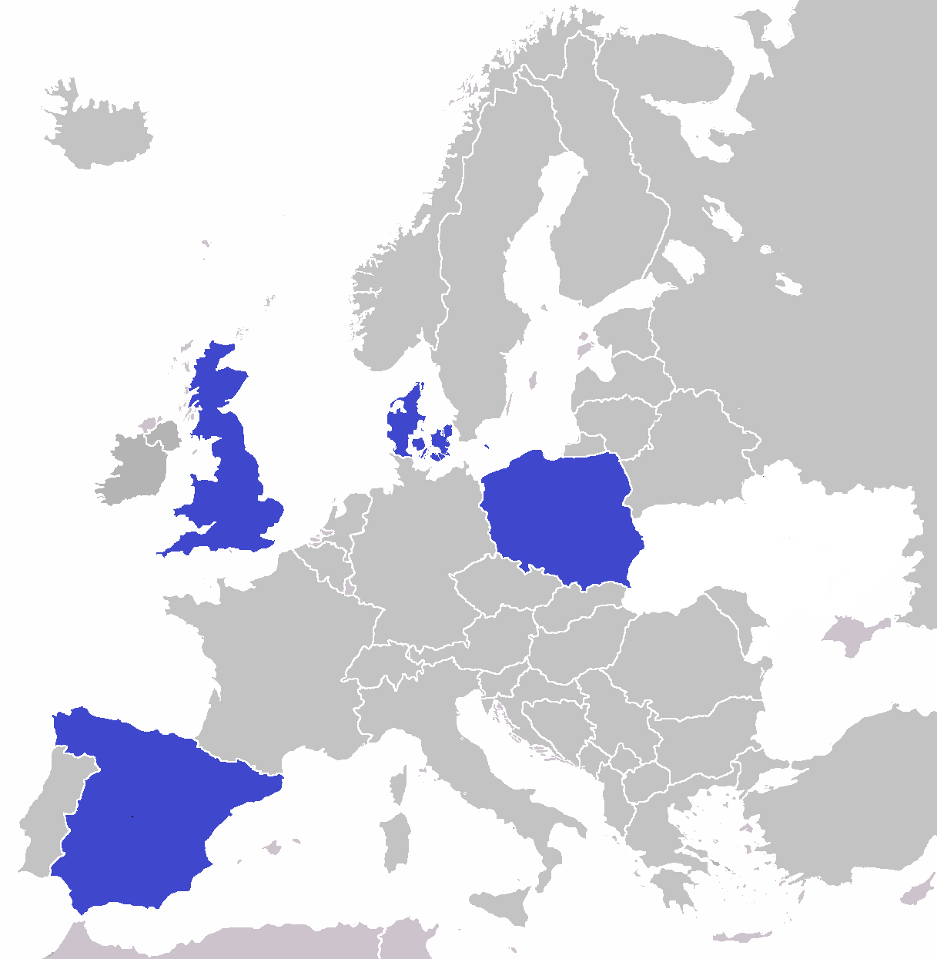
Network of procuring organisations

Slide 10
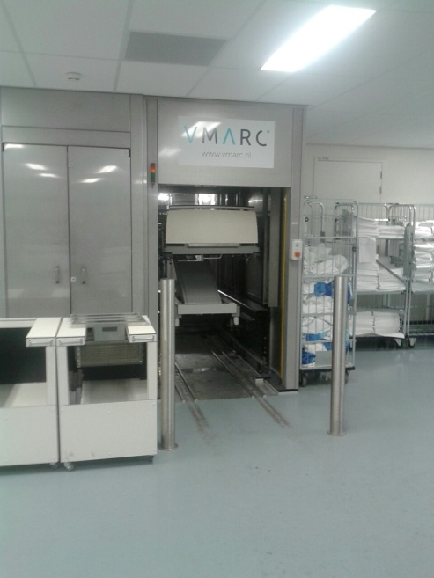
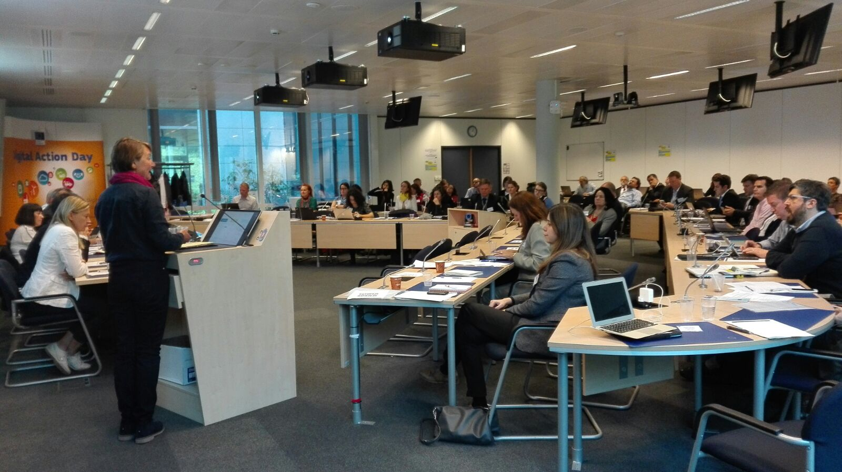
PPI Training
Methodology
Training
PPI Training workshops for Healthcare procurers
Community of Learning Visits (success stories).
Learning visit to Erasmus Medical Hospital (Rotterdam)
Bed washing robot – PPI Netherland project
PPI Stakeholder Workshop co-organised with the EU in Brussels, May 2016

Slide 11
Indentification of unmet needs

Slide 12
Indentification of unmet needs
Synthesis Report: The synthesis report highlights common areas of unmet needs identified in the healthcare sector which eHealth (ICT) technologies could support and/or address.
This is based on previous project experience (EcoQUIP), desk research and analysis from qualitative research undertaken during the project and outcomes from the Synthesis Workshop. This is therefore a summary of unmet needs that can be translated into procurement requirements and communicated to the supply chain

Slide 13
Unmet Need
An unmet need is a problem, bottleneck or desire of functionality with no current good solution in the market or at an affordable price. It is a market gap that could be exploited to start a profitable business around it.
How to identify an unmet need...
What is the current situation?
How would we like it to be different?
What are the outcomes that we need?
Would we buy a product or service if it delivered these outcomes (in a cost effective way)?
Do other healthcare providers share this need?
Can we present a credible demand to the market?

Slide 14
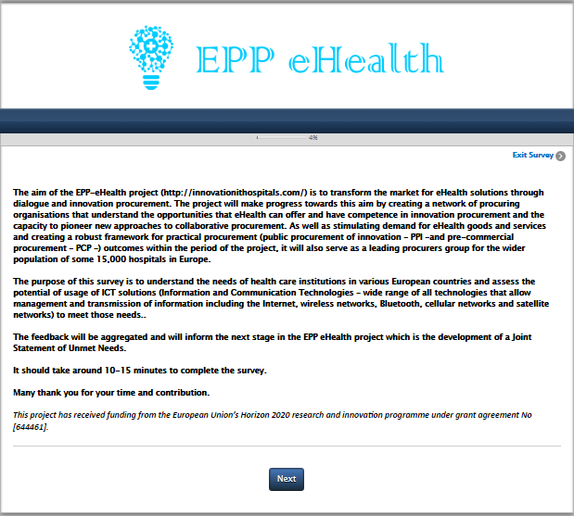
Identifying unmet needs
Suppliers to Procurers perspective analysis
- Online survey
Indentify barriers / opportunities.
- In person interview
- Market consultation
EPP-eHealth Suppliers Survey OPEN!

Slide 15
Survey Statistics
Over +200 surveys collected healthcare procurers approach
Launched online survey suppliers perspective. Open until the 29th of October
Survey available in English, Polish, Danish and Spanish
Online questionnaire
Computer assisted telephone interviews
Data collection on workshops and conferences

Slide 16
Survey outcomes: healthcare perspective

Slide 17
eHealth areas of intervention – Solving through ICTs

Slide 18
Primary eHealth areas of intervention
Ageing population
One of the greatest social and economic challenges of the 21st century and it will affect all EU countries (economy, social security, labour and healthcare systems).
Healthcare systems across Europe must be able to adapt in order to continue providing adequate levels of care whilst remaining financially sustainable.
Diagnosis decision-making
Particularly in relation to cancer diagnoses, but believed that timeframe solutions should be applied to other diagnoses.
Recognised at a policy level e.g.: the UK Government have set cancer waiting time targets.
Need for a solution is further evidenced with the anticipated increase in the number of cancer patients.

Slide 19
Primary eHealth areas of intervention
Chronic disease management
Leading cause of mortality in Europe.
Enhance functional status, minimise distressing symptoms, prolong life and enhance the quality of life.
Need for management solutions to tackle this increasingly common challenge.
Patient self-management
Giving patients with long-term conditions the tools, skills and support they need to improve their own wellbeing and health.
The rising number of patients with long-term illness
Skills shortage
Increasingly, healthcare professionals require a relatively high level of technical know-how
Investment in skills is vital as health professionals will need to develop new skills and competences required for new treatments and new delivery models.

Slide 20
Primary eHealth areas of intervention
Interoperability / Integration and standards
Lack of universal standard-based EHR system adoption.
Existing healthcare processes must be redesigned to incorporate new technologies.
Complex privacy and security challenges
Standards are a huge barrier to ICT adoption in healthcare. Synchronous collective action among multiple stakeholders; standards and rules must be uniform to bridge existing and future networks.
Patient empowerment
Understanding by the patient of his/her role;
Acquisition by patients of sufficient knowledge/skills to engage with their healthcare provider.
And the presence of a facilitating environment.

Slide 21
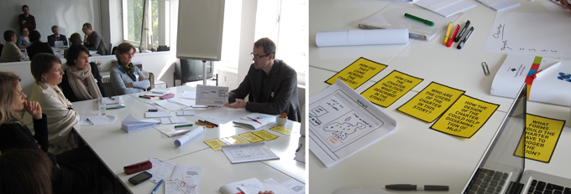
Project procurers unmet needs
Co-creation workshops at
Hospital level

Slide 22
Key Lessons Learned
Definition of PCP objectives and the specifications
Training and support needs of the procuring authorities.
The PCP preparation should be led by a combination of clinicians and hospital managers and commissioners of service, working very closely with the procuring authority responsible
The importance of a though needs assessment – real need: the ability to describe the user need clearly is essential for the whole procurement process.
Establish and fulfil a detail planning from the project very beginning. Timeframes too tight.
Importance of the value of anchoring of the strategy, and the involvement of user groups. Expansion of Ecosystems

Slide 23
Key Lessons Learned
PCP preparation
The lack of proper integration with existing solutions, and issues related to aging infrastructure in hospitals might hinder innovation.
To facilitate the implementation of innovative solution, potential obstacles as a result of existing technical infrastructure should be widely documented and articulated during the preparation phase.
The cost-benefit analysis should be integrated into all innovative procurement processes.
Documentation of the financial effects of the innovation is often missing in pre-commercial projects.
Lack of proper business case generally results in discontinuation of the process into commercialisation.

Slide 24
Key Lessons Learned
Market consultation
Both user involvement and market dialogue are a co-creation process. This approach helps to think how the solution to be developed would actually be exploited and what would be the additional value compared to an application already available on the market.
Market dialogue with the supply side actors is a must activity. e.g.: provide support to the technical dialogue, feasibility check and market scanning for existing solutions.
Relevance of the dissemination of the Market consultation to gather enough feedback from suppliers.
Proper treatment of information gathered during the market consultation is vital for future involvement from the suppliers. Being able to transform the information gathered into an innovation friendly tender specification is important for their future involvement.
Establishing an open dialogue and clear assumptions concerning IPR of the results in early phases is an important success factor.

Slide 25
Key Lessons Learned
In general...
Focus on initial need assessment and a dialogue with suppliers shows positive results.
The tender specification should be based on functionality rather than detailed technical requirements.
Lack of risk assessment and cost benefit calculations hinders innovation.
Projects fail to take into account the issues of integration, implementation and operational challenges
High impact projects have failed due to silo thinking within the health organisation. Idealists are in charge of the project, and tend to fail during the anchoring phase
There is a need for more knowledge and experience with innovative procurement
Procurement of Innovation is about total cost of ownership – not the lowest price per piece

Slide 26
Join our Statement!
Follow us on social media @EPPeHealth
EPP-eHealth :http://www.innovationithospitals.com/

