Slide 2
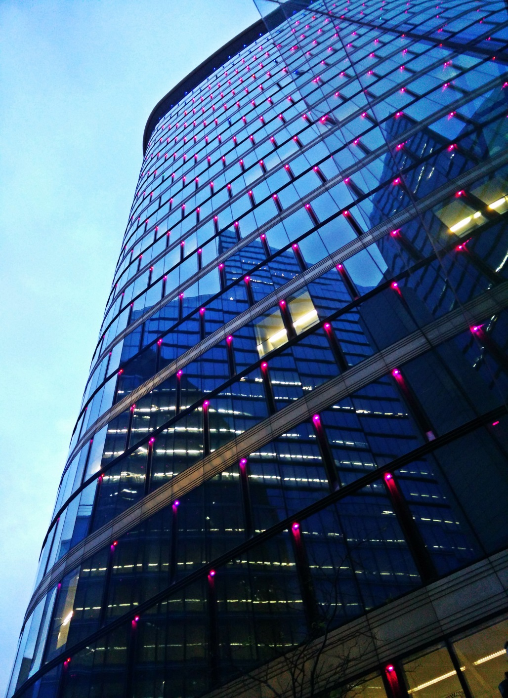
EE19 Public Procurement of Innovation in energy-efficiency
Olav Luyckx
Project Advisor
2016 EU Innovation Procurement event
18-19 October 2016 / Athens

Slide 3
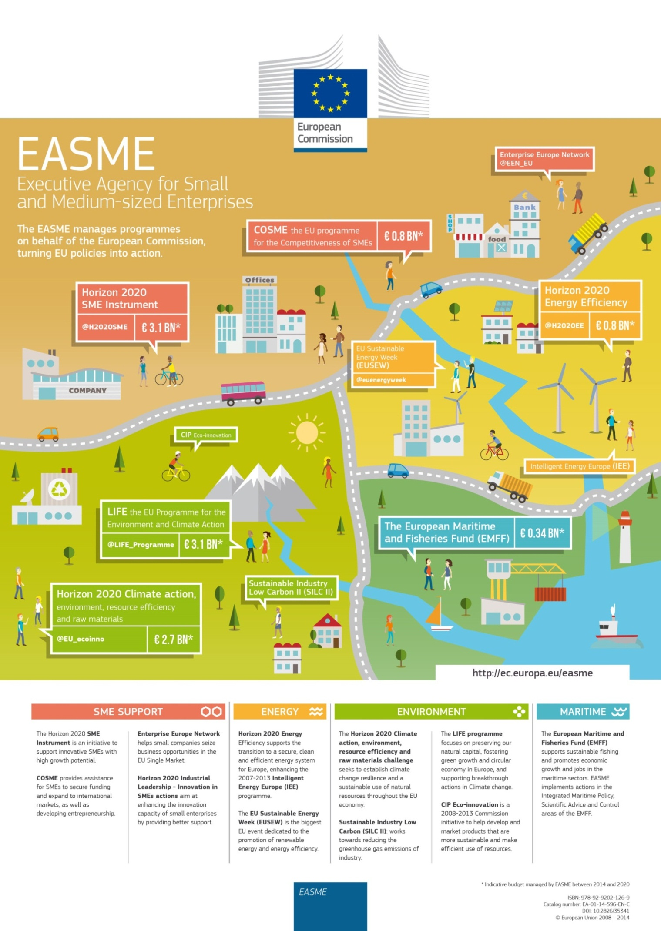
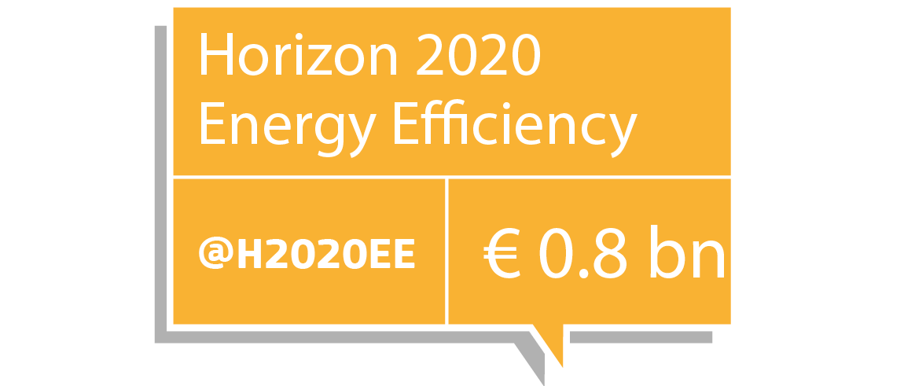
Notes:
H2020
Industrial leadership:
Sustainable Industry Low Carbon Scheme (SILC II)
Innovation in SMEs
Leadership in enabling and industrial technologies (LEIT)
The SME instrument
Fast Track to Innovation pilot
Part of 'Secure, clean and efficient energy' challenge: Energy efficiency calls
Part of 'Climate action, environment, resource efficiency and raw materials' challenge:
Eco-innovation
Raw materials
Research projects
COSME
EU programme for the Competitiveness of SMEs
Budget: €2,3 bn. 2014-2020
Objectives (% budget):
Improving access to to finance (min. 60%)
Improving access to markets (ca. 21,5%)
Improving framework conditions (ca. 11,5%)
Promoting entrepreneurship (ca. 2,5%)
LIFE
EU programme for the Environment and Climate action
Budget: €3,4 bn. 2014-2020
Sub-programme Environment:
Environment and resource efficiency;
Nature and biodiversity;
Environmental governance and information.
Sub-programme Climate action:
Climate change mitigation;
Climate change adaptation;
Climate governance and information.
European Maritime and Fisheries Fund
Objectives:
Transition to sustainable fishing
Economic diversification of coastal communities
Job creation and quality of life improvement in coastal areas
Easier access to finance
Budget: €6,5 bn. 2014-2020
Legacy of IEE
Legacy of Eco-innovation

Slide 4
Call deadlines: 19 January 2017 (open) - 7 June 2017 (closed)
The challenge
Public spending around 19% of EU GDP (2009) ->public sector constitute important driver to stimulate market transformation towards more sustainable energy-related products and services;
The Energy Efficiency Directive requires that central governments purchase only products, services and buildings with high energy-efficiency performance;
Public Procurement of Innovative solutions (PPI) is not sufficiently developed in the field of energy efficiency although it could support the market up-take of energy efficient goods, services or buildings.

Slide 5
The scope
Actions enabling a group of buyers (buyers group) to undertake a one joint procurement or several separate but coordinated PPI procurements per PPI action for innovative solutions for products, services or buildings (NZEB, renovation), which are not yet available on a large-scale commercial basis, and which have energy performance levels that are better than the best levels available on the market;
Actions should lead to first application / commercialisation of the innovative solution, in order to assure its market uptake;
Where appropriate, build upon the outputs of on-going projects (including the Project Development Assistance projects), networks, guides, tools, and rely on the use of cost – benefit analysis (e.g. using a life- cycle approach);
The procurement of innovation process should be associated with coordination and networking activities and awareness and knowledge sharing activities;
Other entities (end-users, certification bodies, private/NGO procurers that provide services of public interest) that share the same procurement need can participate.

Slide 6
Type of Action: Public Procurement of Innovative solutions
EU Contribution 1.0 – 2.0 Mio EUR (this does not preclude submission and selection of proposals requesting other amounts);
35% funding rate to leverage co-financing from the procurers;
At least 3 legal entities from 3 different MS/AC of which at least 2 legal entities from 2 different MS/AC that are public procurers (buyers group).
General Annex D & E of the H2020 Work Programme "Specific requirements for innovation procurement (PCP/PPI) supported by Horizon 2020 grants"

Slide 7
35% of direct eligible costs covered
Preparation and implementation of the PPI procurement
The price of the PPI procurement (called the PPI subcontracting cost in the budget table in the submission system) and
The costs for related coordination and networking activities to prepare, manage and follow-up the PPI procurement:
preparation of tender specifications and open market consultation, monitoring of on-going R&D, validation and testing of solutions at the procurer's premises, dissemination activities, travel for networking activities etc.;
but also coordination & networking activities related to contribution to standardisation, certification, regulation, preparation of follow-up PPI procurements to deploy the innovative solutions even more widely;
Coordination & networking = max 50% of the requested grant;
Indirect costs = flat rate of 25% of the direct costs.

Slide 8
Total cost of the action (€ 5,7 Mio)
Total cost of the action (€ 5,2 Mio)
<50% spent on
Coordination &
networking
activities
50% spent on
Coordination &
networking
activities
50% spent on
Procurement cost
>50% spent on
Procurement cost
35% H2020 co-financing can be distributed as
follows (theoretical example):
Maximum allowed amount for coordination and networking (50%) = € 1,0 Mio
50% for actual procurement = € 1,0 Mio
Own contribution also contributes then
50% to coord & network cost = € 1,85 Mio
50% to procurement cost = € 1,85 Mio
35% H2020 co-financing can also be distributed as follows (theoretical example):
Less than 50% (43,9%) for coordination and networking i.e. € 0,8 Mio
Leaving € 1,02 Mio for actual procurement
Own contribution also contributes then
<50% to coord & network cost = € 1,48 Mio
>50% to procurement cost = € 1,9 Mio
H2020 co-financing reduces your risk, by taking on board part of the coordination and
networking costs and the actual procurement costs of the innovative solution

Slide 9
Expected Impact
Prepare and implement the PPI procurement and PPI contracts within the timeframe of the project to ensure the first application / commercialisation of the innovative solutions.
Energy performance levels of new buildings should be at least 25% better than current regulations or reach NZEB performance levels;
For existing buildings, energy savings of at least 60% compared to the existing building should be reached, using innovative solutions;
Products and services, should demonstrate at least 25% better performance in terms of energy efficiency than best available solutions on the market;
wherever possible, use quantified indicators and targets

Slide 10
Relevant initiatives & guidance
CEPPI 2 (649720)
Capacity building for city authorities to embed (PPI) principles within the normal procurement processes of cities;
Five peer learning workshops open to interested cities;
http://www.ceppi.eu/home/
SPP Regions (649718)
Promote networking and collaboration at European and subnational regional level on sustainable and innovative procurement (SPP/PPI);
Establish a Sustainable Procurement and Innovation Network;
http://www.sppregions.eu/home/

Slide 11
Relevant initiatives & guidance
EURECA (649972)
Development of common practices & procedures for PPI and PCP for the procurement of Green Data Centres;
Platform for networking activities for public procurers;
Tailored procurement practical training & awareness programmes on environmental, legal, social, economic and technological aspect of data centre procurement;
http://eureca-project.eu/home
PAPIRUS PROJECT (CIP – programme)
PPI for providing materials characterized by near zero energy consumption for the repair and construction of buildings;
E-learning course on PPI;
http://www.papirus-project.eu/

Slide 12
Relevant initiatives & guidance
PRO-LITE partnership
Procurement of innovative lighting technologies and solutions in Europe;
Develop new procurement frameworks or contracts for lighting;
Case studies & guidance;
http://www.prolitepartnership.eu/
Procurement of Innovation Platform
Web site, Procurement Forum & Resource center on PPI & PCP;
https://www.innovation-procurement.org
European Assistance for Innovation Procurement
Toolkit for policy makers, public procurers and legal services on PCP and PPI procurement procedures;
Events: 23 November – energy sector - Stockholm
No assistance to EU funded project (cross-funding!!!);
http://eafip.eu/

Slide 13
Partners & support for proposal preparation
EASME (https://ec.europa.eu/easme/en/energy)
EU procurement forum (https://procurement-forum.eu/)
Linkedin (e.g. PCP/PPI Linkedin group https://www.linkedin.com/groups/3971446/profile)
Ongoing PCP/PPI initiatives in countries around Europe (https://ec.europa.eu/digital-single-market/news/innovation-procurement-initiatives-around-europe)
National/regional competence centers/support programs for PCP/PPI (https://ec.europa.eu/digital-single-market/news/innovation-procurement-initiatives-around-europe)
Horizon 2020 participant portal (http://ec.europa.eu/research/participants/portal/desktop/en/funding/index.html)
Your own network of colleague procurers/public services in your field, etc;
National Contact Points for Horizon 2020 (http://ec.europa.eu/research/participants/portal4/desktop/en/support/national_contact_points.html)

Slide 14
THANK YOU FOR YOUR ATTENTION
Olav Luyckx & Cécile Kérébel
Project advisor / Department B - LIFE and H2020 Energy, Environment, Resources / Sector - Public Authorities, Energy Services and Financing olav.luyckx@ec.europa.eu
cecile.kerebel@ec.europa.eu
EASME on Twitter
@H2020EE • @H2020SME • @EEN_EU • @EU_ECOINNO

