Slide 1
SC5-26-2017: Pre-commercial procurement on soil decontamination
2016 EU Innovation Procurement event
18–19th October 2016, Athens
Christos Fragakis,
Deputy Head of Unit, Sustainable Management of Natural Resources,
DG Research and Innovation

Slide 2
SC5-26-2017: Pre-commercial procurement on soil decontamination
Specific Challenge
support public authorities in identifying the most fit-for-purpose and cost-effective innovative solutions to address soil decontamination/remediation avoiding 'dig and dump'
develop and fully test these solutions to make them readily available for uptake
reduce fragmentation of demand for the solutions and benefit from economies of scale for best value for money
promote demand driven innovation in the soil decontamination sector in Europe
share cost/define common specifications with other procurers and create standards

Slide 3
SC5-26-2017: Pre-commercial procurement on soil decontamination
Scope
Enable a consortium of procurers (buyers) to launch a joint Pre-commercial procurement to procure research and development for:
identification and development of innovative solutions for soil decontamination/remediation and avoid 'dig and dump'
compare pros and cons of several competing alternative options through open, competitive, non-discriminatory and transparent process to de-risk investments in large scale deployment;

Slide 4
SC5-26-2017: Pre-commercial procurement on soil decontamination
Scope
Activities shall include:
networking relating to preparation, management and coordination,
joint research activities relating to the validation of the PCP strategy and
activities for the follow-up of the joint procurement, such as activities for awareness raising, networking, training, evaluation, validation and dissemination of results
Proposals should build on and take care to avoid duplication of activities undertaken by BRODISE project

Slide 5
SC5-26-2017: Pre-commercial procurement on soil decontamination
Expected Impact (2017)
deployment of innovative beyond state-of-the-art solutions;
reduced fragmentation of demand for innovative solutions by collectively implementing the PCP to address soil decontamination challenges;
opportunities for the supply side for wide market uptake and economies of scale;
new products, processes and/or services leading to viable new businesses, jobs and growth;
underpinning relevant Sustainable Development Goals;

Slide 6
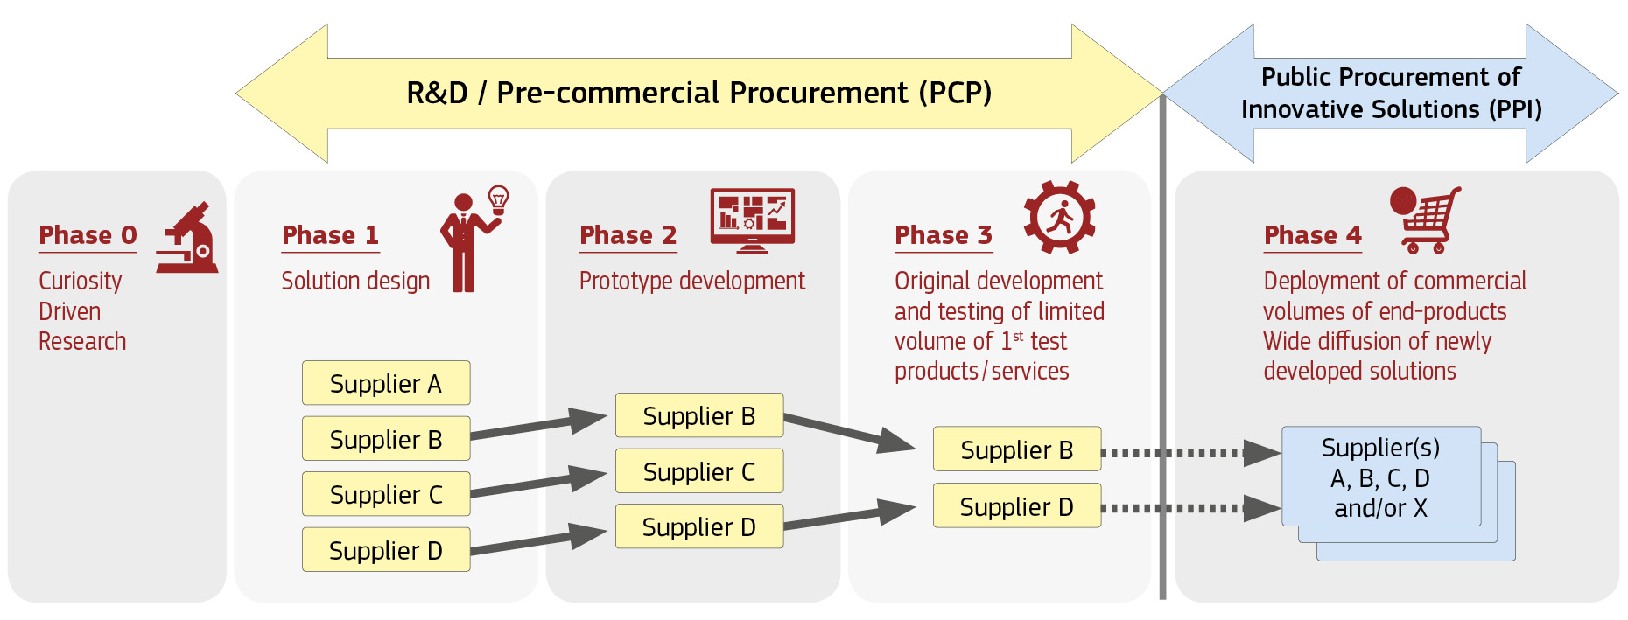
PCP and PPI
complementary
Innovation Procurement:
Procurement of R&D services to tackle specific public needs when solutions are not yet on the market (PCP)
Procurement of solutions new to the market where the public sector acts as first customer (PPI)

Slide 7
PCP and PPI cofund actions – minimum participation requirement
The core of the consortium should be a qualified 'buyers group' able to implement the action;
Additional partners such as business/SME support organisations, innovation agencies or sectoral organisations may be included to assist procurers;
Minimum 3 independent participants from 3 different MS or AC, of which minimum 2 public procurers (buyers group) from 2 different MS or AC

Slide 8
SC5-26-2017: Pre-commercial procurement on soil decontamination
PCP
90%
Deadlines: 07 Mar 2017
Type of action: PCP
Indicative budget: 5 M€
Duration (Only indicative): Project(s) should have a maximum duration of 2 years

Slide 9
Thank you for your attention! Christos.fragakis@ec.europa.eu
Find out more:
www.ec.europa/research/horizon2020

