Slide 1
Innovation procurement in action in the Healthcare Sector
Gaynor Whyles
EcoQUIP Coordination Team
JERA Consulting
gaynor.whyles@jeraconsulting.com

Slide 2
EcoQUIP
AIM? To demonstrate how to improve the efficiency, quality and environmental sustainability of healthcare through innovation procurement.
Creating an ‘Innovation Procurement Leaders Group’ of individuals that have competence in innovation procurement and the capacity to pioneer new approaches to procurement.
Funded through the EC CIP programme – DG Growth
4.5 years - April 2012 – October 2016
Built on the experience of LCB-Healthcare (Lead Market Initiative - DG Growth)

Slide 3
Bringing together hospital partners with enabling and network organisations in Italy, Poland, Hungary, Netherlands, and UK
Bologna University Authority – St. Orsola-Malpighi Polyclinic
Erasmus University Medical Centre
Nottingham University Hospitals NHS Trust
Sucha Beskidzka Hospital
Semmelweis University Health Services Management Training Centre
The Rotherham NHS Foundation Trust
Department for Business, Innovation and Skills
Optimat Ltd
JERA Consulting Ltd
Department of Health England
European Health Property Network
Heath Care Without Harm Europe
Notes:
We have 12 project partners consisting of hospitals, enablers - government departments, innovation procurement experts, networks

Slide 4
EcoQUIP
Pilot innovation procurement projects at the heart of EcoQUIP
AIM? To demonstrate what is possible and offer examples of good practice for the wider population of hospitals in Europe.
Across a diversity of countries: Italy, Poland, Hungary, the Netherlands and UK

Slide 5
Innovation Procurement?
“Undertaking procurement in a way that stimulates the supply chain to invest in developing better and innovative goods and services to meet the unmet needs of an organisation”
This meant changing the way we think about and undertake procurement
Procurement in a way that unlocks the creativity and innovation potential of suppliers to deliver better patient outcomes, cost effectively
“The goods and services you need, when you need them, at a price that reflects their value”.

Slide 6
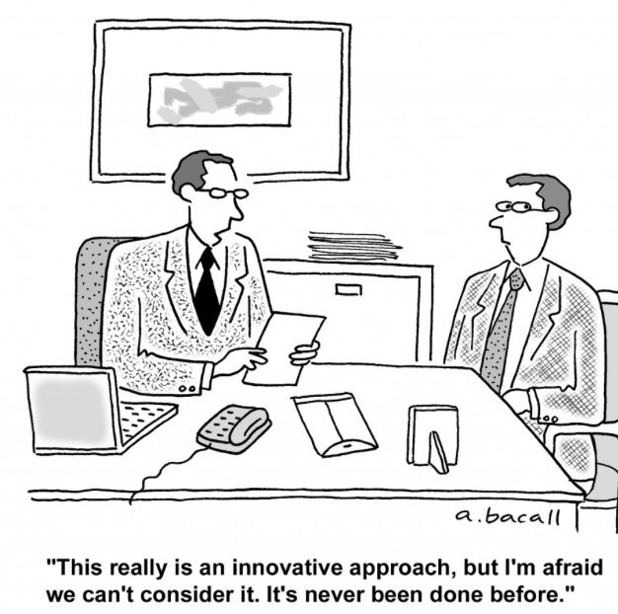
In the beginning….
This really is an interesting approach, but I’m afraid we can’t consider it. It’s never been done before

Slide 7
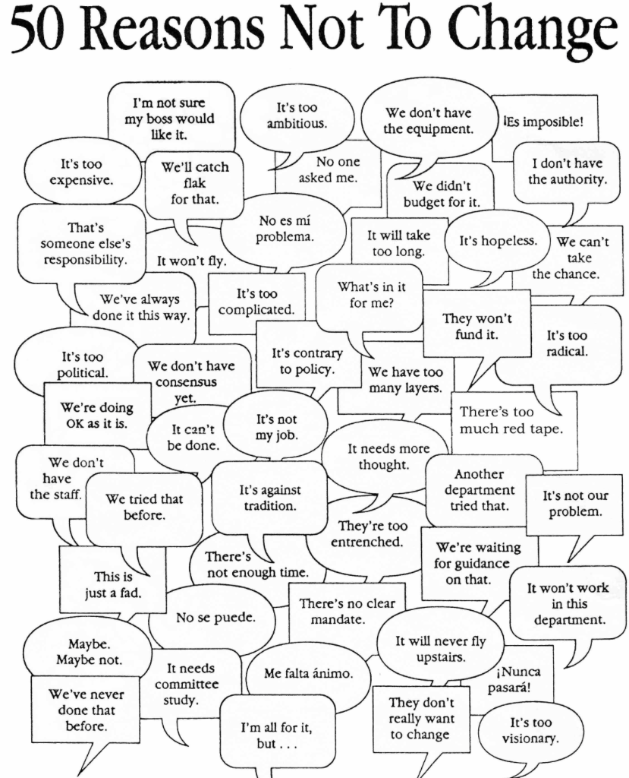
But plenty of reasons why….......

Slide 8
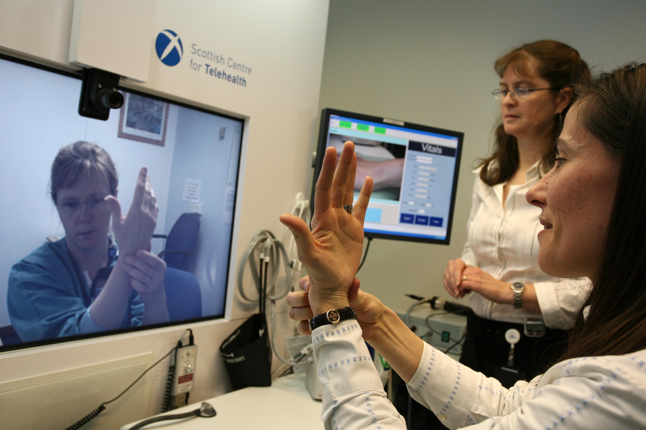
Healthcare is facing major challenges that need innovative solutions
Upward pressure on the costs of providing care
Downward pressure on budgets
An unresolved gap between the service on offer and the healthcare needs of populations
Increased expectations that healthcare budgets and provision must be sustainable
Increasing hygiene and infection control issues
Changes in healthcare delivery, patient expectations and an aging population
Environmental problems and targets
New technology creating new opportunities

Slide 9
A procurers view of innovation
Sensible procurers worry when they hear the word “new”
New products and services have risks.
They might…..
not work as expected
not be delivered on time
cost more ….. and anyway, have no track record
We try to avoid innovation because it is risky
But in some cases (more than we admit) we have no choice –Many existing products and services cannot deliver what we need.
If we keep buying them we will fail
New challenges need new solutions
New technology offers new opportunities
The cost of NOT innovating – often overlooked
How can we buy innovative goods and services sensibly?

Slide 10
A suppliers view of innovation
Developing new products incurs technical risk and requires investments of time and money
Rational suppliers innovate and develop new products only if they have to, e.g.
to protect margins
to win business
to retain business
Technical and resource risks are under the control of the supplier and can be managed
The risk that the supplier cannot control is:
Having developed the product will someone buy it?
Is there a genuine and credible demand?
How can we encourage and enable suppliers to innovate?

Slide 11
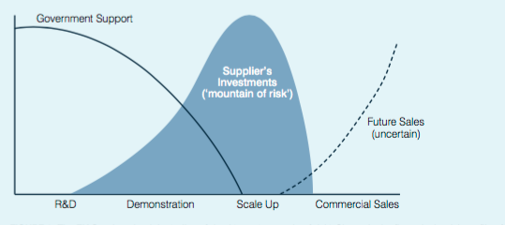
From Whyles, van Meerveld and Nauta, 2014, 2015

Slide 12
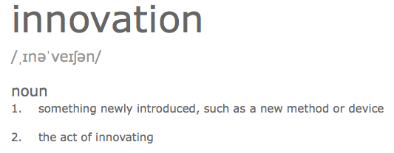
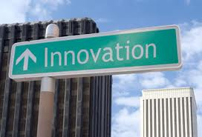
What do we mean by innovation?
“Innovation can be viewed as the application of better solutions that meet new requirements, in articulated needs, or existing market needs”.
A key success factor for innovation is an accurate understanding of the unmet need it is targeting
Successful innovation procurement requires that customers accurately define their unmet needs and requirements

Slide 13
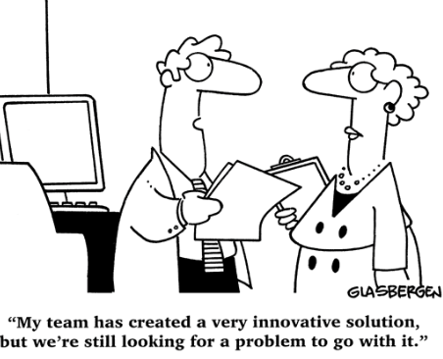
Innovation Procurement?
Customers tend to buy what is available, rather than asking for what they need
Suppliers respond to customer and market demand.
In the absence of a clear demand suppliers push ideas and products
It would be better for everyone if customers expressed their needs to suppliers

Slide 14
Buyer Supplier Paradox
Innovation procurement creates the missing demand and brings new solutions and options to the customer
Typical problem?
The Buyer –Suppler Paradox
If there was a demand we would invest to supply solutions
If there was a viable and affordable solution to my problem we would buy it
“The key to success was to begin by asking for what was needed – not what we thought was available or affordable. The results have exceeded all expectations”. John Cartwright, Director of Estates and Facilities, Rotherham NHS Foundation Trust.
In EcoQUIP Pilots customers accurately identified their unmet needs and then communicated them to the market in a way that stimulated suppliers to respond with new solutions.

Slide 15
Methodology: Forward Commitment Procurement
A three-stage process:
1. Customers establish an accurate understanding of their unmet and future needs
2. Customers then communicate this early in an accurate & convincing way to suppliers
3. Customers provide an opportunity to offer new solutions on an equal playing field

Slide 16
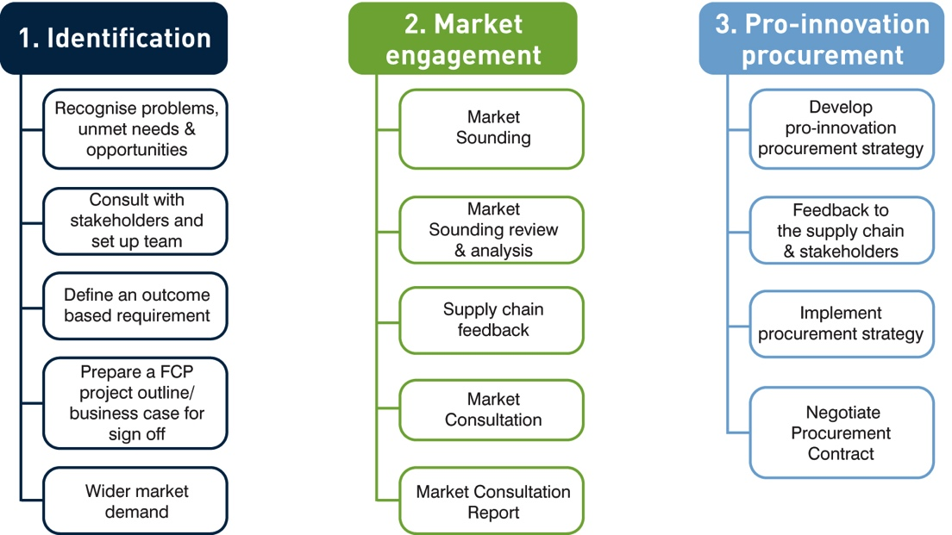
Forward Commitment Procurement (FCP)
Notes:
The approach we took was based on the FCP approach – breals the process down into stages and helps to manage the perceived risjk on the part of the supplier and the customer
The importance of identifying a clear, credible and accurate demand and a receptive environment for new ideas meant that engaging stakeholders has been a crucial under pinning for the pilot projects
Defining needs in terms of outcomes rather than goods enables suppliers room to be creative and distimguish teir offering on factors other than price
Wherever possible, engaging and enrolling a wider market to encourage suppliers and facilitate roll out of new ideas
Pre-procurment market engagement is another key feature we see as important – giving early warning to suppliers and enabling customers to get feedback on their outcome specifications before committing to the procurment process, also helps to dnefy barriers
Finally – creating a procurment process that provides a level playing field for innovative solutions, new suppliers, SMEs

Slide 17
Diverse set of projects addressing genuine unmet needs
Erasmus MC, Rotterdam, The Netherlands
Sustainable and effective bed-cleaning
Beds and mattresses for improved patient outcomes
The Rotherham NHS Foundation Trust, Rotherham, UK
Ultra-efficient Lighting for Future Wards
Flexible and adaptable pressure care management mattresses
People Centred Low Carbon Catering Services for Hospitals
The University Hospital of Bologna (AOSP), Emilia – Romagna Region, Italy
Integrated people-centered and environmentally sustainable facilities services
Nottingham University Hospitals NHS Trust, Nottingham UK
Ultra-Low Emission Energy Solution
Supply chain challenges in 6 clinical areas
Sucha Beskidzka Hospital and Rawicz Hosital, Poland
Low carbon, sustainable uniforms for staff comfort
Thermal Comfort for staff and patients

Slide 18
Outcomes of Pilot Projects?
Pilots have clearly demonstrated that it is possible to:
Change procurement practices for better outcomes
Stimulate the supply chain to bring forward, and invest in, innovative solutions and products
Deliver efficiency, quality and sustainability using innovation procurement approaches
Regulatory, cultural and process barriers can be overcome
Better and more sustainable does not mean more cost – innovation procurement delivers!

Slide 19
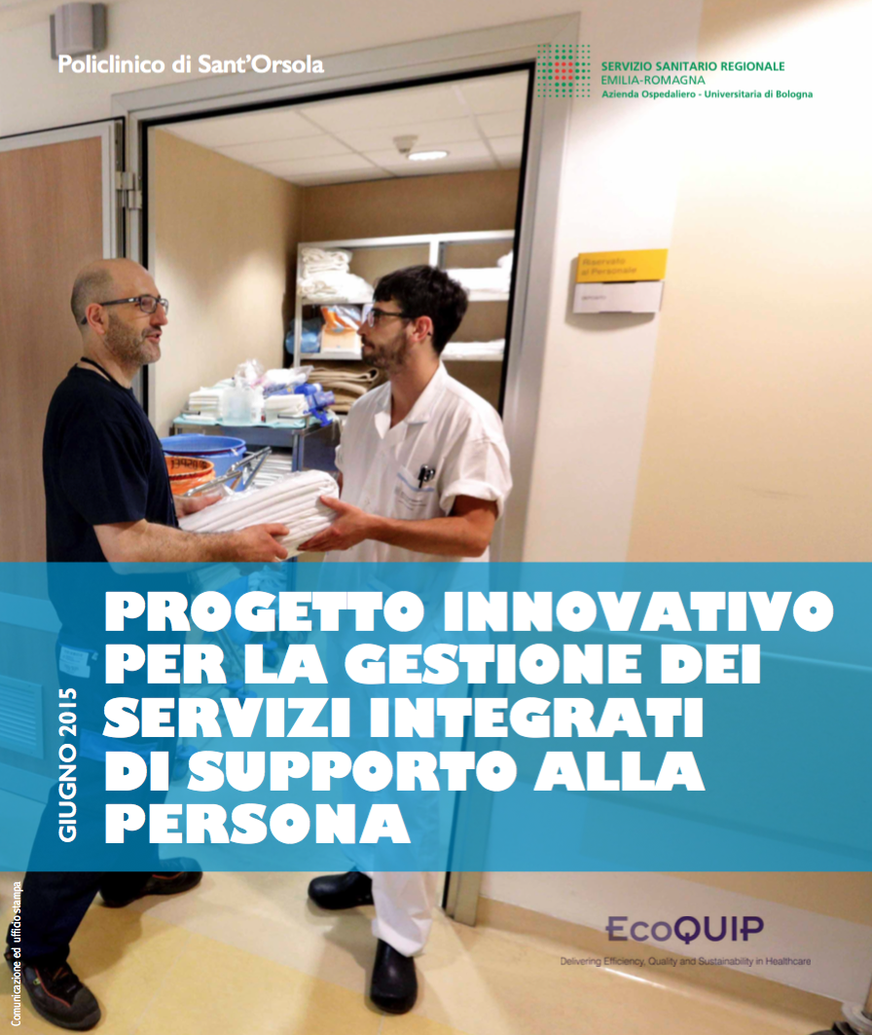
The University Hospital of Bologna
Transforming service delivery through innovation procurement
The opportunity?
Re-tendering of soft facilities services
The problem?
Large, complex undertaking (35 pavillions, 1500 beds, …million patients
Staff unclear about roles and responsibilities
Too may important issues ‘falling through the gaps’, putting patients at risk
The unmet need? Integrated people-centered and environmentally sustainable facilities services

Slide 20
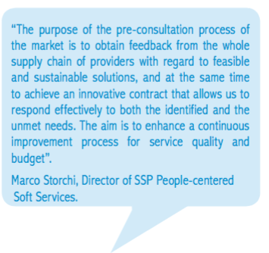
The University Hospital of Bologna
Innovation procurement approach?
Building relationships with the local procurement agency
Stakeholder consultation and engagement
Established a thorough understanding of the current situation
Market engagement in advance of formal procurement
Responding to suppliers feedback following consultation
Pre-tender trial of integrated approach to convince suppliers and reduce risk
Progressive improvements and innovation will be sought within the contract

Slide 21
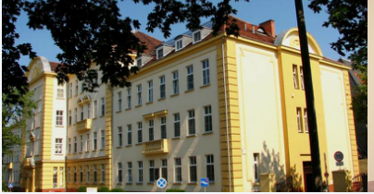
The need and opportunity?
Budget to replace staff uniforms
Uniforms heavy cotton and costly to launder
User consultation showed uniforms to be uncomfortable, poor quality, not fit for purpose
Unmet need?
Functional, attractive,and user friendly, easy to clean, durable, cost effective and environmentally sustainable.
Notes:
We have 12 project partners consisting of hospitals, innovation agencies and innovation procurement experts.

Slide 22
Outcome?
Uniforms at lower whole life costs (-20%)
Light, comfortable and durable
Lower carbon life-cycle
Moisture management and better hygiene
Environmentally sustainable eco-textile
(Eucalyptus fibre)
When compared to cotton produced with fewer pesticides and less water
Higher fibre yields per hectare
And….a local company....
Notes:
We have 12 project partners consisting of hospitals, innovation agencies and innovation procurement experts.

Slide 23
The problem?
South facing aspect, high temperatures
Legal requirements to protect against direct solar radiation
Unmet need?
‘cost-effective and low carbon solution to maintain the thermal comfort of patients and staff in the County Hospital in Sucha Beskidzka’
Outcome?
Innovative retrofitted awnings generating power from PV panels - cost-benefit of circa €15k pa
Notes:
We have 12 project partners consisting of hospitals, innovation agencies and innovation procurement experts.

Slide 24
An innovative integrated solution for the provision of high quality patient-appropriate meals that are enjoyable, attractive, support patient recovery and is delivered as an integral part of nursing care
Shared vision across the team
Transformed the patient experience
Supplier investment (5+5 year contract)
Savings over the first 5 years of more than €1 million
Soil Association Bronze, Silver and now Gold for sustainable catering
“Yet again the FCP approach has proved highly effective in drawing out an innovative response from suppliers that delivers better services, better outcomes and better value’.
John Cartwright, Director of Facilities, Rotherham NHS Foundation Trust

Slide 25
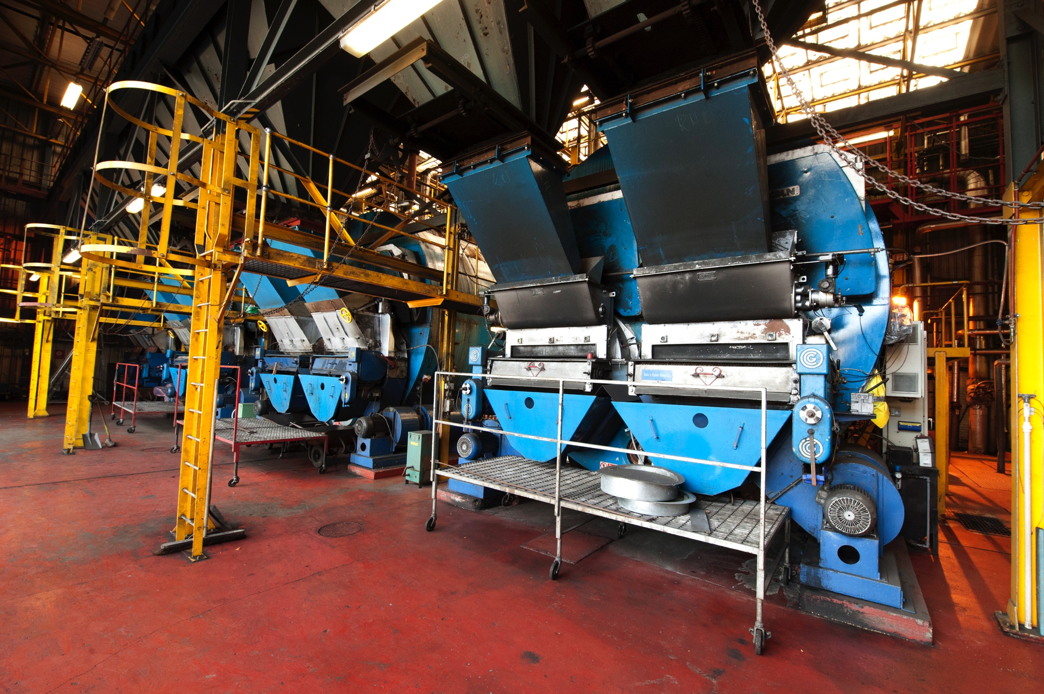
The problem?
Coal fired boiler coming to end of life
Steam distribution system over large site in need of repair
Lack of capital for major investment
Market dialogue explored
The adoption of Fuel Cell CHP
Tri-generation for cost effective cooling
Options for energy demand management
Non-capital financing options
Grants and demonstration funding

Slide 26
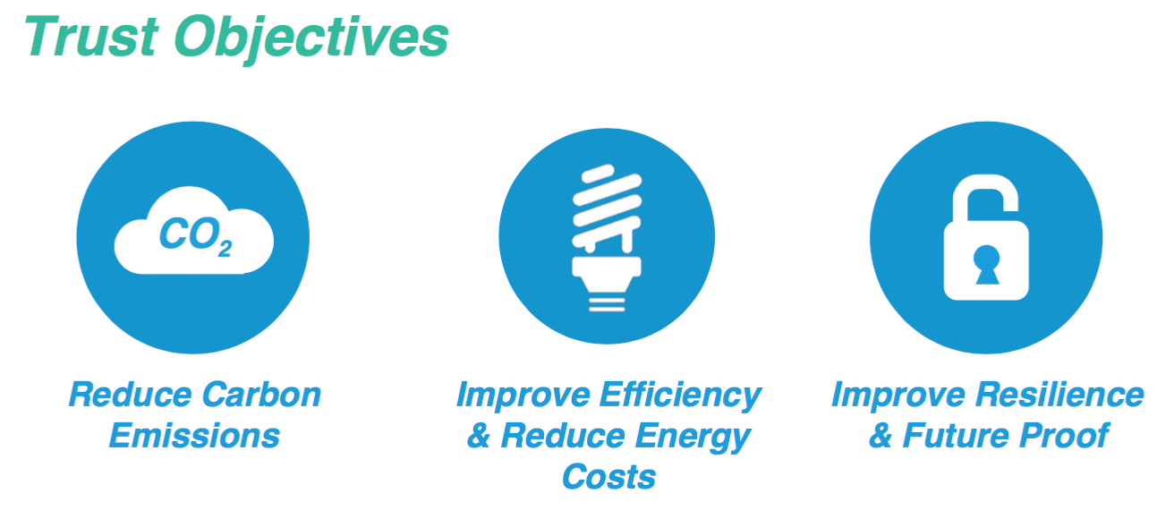

Slide 28
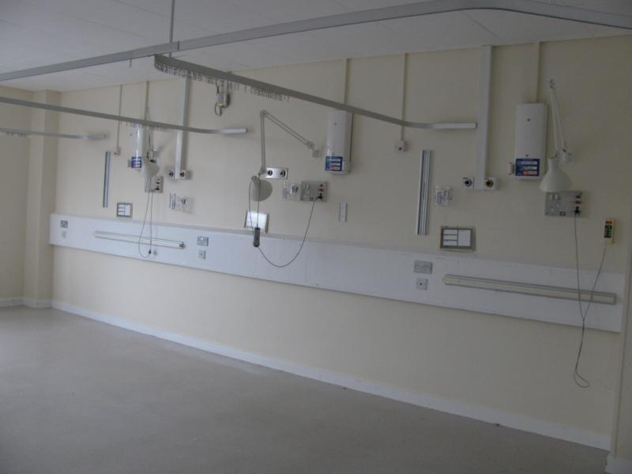
Future Ward Solution
The opportunity?
Ward refurbishment over 8 years
Vision of CEO – hospital of the future
Unmet need?
A ‘step change in the patient experience’
Ultra efficient lighting, future ready, progressive improvements
Cost effective - whole life costs
Efficiency, quality and sustainability

Slide 29
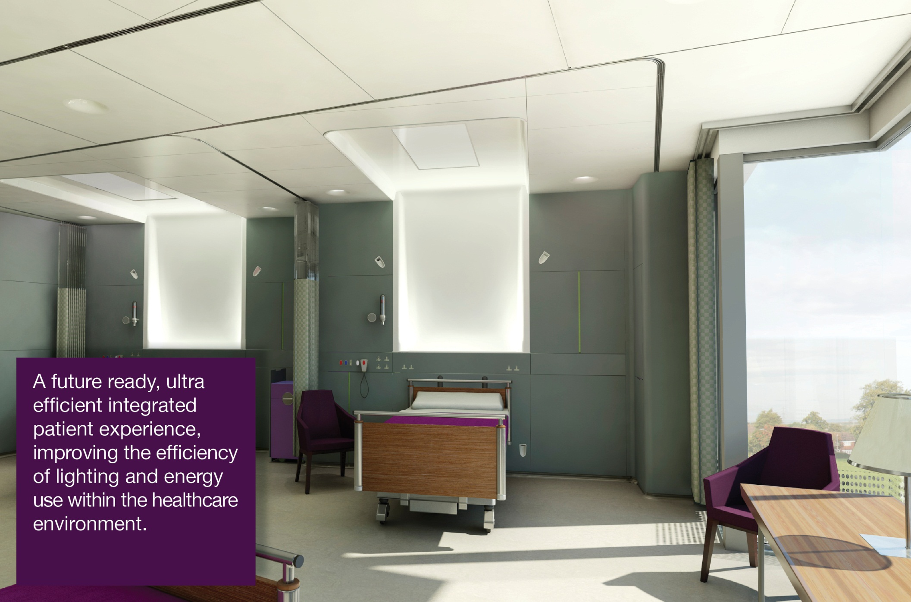
The Pilot Projects
The Rotherham NHS Foundation Trust, UK

Slide 30
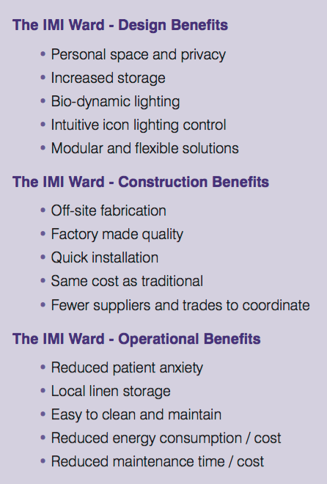
Outcome?
New off-site built solution
Future ready for LED / OLED
Same price installed as traditional refurbishment
Lower operational cost
Innovation?
New product with LED, and OLED Lighting Off-site build
And……new SME formed
WINNER – Lux Lighting Award
Notes:
We have 12 project partners consisting of hospitals, innovation agencies and innovation procurement experts.

Slide 32
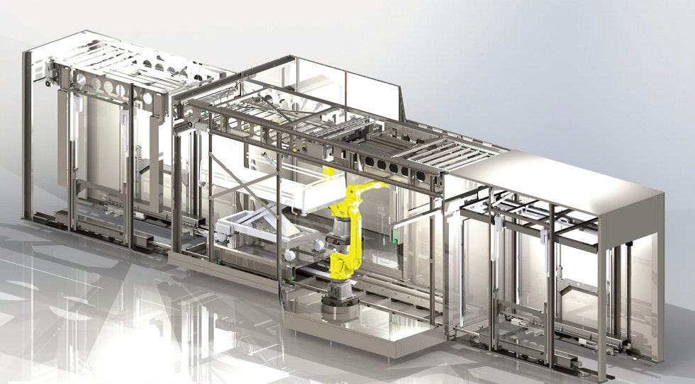
Robotic Bed Washing Facility

Slide 33
Messages from EQ workshop: Enabling factors?
New regulations, increasing profile of innovation procurement
PPI Platform and new case examples
The type of action was (really) important….
Coordination action and Co-financing
Focus on healthcare as a sector – not a technology or solution
Breadth of scope of the original call – allowed identification of genuine needs as part of the action
Support for capacity building and network development and local external facilitators
4.5 year project – change and innovation take time

Slide 34
Messages from EQ workshop Innovation Procurement into practice?
Requires new thinking and new approaches to procurement - a cultural shift
Procurement needs to be seen as a a strategic function
Change within large complex organisations is difficult. And takes time. But is possible.
Innovation procurement is still new and creating capacity and capability will take time and the right support measures and appropriate funding structures
Don’t over specify solution or process – allow room for innovation and new approaches by the ‘procurers’
The PPI v PCP dilemma

Slide 35
Now…......?
“How interesting…this could really help us......so tell me all about these case studies....”.

Slide 36
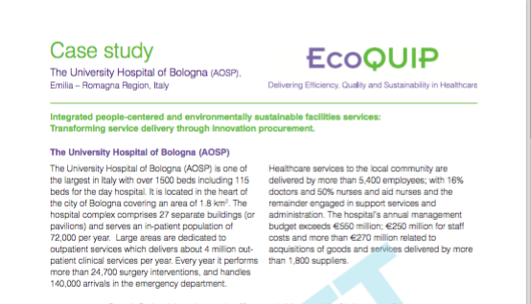
EcoQUIP case study based final report published later this month: www.ecoquip.eu
gaynor.whyles@jeraconsulting.com

Slide 37
Thank you!
www.ecoquip.eu
gaynor.whyles@jeraconsulting.com

Slide 38
Spectrum of innovation procurement?
Fund supply side research
Stimulate supply side
Trails and Demonstrations
Early adopt
PCP = Pre-Commercial Procurement
Customer funds / directs research towards developing essential goods and services to meet an unmet need / requirement
PPI = Public Procurement of Innovation
Creating opportunities and market conditions for suppliers to develop and / or supply innovative or new to market goods and services

