Slide 1
The eafip initiative
Riga, 9th of June 2016

Slide 2
Context of eafip
What is Europe’s 2020 strategy ?
Why is innovation important ?
What is the role of public procurement ?
How can the eafip initiative support you ?

Slide 3
Europe’s 2020 strategy
Smart
Sustainable
Inclusive
Innovation
Education
Climate/
energy
Employment
Social inclusion
Notes:
Interrelated targets: Europe 2020 – A strategy for a smart, sustainable and inclusive economy.
invest 3% of the EU’s GDP in R&D
Education: 40% of the younger generation a tertiary degree;
Climate/energy: reduction of greenhouse gas emissions by 20 - 30% (as compared to 1990); share of renewal energies 20%; 20% increase in energy efficiency;
Employment: 75% of the population employed;
Social inclusion: 20 million less people at risk of poverty;
EU states -> very divers

Slide 4
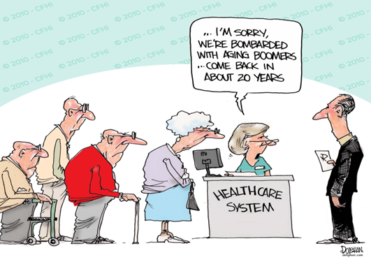
Europe’s 2020 strategy
LONG-TERM CHALLENGES:
*competitiveness *scarcity of resources *aging population
CHOICE:
Regain competitiveness, boost productivity;
Slow uncoordinated pace of reform --> high levels of unemployment and social distress.
Notes:
Globalisation (competition): Countries such as China or India are investing heavily in research and technology in order to move their industries up the value chain and "leapfrog" into the global economy. This puts pressure on some sectors of our economy to remain competitive, but every threat is also an opportunity. As these countries develop, new markets will open up for many European companies.
Resources: Strong dependence on fossil fuels such as oil and inefficient use of raw materials expose our consumers and businesses to harmful and costly price shocks, threatening our economic security and contributing to climate change. The expansion of the world population from 6 to 9 billion will intensify global competition for natural resources, and put pressure on the environment. The EU must continue its outreach to other parts of the world in pursuit of a worldwide solution to the problems of climate change at the same time as we implement our agreed climate and energy strategy across the territory of the Union.
Ageing: pressure on the welfare system, on the health care system.

Slide 5
Context of eafip
What is Europe’s 2020 strategy ?
Why is innovation important ?
What is the role of public procurement ?
How can the eafip initiative support you ?

Slide 6
What is innovation?
”connecting knowledge and technology with the exploitation of market opportunities for new or improved products, services and business processes ” (2006)
“when an invention is introduced commercially as a new or improved product of process” (Maclaurin, 1953)
”invention implemented and taken to market” (Chesbrough, 2006)

Slide 7
Why is innovation important?
Overcome the limitation of physical resources
New markets
New employment opportunities
Solution to challenges

Slide 8
Context of eafip
What is Europe’s 2020 strategy ?
Why is innovation important ?
What is the role of public procurement ?
How can the eafip initiative support you ?

Slide 9
Role of public procurement
Europe 2020 Flagship Initiative
Innovation Union
“The challenge is to use public procurement and public services to lead the way, shape the market for innovative solutions and equip society to meet the challenges of the future”.

Slide 10
Role of public procurement
Europe 2020 Flagship Initiative
Innovation Union
“From 2011, Member States and regions should set aside dedicated budgets for pre-commercial procurements and public procurements of innovative products and services. (…)
This should create procurement markets across the EU starting from at least €10 billion a year for innovations that improve the efficiency and quality of public services, while addressing the major societal challenges.”

Slide 11
Role of public procurement
National processes:
- Administrative task;
- Small scale;
- National competition.
European coordination:
- Integrate the EU public markets;
- Improve value for money;
Smart use of procurement:
- Professionalization;
- Economies of scale;
- Innovation;
- Sustainability.

Slide 12
Strategic objectives & Procurement
Innovation Procurement
Legislation
Policy
Funding

Slide 13
Strategic objectives & Procurement
Barriers to innovation procurement:
Lack of knowledge and capabilities
Disconnection between public procurement and innovation policy objectives
Risk aversion

Slide 14
Context of eafip
What is Europe’s 2020 strategy ?
Why is innovation important ?
What is the role of public procurement ?
How can the eafip initiative support you ?

Slide 15
eafip INITIATIVE
Toolkit
Free assistance
Workshops&
Conferences

Slide 16
Stephan Corvers
Corvers Procurement Services b.v.
Email: s.corvers@corvers.com

