Slide 1
IMAILE
Europes first PCP - Education
Ellinor Wallin Project Manager

Slide 2
AGENDA AND CONTENT
PCP from demand perspective
Background and why PCP approach
IMAILE PCP in a nutshell
Challenges and lessons learned
PCP benefits
IMAILE suppliers

Slide 3
Background – WHY
Digital reform in Education
2010 – 2012 SMILE Interreg project ICT / STEM infrastructure
Keys for succés: infrastructure, devices, internet Connection , training teachers & students, ICT solutions ( software, apps)
DEVELOPMENT OF INNOVATIVE ICT BASED UPON REAL NEEDS
2013 Prestudy -identify mid / longterm Education Challenge
PCP as a tool ICT 2013 8.2.a submission 16 / 4 2013

Slide 4
IMAILE in a nutshell
February 2014 – January 2018
10 partners in 7 countries
4 partners Buyers Group ( Se, Fi, De, Es)
Support organisations PCP, ICT and Dissemination
First PCP (Pre-commercial Procurement) of Education at EU level
Total budget 5.5 million euro
Funded by EC ( 75%) and procurers ( 25%)
Challenge - increased demand of personalised learning

Slide 5
IMAILE Consortium
Procurers
PCP experts
ICT experts
Dissemination experts

Slide 6
IMAILE CHALLENGE
INCREASED DEMAND OF PERSONALIZED LEARNING
How can innovative technology support ONE teacher to adress each student ( average 23 ) on personal level according to their needs , interests, motivation and skills in STEM subjects?
Dreams of an astonaut career
Speaks only Romanian
Can mulitiply like a 8 grader
Loves basket
Never completes her Math tasks
Has Dyslexia

Slide 7
Or according to Einstein…

Slide 8
IMAILE PCP METHODOLOGY
PHASES | CONTENT | FOCUS
1 | Phase of needs- assement | Buyers group needs is always in priority
2 | Phase of market analysis | Market analysis desktop Events and workshops
3 | Phase of Innovation Gap | Confirm a PCP approach
4 | Phase of Launching the PCP call | Open call for tenders on TED
5 | PCP in 3 stages | Monitoring and dialogue in 3 stages
6 | Standardization | Two final PLE/ STEM solutions ready for PPI

Slide 9
Status IMAILE May 2017

Slide 10
Lessons learned
Challenge | Solutions
Network / partners | Important with PCP skills within consortium
R&I as public procurer ( local, regional) | Important to scout R&I skills into the consortium . Create a role as Technical manager to support Coordinator and project manager.
Contractual aspects | Create a role of Contract manager to monitor and support Coordinator / Project manager
Identify PCP challenge | Workshop, surveys during proposal stage. Make sure to have a common understanding of the Challenge/ problems to solve in all countries.
Analyze the global market | Create Open market consultation strategy, involve the industry early
Dialogue demand / supply side | Steer the process early & explain your needs. Challenge Brief in focus .
Stand alone PCP projects | Use support from ”PCP familiy ” EC events, PCP meetings IMAILE provides newsletters, inspiration, material and final report with Acrued knowledge of the PCP process

Slide 11
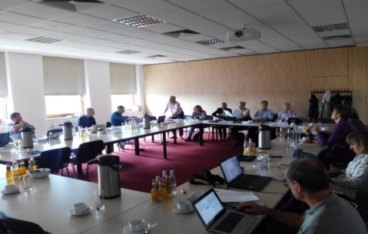
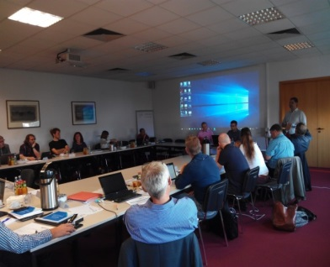
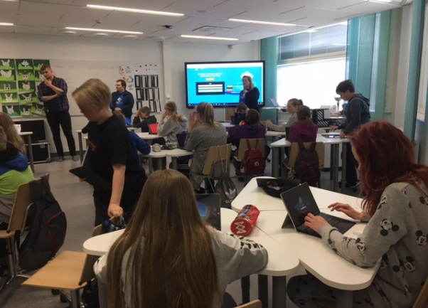
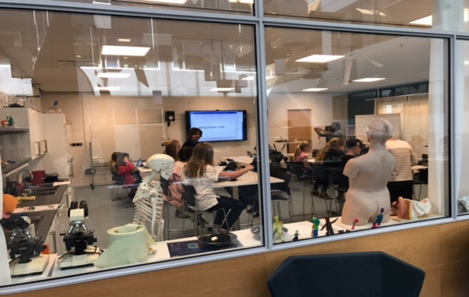
Greatest advantages of PCP
Public organization in driver´s seat of innovation – “we don’t always know where we are going but we like to be in the drivers seat of innovation for our schools”
Demand and supply side dialogue
Testing with real end users and in real environments ( schools)

Slide 12
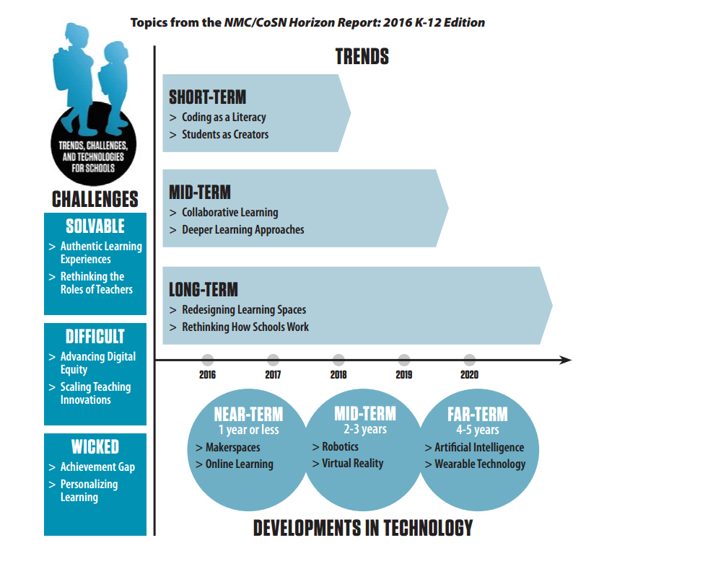
State of the art Challenge 2017
Increased demand personalized learning
Provide personalized learning to all students
Reduce teacher planning/ administration time?
Increase STEM motivation among students
Prevent Early dropouts
Inspire students to STEM future carereers

Slide 13
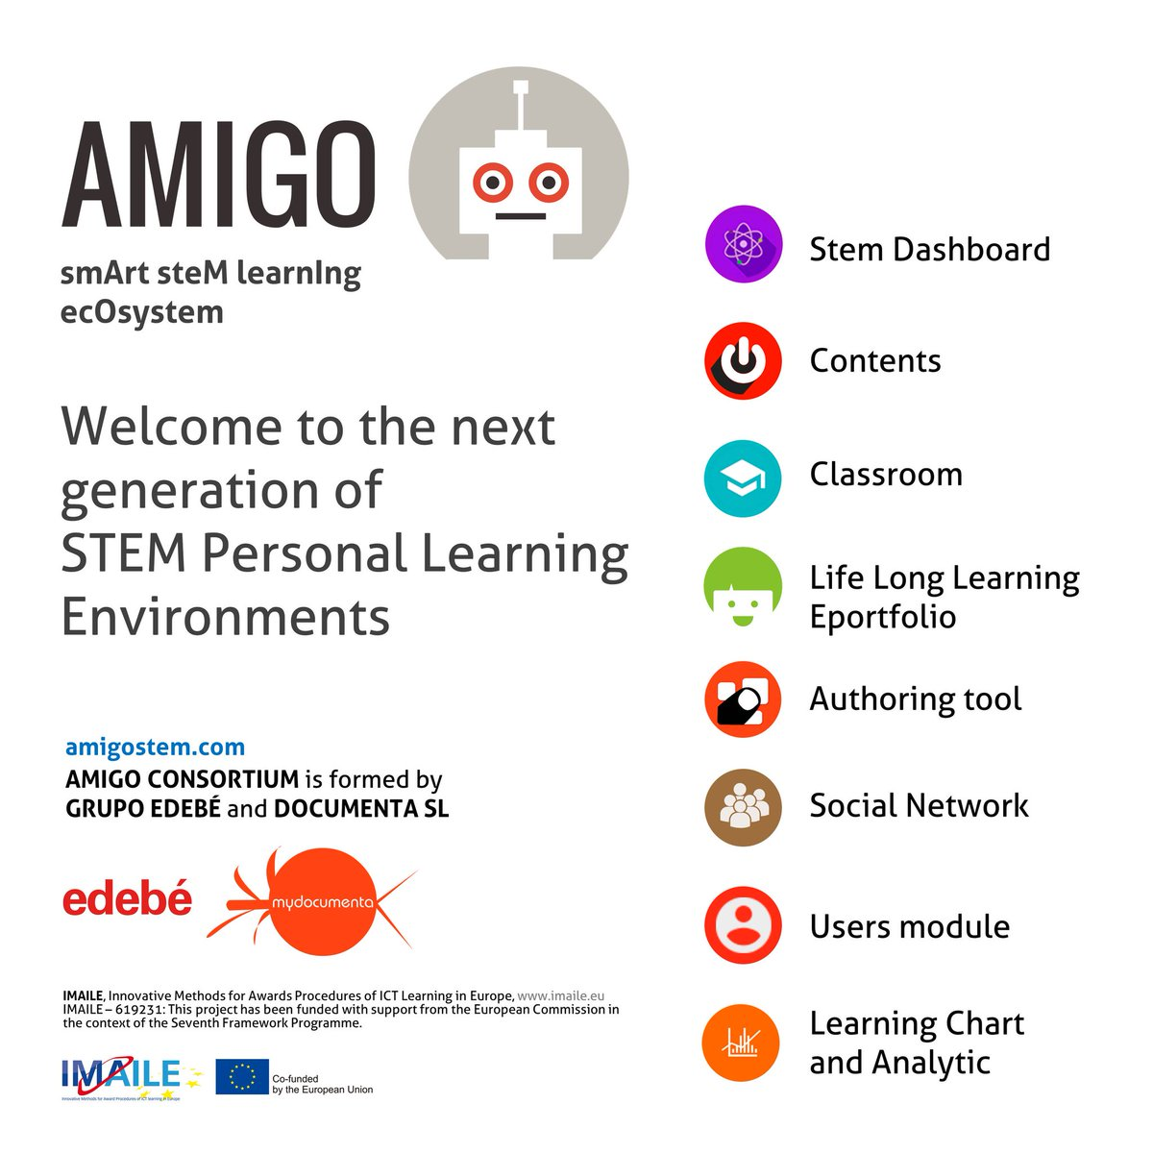
Two innovations based upon IMAILE challenges

Slide 14
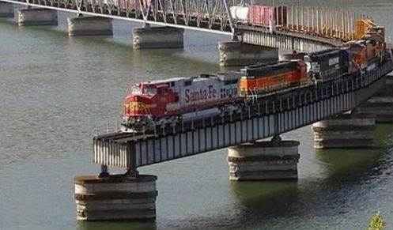
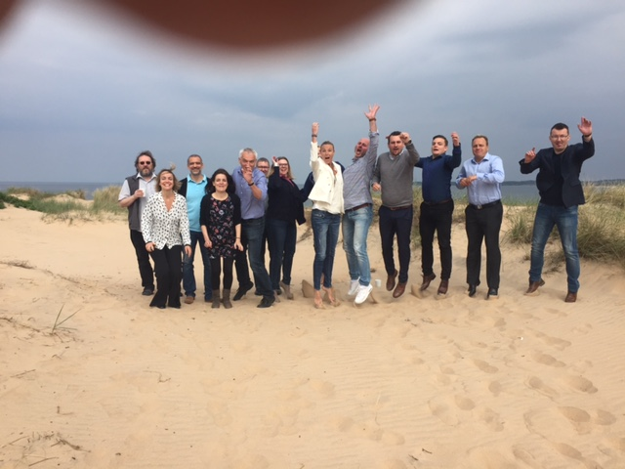
SUMMING-UP & GOOD LUCK
Sign up to our Newsletters ,follow us at LinkedIn, Twitter & stay tuned for lessons learned !
Follow LEA-N project proposal and join as observer city 2018 – 2020
Dissemination is important to us please contact to arrange a PCP event
http://www.imaile.eu
@imaileproject
Project manager - Ms. Ellinor Wallin:
ellinor@euprojektkonsult.se

