Slide 1
aims at a
holistic ecosystem
providing the next generation of
Personal Learning Environments (PLE) with multiple functions
to attract interest
towards STEM fields.
+
AMIGO CONSORTIUM is formed by
Magdeburg, September 2016
IMAILE – 619231: This project has been funded with support from the European Commission in the context of the Seventh Framework Programme. http://www.imaile.eu

Slide 2
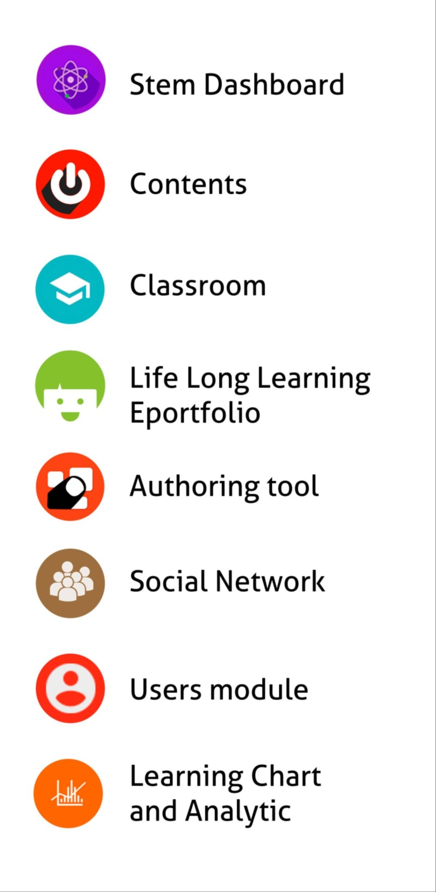

Slide 3
How AMIGO faces IMAILE challenges
1. INCREASING STEM MOTIVATION
The gamification system engages students and avoids their lack of interest in STEM as it stimulates positive competition, rewards the effort and allows to:
achieve goals
improve the ability to formulate short- and medium-term objectives
find the resources to achieve them
The new social network allows students to collaborate when performing STEM activities or projects.
EDEBE + MYDOCUMENTA + GRADIANT

Slide 4
How AMIGO faces IMAILE challenges
2. PERSONALIZED LEARNING APPROACH
The individual STEM profile and the eportfolio (powered by analytics):
Provides learners with useful information to personalize learning.
Helps students to control their learning.
The intelligent tutoring system allows students to reinforce their learning pathway based on their performance so they can:
Improve weaknesses and gaps in STEM learning
Leverage student’s STEM interests
EDEBE + MYDOCUMENTA + GRADIANT

Slide 5
How AMIGO faces IMAILE challenges
3. DEMAND OF STEM PROFESSIONALS
The eportfolio allows students and teachers to:
Create their own curriculum based on STEM resources, personal experiences and lessons learned.
Personalize public or private views to share with STEM teachers, recruiters, classmates, etc.
Monitor STEM skills, strengths, and weaknesses to focus their priorities.
EDEBE + MYDOCUMENTA + GRADIANT

Slide 6
How AMIGO faces IMAILE challenges
4. A SPACE THAT HELP ESL
Tutoring system ensures students at risk receive the support they need in a timely manner.
Teachers can create learning environments through individual support and flexible learning pathways.
Helping families to support their children’s education by following their learning path.
Creative, collaborative and social approach to learning that motivates students and rises overall satisfaction.
Gamification stimulates positive competition and rewards the effort and the ability to achieve goals, to formulate short– and medium-term objectives and to find the resources to achieve them.
The STEM EDP helps students to reinforce the idea that they can take control over their learning.
Increases the percentage of students’ ability to learn in contexts other-than–school.

Slide 7
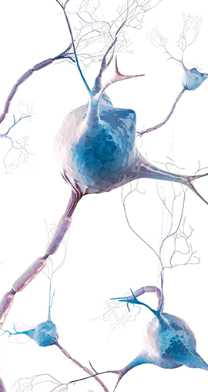
R&D: ACTIVITIES DEVELOPED DURING THE IMAILE PCP
IMAILE PCP challenge has provided the opportunity to enrich the ecosystem altogether with two ed-tech partners by:
Converting the innovative, secure and modular cloud ecosystem platform accessible from different devices and fulfilling the requirements of scalability, mobility, portability and interoperability.
Interconnecting a wide variety of tools to empower STEM learning through enhancing motivation, creativity, curiosity and social iteration.

Slide 8
What do teachers think?

Slide 9
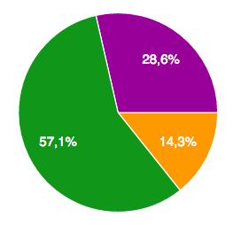
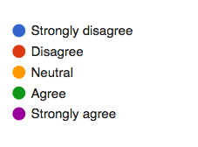
Support of Individual learning paths
AMIGO provides a personalized delivery of training, content and suggestion of goals, in order to achieve progress in a seamless entertaining way.

Slide 10
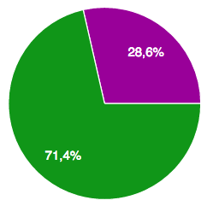
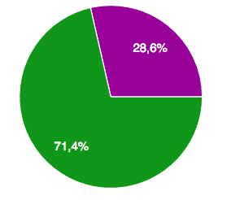
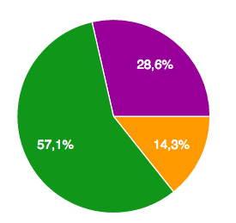
Increased Motivation to learn STEM topics
AMIGO helps students to reinforce the idea that they can take control over their STEM learning process with social and motivational activities.
Support of Individual learning paths
AMIGO provides a set of attractive tools that enhances the interest of students and teachers to STEM subjects, based on its personalized delivery of training, content and suggestion of goals, in order to achieve progress in a seamless entertaining way.
STEM Dashboard
eportfolio
AT

Slide 11
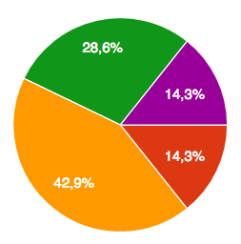
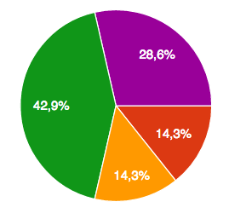
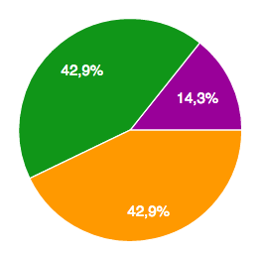
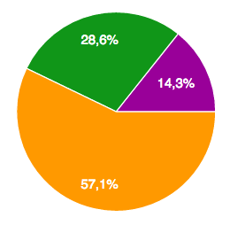
Time reduction for course/class planning and preparation
Creation and personalization of educational contents, activities, tests, group management and attending students’ needs is easier for teachers.
PLE
STEM Dashboard
ePortfolio
AT

Slide 12
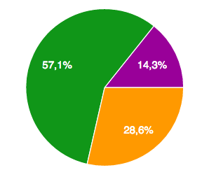
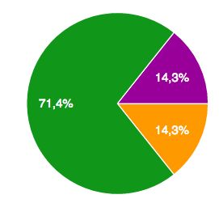
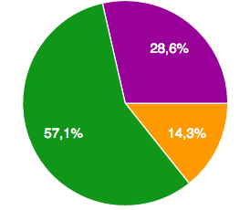
Assessment support
It helps students to know themselves better: their strengths, weaknesses and potential risks, reinforce their interests and discover new opportunities in STEM domain.
PLE
STEM Dashboard
ePortfolio

Slide 13
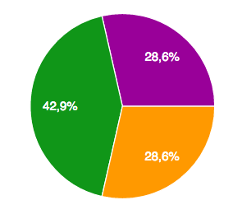
Monitoring and Reporting of learning process.
AMIGO helps to monitor the learning process and take the best actions to positively impact it.
Assessment & Communication
PLE
STEM Dashboard
ePortfolio

Slide 14
Creating a positive learning environment that empowers students in STEM is critical to preparing the next generation for the future.
Our challenge in developing AMIGO is to turn students’ interest into action and make STEM the winner in the competition for their attention when it comes to career choices.
Fostering young people’s STEM literacy is a turning-point strategy for carrying Europe’s ideals of equal opportunity and shared prosperity well into the 21st century.
SUMMARY
Creating a positive learning environment for STEM is critical to preparing the next generation for the future.
Our challenge in developing AMIGO is to turn students’ interest into action and make STEM the winner in the competition for their attention when it comes to career choices.
Fostering young people’s STEM literacy is a turning-point strategy for carrying Europe’s ideals of equal opportunity and shared prosperity well into the 21st century.
Valhallaskolan students, AMIGO Pilot in the University of Halmstad
EDEBE + MYDOCUMENTA + GRADIANT

Slide 15
Thank you very much
AMIGO CONSORTIUM is formed by the companies
+
IMAILE – 619231: This project has been funded with support from the European Commission in the context of the Seventh Framework Programme. http://www.imaile.eu

