Slide 1
CLOSEYE PROJECT
Lessons learned from CLOSEYE POV
Riga, 9th June 2016
PRESENTED BY: David Ríos (ISDEFE)

Slide 2
Introduction
The public sector faces important technology challenges which require transformation.
New collaboration mechanisms between public actors (operational perspective) and private actors (technological perspective) in order to increase market visibility:
New Public Procurement Mechanisms
  Needs Definition
  Identification of solutions
  New validation strategies
  Visibility of the OFFER
Visibility of the DEMAND
POV
PCP
PPI

Slide 3


CLOSEYE Project
FP7 Security WP 2012
  Topic “SEC-2012.3.1-2” Pre-Operational Validation
    Activity 10.3 – Intelligent Surveillance and enhancing border security (Sea Borders)
  Budget
    Total of 12 M€
    4.5 M€ for the call for tender
  The Consortium
    Public Authorities: GC (Coordinator), GNR, MMI
    Support: ISDEFE, ASI, EUSC,
  Other collaborating entities:
    FRONTEX, EDA, Icelandic Coast Guard,
    Italian Ministry of Interior
~75% EC funded

Slide 4
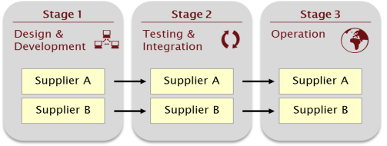

Introduction
The POV model
CSA
CP
CSA
Phase1
Needs Analysis
+
Market Research
+
Validation Strategy
+
Tender Preparation
Phase 2
Tendering process
Contract execution
Phase 3
Assessment
+
Conclusions
+
Recomm.
R&D SERVICE

Slide 5
Introduction
CLOSEYE Project promotional video
https://youtu.be/TbtvoEXEas0

Slide 6

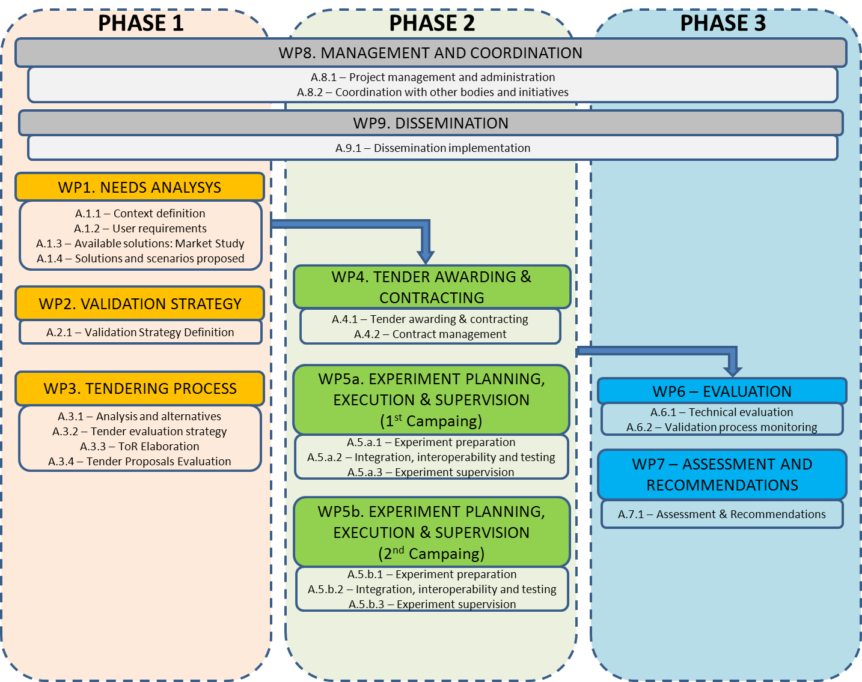




CLOSEYE Phases and Key Activities

Slide 7
CLOSEYE Phase 1

Slide 8

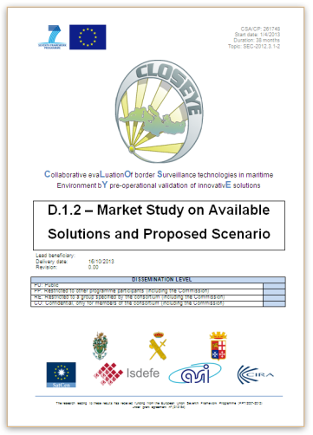
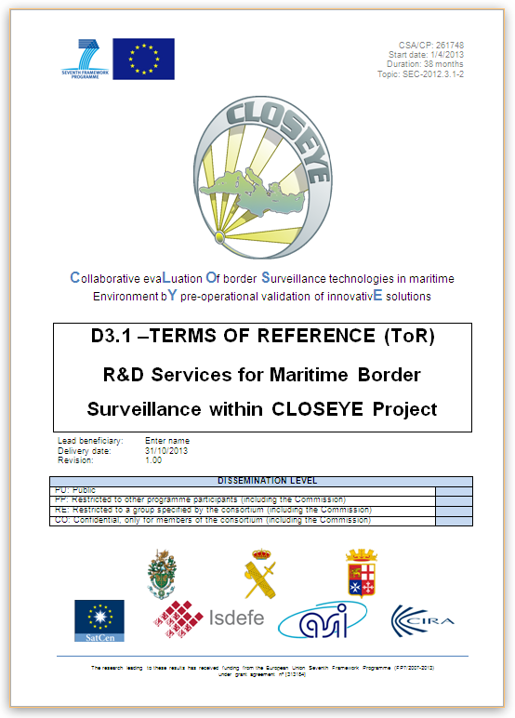
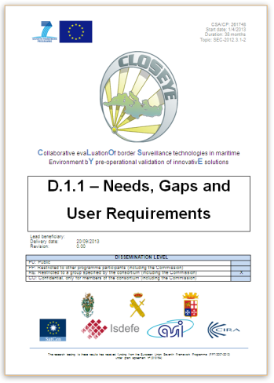
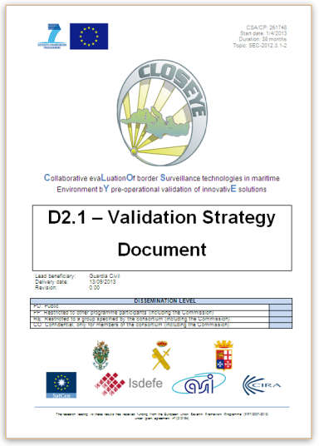

Phase 1 Outcomes
The CLOSEYE Requirements
  Terms of Reference document

Slide 9
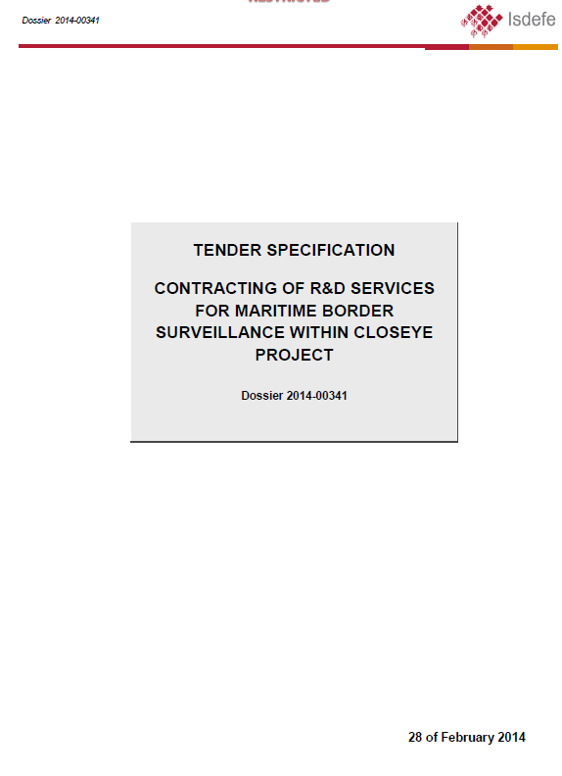
Phase 1 Outcomes
Tender Specification document
  Purpose of the tender and legal regime;
  Structure of the tender;
  Terms and conditions;
  Total budget
  Budget distribution per lot;
  Awarding procedure;
  Award criteria;
  Deadlines;
  Invoicing and payment;
  Etc...

Slide 10
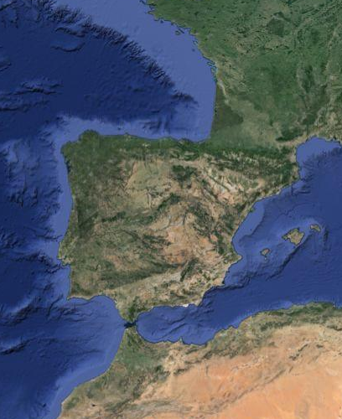
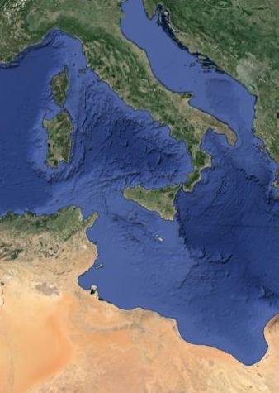
Scope of the Contract
Open Call for Tenders
  For Research and Development Services for the Pre-Operational Validation of Common Application of Surveillance Tools
  Maximum budget available: 4.533.656 €
  Tender divided into 2 independent lots, each associated to a different scenario.
LOT 2
Max Price
2.266.828 €
LOT 1
Max Price
2.266.828 €
ALBORAN SEA
SCENARIO
CENTRAL MED.
SCENARIO
SOLUTION A
Company A
SOLUTION C
Company C
SOLUTION B
Company B
SOLUTION D
Company D

Slide 11
CLOSEYE Organisation
Management Structure: CVE Constellation
CB: Contracting Board
  Accountable for the definition of the terms and conditions for the Tendering process.

Slide 12
CLOSEYE Organisation
New elements of the POV model
  The organization: The Common Validation Entity (CVE)
      Appointed by the Users (partners)
      To conduct the joint validation with a joint mandate and joint resources of all public purchasing authorities;
      To coordinate the tendering process and evaluate the proposals;
      To award the CLOSEYE Contract to the selected companies following the approval and decision of the Contracting Board
CSA
CP
CSA
Phase 1
Needs Analysis
Tender Preparation
Phase 2
Contracting
Experimentation
Phase 3
Evaluation
Assessment
Recommendations
Services
INDUSTRY

Slide 13
CLOSEYE Organisation
Governance Rules defined in contractual documents:
    Grant Agreement
    Consortium Agreement
Control mechanisms established by the CB:
    approval of the Tender Specifications proposed by the CVE;
    approval of the proposal evaluation criteria;
    approval of the proposals received;
    approval of the proposal evaluation results;
    approval of the awarding and contracting decision.
Final go ahead for the CVE to formalize the CLOSEYE Contract has been stated in the deliverable D4.1 – Contract Acceptance.
The Consortium Members explicitly agree that all liabilities arising out from or in connection with the Tendering Process and the Awarding and Contracting Process shall be joint and severally assumed by all Consortium Members.

Slide 14
Tendering process calendar
PUBLIC
RESTRICTED
STEP 1
STEP 2
TENDER PUBLICATION (ToR Public Version)
SOLVENCY EVALUATION
ToR RESTRICTED VERSION DELIVERY
&
PROPOSALS RECEPTION
TENDER PROPOSALS EVALUATION AND AWARDING DECISION
CONTRACT FORMALIZATION AND SIGNATURE
40 days
15 days
45 days
Maximum 2 months
28th FEB’14
9th APR14
23th APR’14
9th JUN’14
24th JUL’14
End AUG’14
Deadline for submitting the required documentation for STEP 1
Deadline for submitting the technical and economical proposals
Tender documentation wide publication:
  Tender Specification
  Public version of ToR
  Annexes
Deliver the restricted version of ToR to the selected companies
CLOSEYE Contracting Board: Proposals evaluation and awarding decision

Slide 15
Tendering Process Results
Participation figures:
  Total number of 8 proposals received
  Six Proposals moved to Step 2
    2 proposals for Lot 1
    4 proposals for Lot 2
  Companies participating in the Tendering Process:
    14 as main contractors
    >20 as subcontractors
 | Lot 1 | Lot 2
Maximum contract price (exc. VAT) | 2.266.828 EUR
Lowest proposal | 2.200.630 EUR | 2.153.486 EUR
Highest proposal | 2.256.913 EUR | 2.256.913 EUR

Slide 16
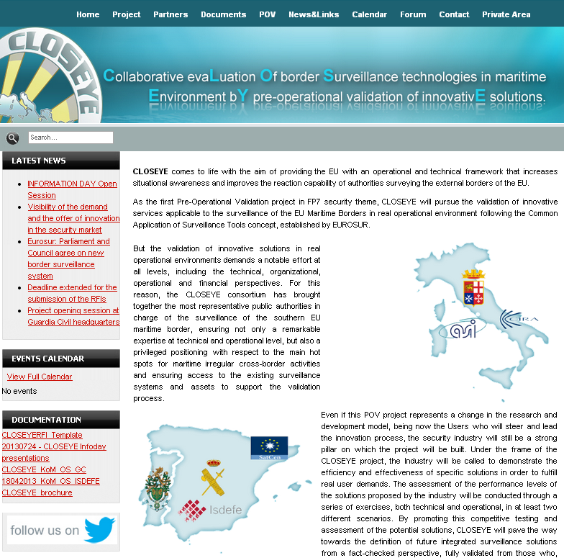
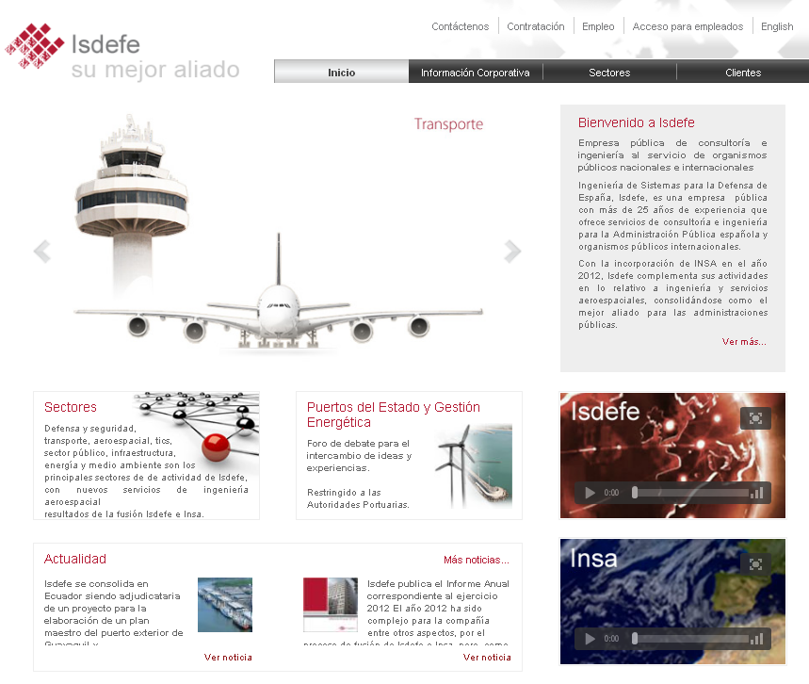
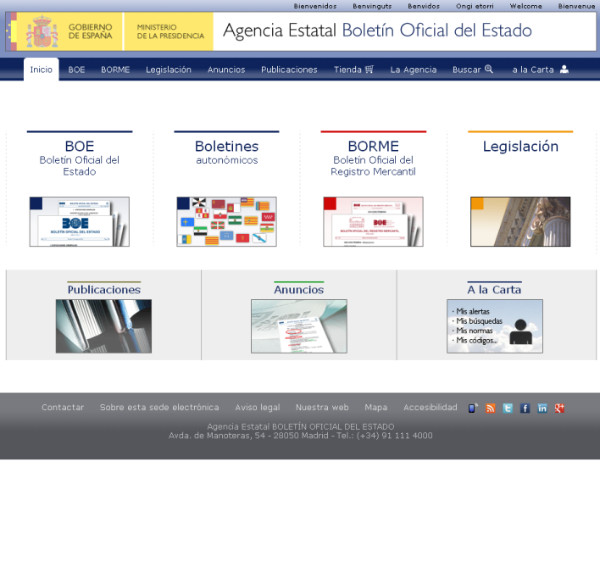
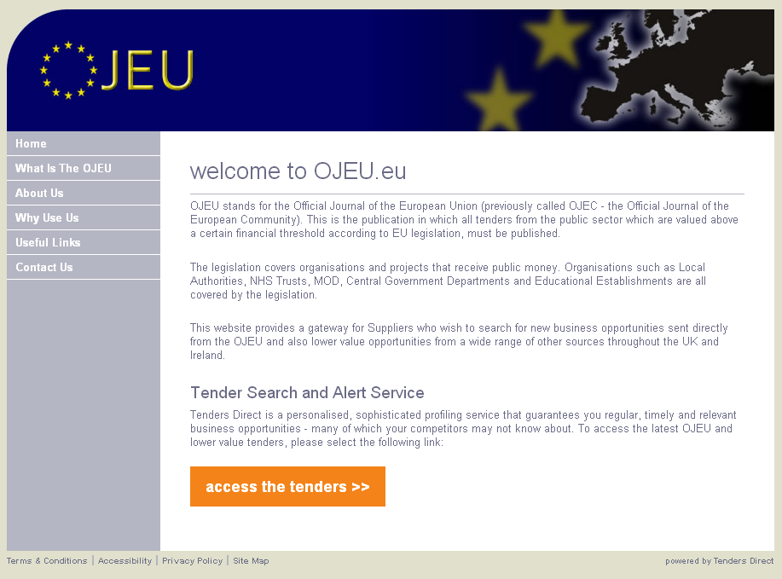
Tendering Process Transparency
Publication
  “Public purchasers shall ensure EU wide publication for the POV call for tender”
CLOSEYE Website
ISDEFE Website
Spanish Procurement Platform
Official Journal of the EU*
* http://ted.europa.eu/udl?uri=TED:NOTICE:73688-2014:TEXT:EN:HTML&amp;tabId=0&nbsp

Slide 17
CLOSEYE Phase 2

Slide 18
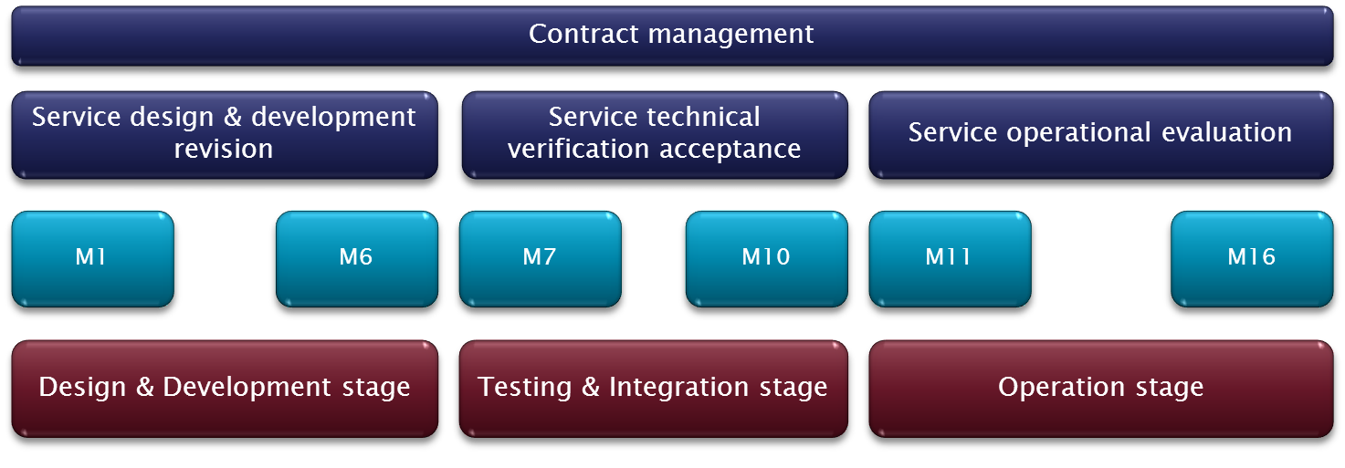
Contract execution
Apr.’13
Jul.‘14
Aug.‘14
Dec.’15
Jan.’16
Oct. ’16
Phase 1
Needs Analysis
Public Tender
Phase 2
Contract Execution
Pre-Operational Validation
Phase3
Evaluation
Recommendations
Service
INDUSTRY
Contractors in Phase 2

Slide 19
Contract execution
Apr.’13
Jul.‘14
Aug.‘14
Dec.’15
Jan.’16
Oct. ’16
Phase 1
Needs Analysis
Public Tender
Phase 2
Contract Execution
Pre-Operational Validation
Phase3
Evaluation
Recommendations
Contract Management
Design Supervision and acceptance
Implementation supervision and acceptance
Integration
Testing
Logistics
Operation
Validation
And more……
End-Users in Phase 2

Slide 20
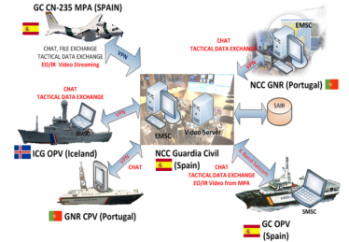

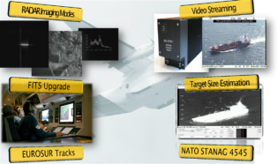

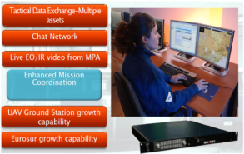



CLOSEYE Solutions
LOT 2
SOLUTION 1
Main features
    CN-235 GC01 MPA Improvements;
    MPA Enhanced Mission Support centre with improved communications with patrolling assets.
    Shipborne MPA mission support centre, enhanced communications and common tactical situation picture (SP, IC)
    Compact S-MSC (PT)
    Integration at SP and PT NCCs.
ALBORAN SEA
COMPLETED
Solution design and development
COMPLETED
Integration and Verification
COMPLETED
Operational Stage

Slide 21
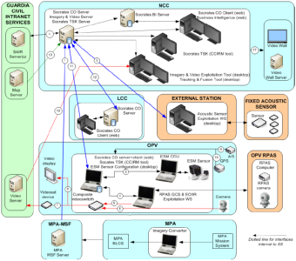

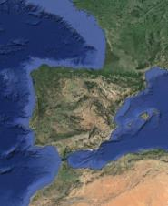
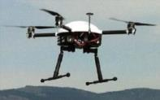
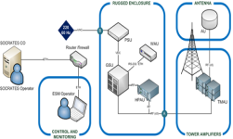
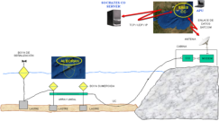
CLOSEYE Solutions
LOT 2
SOLUTION 2
Main features
    Acoustic sensor & ESM systems.
    Small quadricopter RPA system to be deployed from OPV.
    Integrated C3 System to be installed at Coordination Centres and patrolling vessels, including:
    Databases, Business intelligence module, CCIRM, sensor exploitation tools;
    System integration at Spanish and Portuguese NCCs and assets.
ALBORAN SEA
COMPLETED
Solution design and development
COMPLETED
Integration and Verification
COMPLETED
Operational Stage

Slide 22
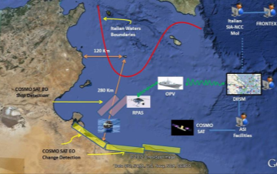

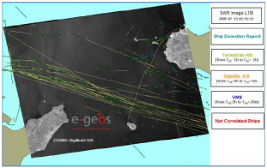
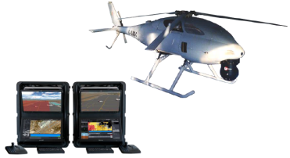

CLOSEYE Solutions
LOT 1
SOLUTION 1
Main features
    Integration of enhanced change detection and vessels detection services through EO Satellite Surveillance;
    Extended sensing and reaction capabilities through the use of projectable RPA System;
    EUROSUR data model assimilation;
    High level of integration at CNISM level.
CENT. MED.
COMPLETED
Solution design and development
COMPLETED
Integration and Verification
ONGOING
Mar’16 – Jun’16
Operational Stage

Slide 23
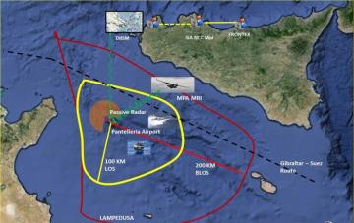

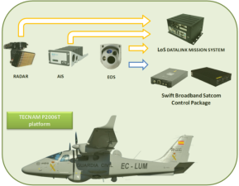
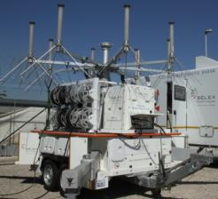
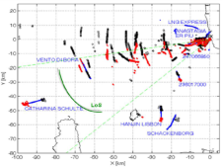
CLOSEYE Solutions
LOT 1
SOLUTION 2
Main features
    Cost-effective aerial surveillance solution through the use of the P2006T MRI platform;
    Increased detection range by means of a passive DVBT Radar solution;
    EUROSUR data model assimilation;
    High level of integration and track management at CNISM level.
CENT. MED.
COMPLETED
Solution design and development
COMPLETED
Integration and Verification
COMPLETED
Operational Stage

Slide 24
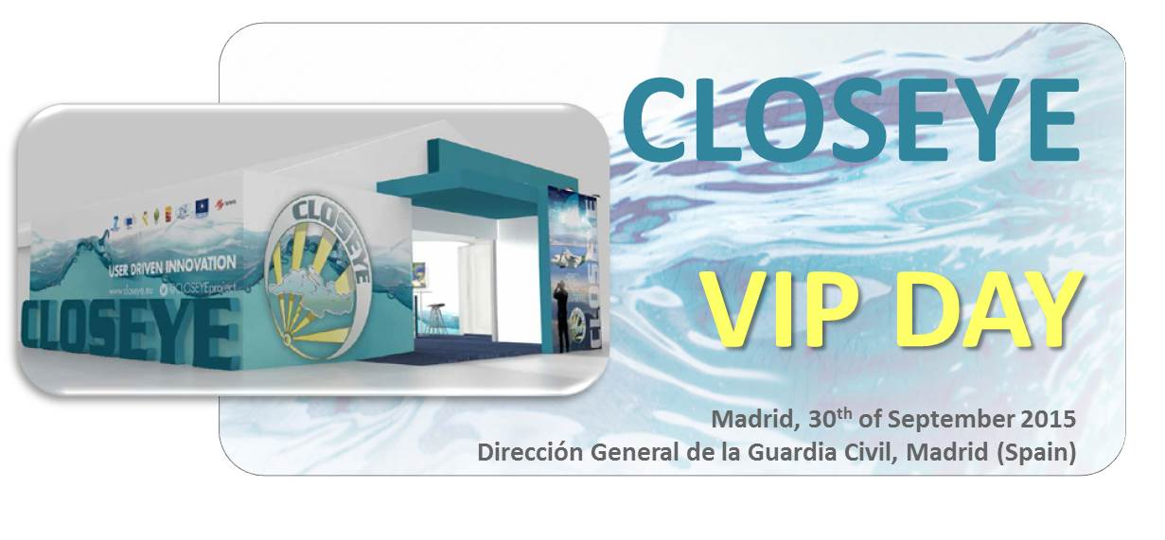
CLOSEYE VIP Event 2015
Event held at GC Headquarters (Madrid), on the 30th of September 2015
Objectives:
  Formal opening of the operational experimentation stage to be carried out at the Alboran Sea Scenario (Op. INDALO 2015)
  Disseminate the results achieved so far during, including as well the result of the first operational campaign conducted in Italian waters during June and July
Participants
  Project Partners;
  MS Authorities;
  European Commission;
  EU Agencies;
  Industry
http://www.closeye.eu/index.php/news/closeye-news/123-vip-day
Presentations Here

Slide 25
CLOSEYE Phase 3

Slide 26
CLOSEYE Phase 3
Work in progress:
  Harmonization of tools and methods;
  Definition of reference levels for the evaluation of the operational relevance of the systems;
  Assessment of the technological maturity of the developed solutions and their proximity to the market;
  Evaluation of the operational relevance of the developed solutions and determine if they are:
    Adequate and ready to use;
    Adequate but require additional development;
    Not valid in their current status, but potentially valid if certain modifications take place (both in the system or in the context);
    Not valid for their use in maritime border surveillance under the conditions featured in the CLOSEYE experiment;
  Identify the costs associated to the lifecycle of the solutions;
  Analyze the road to market and potential business models;

Slide 27
CLOSEYE Phase 3
Provisional assessment – Lessons learnt:
  The level of satisfaction of the CLOSEYE partners with the developments carried out by the contractors is high.
  Validation of surveillance technologies in real operational scenarios has proved to be the only way to guarantee a reputed assessment of their operational relevance;
  The tasks required to conduct realistic pre-operational validation activities are equivalent to a real deployment of a system, but with several implications (impact in daily operations, security constraints, integration constraints, …)
  The effort required was way above the initial expectations;
  Close cooperation between Users and Industry has been considered as very positive by both parts, and it shall reverberate on a higher visibility of the demand and of the offer in the EU security market

Slide 28
Conclusions
The CLOSEYE experience has been seen as positive
by all participants (users, partners, industry).
Strong points:
  Harmonization of vision, criteria, procedures and terminology for a common challenge;
  Accelerated development based on real & urgent needs;
  Improved cooperation mechanisms among users from different Member States, and also between the supply side and the demand side: Building a more solid market.
“A strong effort has been made in consolidating a common understanding of the problem, which makes potential solutions valid also for other Users and applications (Common Application of Surveillance Tools)”

Slide 29
Conclusions
Margin for improvement:
  At Programme level:
    Consolidate a research strategy in maritime surveillance;
    Improve the tools available for the users to participate in the innovation cycle (technical, financial & programmatic)
  At Cooperation level:
    A stronger support from EC bodies and Agencies is required at different stages of the project (needs assessment, tendering process, operations, assessment…)
    More awareness on the project model and its goals and particularities is required among Public Authorities, End Users, Industry and Commission;

Slide 30
David Ríos Morentin
ISDEFE – Intelligence and Homeland Security
Email: drios@isdefe.es
https://es.linkedin.com/in/davidriosmorentin
www.isdefe.es

