Slide 1
Water
Public Innovation Procurement Policies
Contract number: 619069. Project duration: January 2014 – December 2016 This project has received funding from the European Union’s Seventh Framework Programme for research, technological development and demonstration under grant agreement no 619069.
The sole responsibility for the content of this publication lies with the Water PiPP project. It does not necessarily reflect the opinion of the European Union, which is not responsible for any use that may be made of the information contained therein.

Slide 2
Key Features
Gathering together experts and practitioners in the area of water procurement to facilitate exchange of knowledge
Acting as an information hub providing the latest and most relevant information about the procurement of innovative products and services in the water sector
Creating a community of practitioners who can openly discuss the procurement of innovative products and services in the water sector
Financed by: European Union – 7th Framework prog.
Duration: 1st Jan. 2014 → 31st Dec. 2016 (36 months)
Total Budget : 1,332,545 €

Slide 3
Partners

Slide 4
Objectives and WPs
Analysis of existing innovative procurement policies and practices (WP 1 – closed)
Development of strategy/methodology for transfer to the water sector with stakeholder consultations (WP 2 – closed)
Pilot Activities : Test the application in procurement preparation (WP 4 – ongoing with Viveraqua, CAP holding, Helsinki Region Environmental Services, Regione Puglia)
Development of guidance, training, workshops, webinars + Dissemination of lessons learnt (WP 4 + 5 – ongoing)

Slide 5
Schedule
2014
2015
2016
MS: defining the state of the art of IP practices and potential adaptation to water
MS: Collaborative platform
MS: Support to implement procurement strategies
MS: Support to implement procurement strategies
MS: Performing a collab. Pilot Innovative procurement preparation phase
MS: Performing a collab. Pilot Innovative procurement preparation phase
WP1 : Transferability of Innovation Oriented Public Procurement experiences to the water sector (UNIZAR)
WP2 : Involving the key stakeholders of the Innovation Procurement Chain (ARCA)
OBJECTIVES from networking to action by
Tackling pilots’ issues to implement Innovative Public Procurement
Providing support and expertise from the project
Discuss an action plan to collaboratively prepare these initiatives
WP3 : Capacity building and awareness raising (OIEau)
WP4 : Collaborative pilot procurement preparation phase (TEHA)
WP4 : Collaborative pilot procurement preparation phase (TEHA)
WP5 : Communication and dissemination (ICLEI)

Slide 6
Evidences: Bottlenecks for innovation in water sector (1/3)
1. Risk adversion of the water sector: The water service sector, as well as industrial sectors have a high capital-intensity and deal with high risk aversion for innovative technologies. Therefore there is a low preparedness to act as a innovator or launching customer for innovative processes or products. Due to health issues, this risk aversion is also prominent in the public regarding drinking water.
2. Lack of demonstration sites: There is a lack of demonstration sites for new technologies to customers and consumers due to the difficulty in pooling together a wide group of stakeholders acknowledging the benefits of innovation and also the capital-intensive nature of such large-scale demonstration in relation to their true economic value. But without a demonstration site there is no national market, and without a national market there is usually no international market. The reason of the lack of demonstration sites is very much linked to (1), the risk aversion of the water sector.

Slide 7
Evidences: Bottlenecks for innovation in water sector (2/3)
3. Inconsistency and fragmentation of policies and regulations: The water sector is characterized by a complicated regulatory environment along/across the various political hierarchy levels that result in fragmentation (e.g. different regulations and standards per region).
4. Water authorities and water sector fragmentation: At different levels the utilities responsible for water supply, wastewater, storm water, waste, and energy are independent of each other.
The water sector is highly fragmented and conflicting in policy, ownership and responsibilities.
As a result, there is only a low intensity of cooperation between the various sectors and thus potential synergies are not recognized or realized.

Slide 8
Evidences: Bottlenecks for innovation in water sector (3/3)
5. Conservative Procurement: Current approaches give preference to low/lowest cost offers neglecting longer-term operational or lifecycle costs, and to proven technologies, which therefore hampers the innovation processes. At the same time large part of the general public are aprioristically critical or skeptical on innovation procurement.
6. Little competitive tension on the market. Highly concentration on the market and inability of the traditional procurement tendering and contracting to foster the emergence of new players.

Slide 9
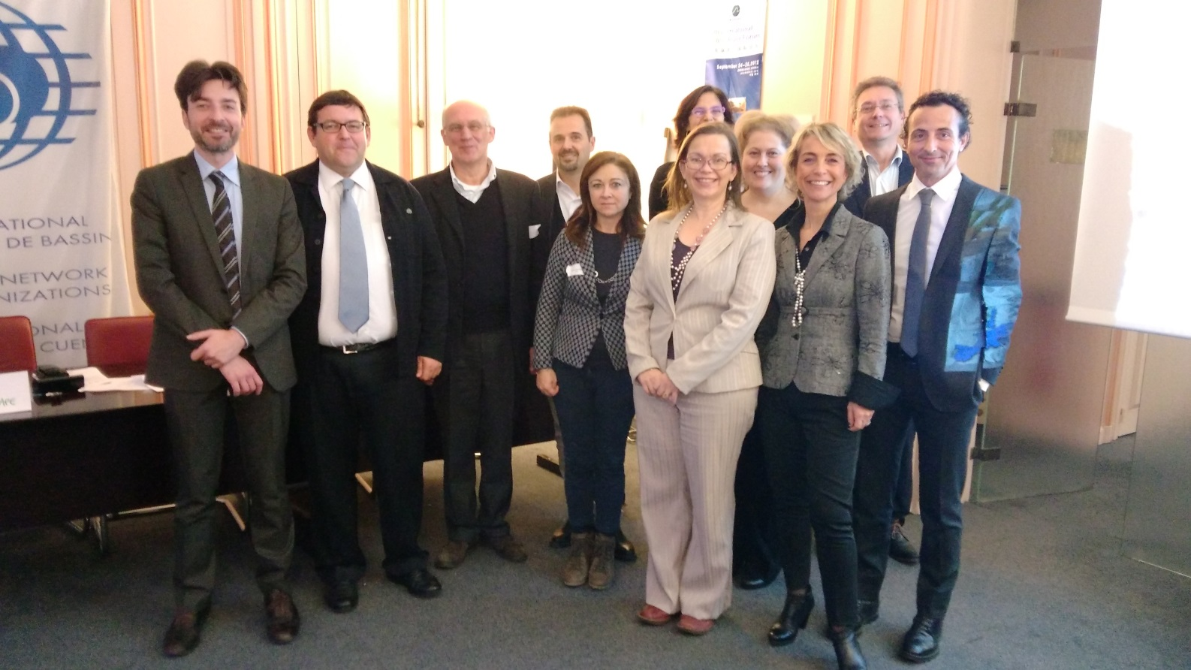
WaterPiPP has selected 4 pilots and is collaboratively working to launch future PCP and PPI
KOM in Paris with WaterPiPP pilots

Slide 10
WaterPiPP has selected 4 pilots and is collaboratively working to launch future PCP and PPI
Pilot area of interest | Desired Solution
Energy efficiency water distribution and wastewater collection, early leaks detection, refurbishment | KPI Analysis tool
Waste water treatment | Techology for reduction of extra sludge (impact and cost)
Water resources management | Analysis and decision support tool
Water distribution | Smart metering
Waste water management | System to optimize the management of collection system and treatment of waste water

Slide 11
Collaborative pilot procurement preparation phase: action plan
1
2
Pilot
3
4
Need description
Business case modeling
Market engagement and State of the art analysis
Procurement approach and instrument definition
Pilot
Buyer group enlargement
December 2015
February
2016
March
2016
April
2016

Slide 12
1
2
Key questions
Do we have a real problem/ concrete challenge that impact negatively on the quality and/or cost of public services offered?
Do exist a wide potential market (public and private) for the new solution desired?
Need description
Business case modeling
Market engagement and State of the art analysis
Procurement approach and instrument definition
Pilot

Slide 13
3
Key questions
How to dialogue with the market to assess the technology state of the art?
Is there a market gap (actual need versus solution currently available on the market)?
Are radical improvements and new breakthrough solutions needed (as opposed to incremental adaptations)?
Need description
Business case modeling
Market engagement and State of the art analysis
Procurement approach and instrument definition
Pilot

Slide 14
4
Key questions
What is the appropriate approach/instrument to create incentive for contractors to propose valuable solutions?
Need description
Business case modeling
Market engagement and State of the art analysis
Procurement approach and instrument definition
Pilot

Slide 15
if you are a procurer in water sector
Join WaterPiPP !
For further info:
Francois TOUCHAIS (Project Coordinator)
f.touchais@oieau.fr
Sara BEDIN (Piloting Action WP Leader and PCP expert )
sara.bedin@ambrosetti.eu

Slide 16
Call ICT-34
Smart Water Metering Pre-Commercial Procurement Project Proposal
Partners welcome : European Public Water Utilities, willing to share research and demonstration of innovative technologies for water metering
Already from IT, FR, SP, BE + ?

Slide 17
Call ICT-34
Contact persons :
Mr. Gilles Neveu –
Office International de l’Eau (FR)
g.neveu@oieau.fr
Mr. Diego Macchiella
VIVERACQUA S.c.a.r.l (IT)
diego.macchiella@viveracqua.it

