Slide 1




Concrete scenarios for innovation procurement implementation:
Steps for preparing an innovation procurement project
Leeuwarden, 9th of February 2016

Slide 2
Preparing an innovation procurement
Before the procurement stage

Slide 3
Preparing an innovation procurement
Before the procurement stage
Needs identification and assessment
Prior art analysis and IPR search
Open market consultation
Business case
Technical specs and criteria
Contractual strategy

Slide 4
Preparing an innovation procurement
Needs identification and assessment
Understanding the importance of early
identification of needs
Methods to identify and assess needs/ techniques
How to define the need/challenge

Slide 5
Needs identification and assessment
Understanding the importance of early
identification of needs
Innovation procurement starts with an “unmet need”, which is:
“a requirement or set of requirements that public procurers have now or (preferably) one that public procurers will have in the future, that current products, services or arrangements cannot meet, or can only do so at excessive cost or with unacceptable risk.”
Department for Business Innovation & Skills,
“Delivering best value through innovation. Forward Commitment Procurement.
Practical Pathways to Buying Innovative Solutions”
It all starts with a genuine, concrete need to improve the quality and/or efficiency/cost of services of public interest offered.

Slide 6
Needs identification and assessment
Understanding the importance of early identification
of needs
The starting point for innovation procurement is “recognizing that you have an unmet need that needs a solution and then deciding to do something about it”. Gaynor Whyles, BIS Consultant FCP Programme Manager (JERA Consulting)
An early, proper needs identification and assessment exercise will:
Allow time for an effective understanding of the need;
Create the right basis for the subsequent step: prior art analysis and IPR search;
Ensure a proper information of the market;
Avoid the risk of unidentified unmet needs turning into
urgent problems;
Ease the translation into outcome-based requirements.

Slide 7

Needs identification and assessment
Understanding the importance of
early identification of needs
The most common drivers for unmet needs include:
Policy, legislative, fiscal or budgetary changes (e.g., the need to develop a solution/tool for managing public funds more effectively);
New operational requirements (e.g., the need to develop a tool that allows the managing of electronic patient files);
Societal challenges that need innovative answers (e.g., the need to develop a solution/tool
to effectively monitor and prevent traffic jams
on busy roads).

Slide 8
Preparing an innovation procurement
Needs identification and assessment
Understanding the importance of early identification of needs
Methods to identify and assess needs/techniques
How to define the need/challenge

Slide 9
Needs identification and assessment
QUICK QUIZ
? Do you know of any methods to identify needs?
? Have you used them before?
? Were they useful?
? What should such a method entail?
? Who should be involved?

Slide 10
Needs identification and assessment
Methods to identify and assess needs/techniques
Internal meetings / informal chats in which only representatives of the public procurer participate -> starting point for brainstorming
Senior management workshops, needed especially from a strategic perspective -> to receive support and approval for required financial resources for the procurement
Discussions structured into focus groups (targeting, for example, the different types of activities of the public procurer, the policy objectives) -> could include both representatives of the public procurer organization, as well as external experts / key stakeholders
Surveys conducted by email, phone or post
Customers’/ end-users’ workshops
Notes:
The main questions that need to be answered at this stage are:
• Who are the targeted end-users ?
• What functionalities are they looking for?
-> innovation is driven by the end-users
-> involve the real end-users
-> ask the end-users to define their needs for innovation in terms of desired functions and performance, without identifying a specific solution

Slide 11
Needs identification and assessment
Methods to identify and assess needs/techniques
Identifying and assessing needs approach used in the Smart@Fire PCP project
961 fire brigades were involved in the needs assessment exercise.
“How to increase the safety and reduce risks of first responders undertaking fire-fighting and other civil protection work?”
a large scale survey
face-to-face needs assessment meetings
Interviews
short scenarios: contextual situations with significant details
“Voice of the Customer” methodology
Aims:
to identify and understand the real needs of the end-users
(in this case, fire-fighters), and
to formulate these needs in functional terms.

Slide 12
Needs identification and assessment
Methods to identify and assess needs/techniques
Identifying and assessing needs approach used in the Smart@Fire PCP project
Outcome: the following features of a smart Personal Protective Systems (PPS) are highly desirable for the surveyed fire-fighters:
A localization of the firefighter and his team, in buildings and open areas, displayed on a map, made available to the firefighter and the intervention coordinating officer.
Remote parameter monitoring and historical logging, making the info accessible via an intuitive dashboard for the officer (e.g. a map), enriched with the status of the team, their PPS, and the environment, enabling to set thresholds, generate (automatic) alerts.
Monitoring the environment, more in particular temperature, temperature evolution, hotspot detection and presence of explosive gasses.
General requirements as robustness under mechanical friction, maintenance, repair, cleaning, with easy mounting/dismounting of the ICT and ideally with
self-assessment.

Slide 13

Needs identification and assessment
Methods to identify and assess needs/techniques
WIBGI (Wouldn’t It Be Great if…)
Developed by the English National Health Service (NHS UK)
It takes the form of a collective brainstorm exercise to complete the sentence
“Wouldn’t It Be Great If….”. This approach is used to identify, validate and rank needs;
It can be useful to involve similar staff groups from multiple locations - this ensures that the need is shared by multiple contracting authorities and the developed solutions are scalable;
An experienced facilitator to conduct the session, to draw out the main issues and ideas, as well as a subject domain expert who can guide the facilitator with respect to specialist technicalities.
“During a WIBGI workshop, an expert facilitator works with the clinical team to identify, validate and rank-order their perceived clinical needs. During this workshop the clinical teams are challenged to think out-of-the-box. (Think of the issue that is causing you the greatest discomfort / inefficiency in your daily work. Suppose you were Harry Potter, what would you wish magic could solve for you? Wouldn't it be great if magic could create me a solution for this …). The list of needs that is obtained through this brainstorm exercise is then rank-ordered in terms of importance (e.g. in terms of the size, scale and cost of the problem) into a formal document called the ‘statement of clinical needs”.

Slide 14
Needs identification and assessment
Methods to identify and assess needs/techniques
WIBGI EXAMPLE
Niguarda Hospital PCP
The WIBGI exercise has also been applied at Niguarda Hospital (Lombardy Region, Italy), to socio-health employees who were responsible to move, via manual pushing and pulling, the hospital beds. They were asked:
“Wouldn’t It Be Great If………could be improved in your daily work?"
After a discussion this resulted in a consolidated reply: “It Would Be Great if we had an automated system to move around hospital beds that could avoid collateral effects, such as accidents and functional limitations that affect nursing personnel and socio-health operators who are moving around hospital beds manually today”.
The exercise lead to the identification of the primary need (out of 10 initially identified stringent needs) to develop a new and cost-effective automated
universal medical device for moving hospital beds, that is easy to use and
maneuver for a single operator, equipped with all anti-collusion and
safety systems.

Slide 15
Preparing an innovation procurement
Needs identification and assessment
Understanding the importance of early identification of needs
Methods to identify and assess needs/ techniques
How to define the need/challenge

Slide 16
Needs identification and assessment
How to define the need/challenge
Be clear and simple in the description
Focus on the outcomes that are required rather than a technological description showing how they should be achieved
Don’t over specify and allow the market to be creative
Decide whether to use a broad or a narrow need/challenge
In a joint procurement, the need/challenge has to be relevant for all participating contracting authorities
Validate the identified need/challenge through market consultations

Slide 17
Needs identification and assessment
How to define the need/challenge
EXAMPLE – technology neutral needs description A requirement for ‘electric vehicles’ sounds innovative, but the technology neutral requirement is more likely to be a ‘low carbon zero emission vehicle’ (to give equal chances to solutions based on other technological approaches to compete on the market).
EXAMPLE – describing the problem instead of prescribing the solution A London Borough identified a requirement for “a cost effective, on site waste management solution for non-recyclable waste, suitable for use in high rise flats and council housing in a densely populated urban environment, that eliminates the requirement for waste collection, involves minimal management and is environmentally benign”.

Slide 18
Preparing an innovation procurement
Before the procurement stage
Needs identification and assessment
Prior art analysis and IPR search
Open market consultation
Business case
Technical specs and criteria
Contractual strategy

Slide 19
Preparing an innovation procurement
Prior art analysis and IPR search
Understanding the importance of prior art analysis and the IPR search
How to conduct art analysis and IPR search
Next step

Slide 20
Preparing an innovation procurement
QUICK QUIZ
? Why do you think a prior art analysis/IPR
search is important in innovation procurement?
? Did you do it before?
? How did you do it?

Slide 21
Prior art analysis and IPR search
Understanding their importance
? | PRIOR ART ANALYSIS | IPR SEARCH (patent search)
When | Once the needs are identified | Once the needs are identified
Why | It reveals if the solutions to the identified need are already available or will already become available before the planned procurement will start (in this case, the PCP/PPI might be questionable); It helps validating the identified need(s); It helps confirming the novelty of the identified need(s); To establish the ‘state-of-art’ at the time of the analysis | It is a way to safeguard the fact that the technological solutions to be developed during the planned project are innovative and can thus be protected by IPR; Alternatively, it will reveal whether there is a provider who owns all IPR needed to develop the solution to the identified need(s); To establish the ‘state-of-art’ at the time of the search.
What | All information currently in the public domain (scientific publications, reports, existing products) | A search of registered intellectual property held in a national or international database

Slide 22
Preparing an innovation procurement
Prior art analysis and IPR search
Understanding the importance of prior art analysis and the IPR search
How to conduct art analysis and IPR search
Next step

Slide 23
Prior art analysis and IPR search
How to conduct art analysis and IPR search
Prior art analysis (non-IPR)
Includes products and published ideas which may not be protectable/protected by IPR
Entails a thorough review of existing technologies or ideas, through both online and offline means and of search on key forums for the communication of new technological ideas and inventions (industry journals, trade shows and exhibitions, news sites, academic publications/books/periodicals/magazines)
Requires a team holding relevant technological, industry and scientific expertise
Includes meeting/networking with people who may have relevant experience, such as directors of research at research institutions, retailers, buyers, and other people associated with the
creation, buying or selling of innovative technology

Slide 24
Prior art analysis and IPR search
How to conduct art analysis and IPR search
EXAMPLE of non-patent search (WAUTER project)
Waterschapsbedrijf Limburg, the Dutch organization responsible for purifying and transporting discharge water from 17 waste water treatment plants, procured an innovative solution to centralize its monitoring processes and reduce maintenance costs.
As part of the preparatory stage, Waterschapsbedrijf Limburg performed a desk research of the existing solutions and initiated discussions with sister organizations in order to identify copyright protected software.
It subsequently tested this information during 2 rounds of
market consultation.
Source: Leon Verhaegen, Wauter project

Slide 25
Prior art analysis and IPR search
How to conduct art analysis and IPR search
Conducting an IPR search
Registered IPR (patents, trademarks, designs)
Most relevant for technological R&D arising from PCP/PPI:
patent search (‘absolute novelty’ standard)
Patent searches should not be restricted to national databases but should include all relevant patents, patent applications, and other published relevant work in all countries and at all times:
The European Patent Register’s espacenet (http://worldwide.espacenet.com/?locale=en_EP)
search tool contains 90million patent documents taken from worldwide sources and dating from 1876
Google patents (google.com/patents) allows searchers to
trawl through over 7million US patents

Slide 26
Prior art analysis and IPR search
How to conduct art analysis and IPR search
Conducting an IPR search
Two options are available when conducting an IPR search:
(i) keyword searches - it is essential that the searcher attempts a number of different formulations and is not too specific in the wording used (e.g., instead of searching for a ‘mobile phone’, searchers should select a broader query such as ‘ handheld telecommunications device’)
(ii) patent classification searches – a narrower and more precise/targeted method of using ‘patent classifications codes’;
these divide technologies up into over 70,000 different categories; searchers can initiate a classification search by referring to the ‘classification search’ button on the
espacenet website.

Slide 27
Preparing an innovation procurement
Prior art analysis and IPR search
Understanding the importance of prior art analysis and the IPR search
How to conduct art analysis and IPR search
Next step

Slide 28
Prior art analysis and IPR search
Next step
Interpret the results
Reading the patent or patent application ‘Abstract’ will provide searchers with a useful summary of the invention and may help them to immediately determine the relevance of the invention
The key part of the patent document is the ‘patent claims’, which actually defines the scope of exclusivity which the patent is claiming;
Reading this section of the patent is a technical activity and may require specific expertise;
Consulting a qualified patent agent or attorney may be worthwhile if searchers find a reading of the patent claims to
be a necessary part of determining the relevance of the patent document.

Slide 29
Preparing an innovation procurement
Before the procurement stage
Needs identification and assessment
Prior art analysis and IPR search
Open market consultation
Business case
Technical specs and criteria
Contractual strategy

Slide 30
Preparing an innovation procurement
QUICK QUIZ
? Why do you think the market consultation
is important?
? Did you engage with the market in any of
your previous/current projects?
? How did you do it?
? Any issues faced?
? Any lessons learned?

Slide 31
Preparing an innovation procurement
Open market consultation
Why is it important to consult the market
How to organize a market consultation
Specific issues to consider
Outcome of a market consultations
Practical examples

Slide 32
Open market consultation
Why it is important
it makes suppliers aware of the public procurers’ needs;
it helps cross-check the procurer's analysis of the
prior art/IPR and standardization/regulatory environment;
it clarifies whether the desired solution is already available or not;
It clarifies whether the market is able to deliver what’s needed, in a timely and cost efficient manner;
it helps the public purchaser to learn about the risks and benefits of the various technological solutions that are available on the market / are being developed;
it helps choose the most suitable procurement procedure
and model (e.g., in case the development of the
innovative product requires R&D, the PCP model
followed by PPI);

Slide 33
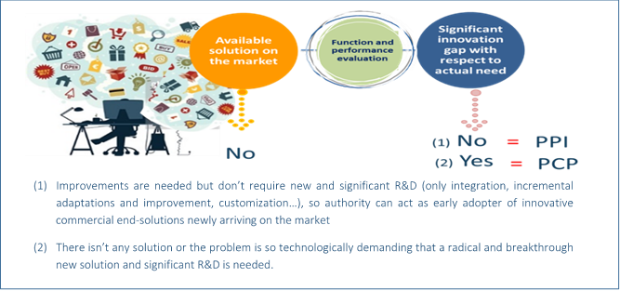
Open market consultation
Why it is important

Slide 34
Preparing an innovation procurement
Open market consultation
Why is it important to consult the market
How to organize a market consultation
Specific issues to consider
Outcome of a market consultations
Practical examples

Slide 35


Open market consultation
How to organize it
Various methods to engage the market exist, including:
market survey
“meet the buyer” events
industry days
webinars or
the organization of an industry platform.
A successful market consultation requires efficient time planning, effective resource allocation and broad coverage (stakeholder- and geographical wise).

Slide 36
Open market consultation
How to organize it - prerequisites
previous identification of the need(s)/challenge(s)
validation of the needs by prior art analysis and IPR search
a mature business plan meant to prioritize the needs
informing the market of the public procurer’s intentions and needs
targeting the right market segments
promoting the open market consultation to the market
selecting the best dialogue method
involving experts who can lead the discussions and subsequently interpret the results of the market consultation.

Slide 37
Preparing an innovation procurement
Open market consultation
Why is it important to consult the market
How to organize a market consultation
Specific issues to consider
Outcome of a market consultations
Practical examples

Slide 38
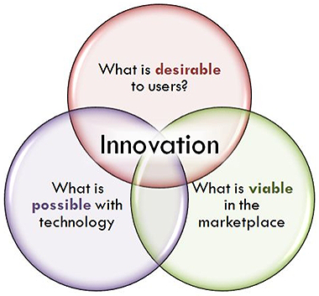
Open market consultation
Specific issues to consider
The identified needs must be communicated openly and clearly, by means of performance/output based specifications, to all potentially interested bidders
Specific technologies that the public procurers have become aware of should be mentioned by means of examples
The suppliers should be allowed sufficient time to respond
The invitation to participate in the market consultation has to specifically mention the desire for an innovative outcome
Compliance with the TFEU principles must be ensured at all times
Clear separation from the procurement itself

Slide 39
Open market consultation
Specific issues to consider
the public procurer needs to pro-actively communicate its needs and requirements;
the participation of a supplier in the market consultation must not affect competition within the future tender procedure;
suppliers’ intellectual property rights (IPRs) and trade secrets must be protected;
suppliers must understand that the competitive phase of the public procurement procedure is conducted separately and all suppliers are treated equally.

Slide 40
Preparing an innovation procurement
Open market consultation
Why is it important to consult the market
How to organize a market consultation
Specific issues to consider
Outcome of a market consultations
Practical examples

Slide 41
Open market consultation
Outcome – 3 potential scenarios
in case the market consultation shows that there are solutions available on the market to meet procurers’ needs, traditional procurement could be employed;
in case the market consultation shows that there is no technology available on the market that meets procurers’ needs but that it seems possible that such technology will be available on a short-to medium-term should (a) the technology vendors become aware of these needs and (b) the public sector customers base is significant, in order to justify investments by the supply side for the development of this technology, PPI / Forward Commitment Procurement could be envisaged;
in case the market dialogue shows that there is no technology available on the market that meets procurers’ needs and that no such technology could be available on a short-to medium-term basis, due to the need to first conduct R&D to investigate available options, PCP could be contemplated. In this third case scenario, the PCP could be followed by a PPI aimed at the early adoption/large scale deployment of the new innovative solutions developed according to procurers’ needs.

Slide 42
Preparing an innovation procurement
Open market consultation
Why is it important to consult the market
How to organize a market consultation
Specific issues to consider
Outcome of a market consultations
Practical examples

Slide 43
Open market consultation
Examples
HAPPI PROJECT (PPI)
The HAPPI project, adopted the following approach to the organization of the market consultation:
1st step – Create an online platform in order to collect information (by means of an online questionnaire) about the innovative solutions available on the market. The HAPPI online platform (DARS) was open for submission from end September 2013 until end January 2014 (http://www.happi-project.eu/happi-platform). Around 150 submissions from 14 different countries were received on the HAPPI Platform during these 4 months.
2nd step - Informed the European companies, and especially SMEs, about the project and the HAPPI platform. 4 INFODAYS were organized in 4 European Countries (UK, France, Italy and Austria) from September 2013, to December 2013. More than 400 delegates attended the meetings, most of which were SMEs.
3rd step – In February 2014, 3 Experts Committees were organized in 3 European cities (London, Turin and Paris). It was decided to create separate meetings in different countries in order to capture the country-related approaches,
sensitivities and point of views. During the meetings each proposal received
through the online platform was examined. Various end-users and experts
attended the meetings (e.g. director of nursing home, gerontologist,
biomedical engineer, innovation expert etc.).

Slide 44
Open market consultation
Examples
HAPPI PROJECT (PPI)
The following main questions were addressed:
Is this product/service really innovative?
Does it address the needs of the beneficiaries (elderly care organizations and hospitals)?
Is this product a prototype or is it already available on the market?
Does it comply with the healthy ageing thematic?
Is it easy to roll out the product/service at a European scale?
The results of each Experts Committee were then reviewed during the Steering Committee #4 and the final list of solutions/procurement categories to be purchased and the procurement format (Number of call for tenders, allotment, procurement type…) were adopted.

Slide 45
Preparing an innovation procurement
Before the procurement stage
Needs identification and assessment
Prior art analysis and IPR search
Open market consultation
Business case
Technical specs and criteria
Contractual strategy

Slide 46
Drafting the business case
What is a business case?
A tool to support investment decisions before, during and after the project:
before the project: to determine whether there are enough economic reasons to start the project;
during the project: to decide whether or not to proceed with changes to the project content, the environment, or the pattern of the project phases; and
after the project: to assess whether the results achieved meet the public procurer’s goals and, if needed, make adjustments accordingly.

Slide 47
Drafting the business case
How to construct it?
Why do we need to draft a business case?
What are the business and social benefits?
What are the risks?
  How often could failure happen ?
  What would impact be ?
  When does it happen ?
  What is the main issue?
  What is the cost of the issue?
What are the potential costs?
How long will the project take?

Slide 48
Drafting the business case
How to construct it?
EXAMPLE business-case in a PPI
Waterschapsbedrijf Limburg had the ambition to become an effective, qualitative and innovative organization that is capable to swiftly adapt to change. In order to justify the innovation procurement of a new IT infrastructure to coordinate its 17 waste water plants, and to gain the higher management support, Waterschapsbedrijf Limburg formulated a business-case.
The business-case calculated the cost reduction from the implementation of IT systems that would centralize and make the monitoring of the water purifying activity more effective.
It asked questions such as: ->>

Slide 49
Drafting the business case
How to construct it?
1. Is this investment delivering a benefit in terms of more efficient
maintenance ?
2. Is this project absolutely necessary to survive as organization ?
3. Is this project delivering strategic benefits ?
4. Can this project deliver future strategic benefits ?
Based on the business-case, Waterschapsbedrijf Limburg decided to pilot a small scale implementation of the solution. This was considered a risk mitigation measure. Based on the additional knowledge gained during the pilot, the business-case was refined. The benefits for both “go” and “no go” scenarios were calculated.
Based on the conclusion of the refined business-case, that the project would deliver important benefits in terms of efficiency, cost reduction and reduction of energy consumption, the project was continued.
Source: Leon Verhaegen, Wauter project

Slide 50
Preparing an innovation procurement
Before the procurement stage
Needs identification and assessment
Prior art analysis and IPR search
Open market consultation
Business case
Technical specs and criteria
Contractual strategy

Slide 51
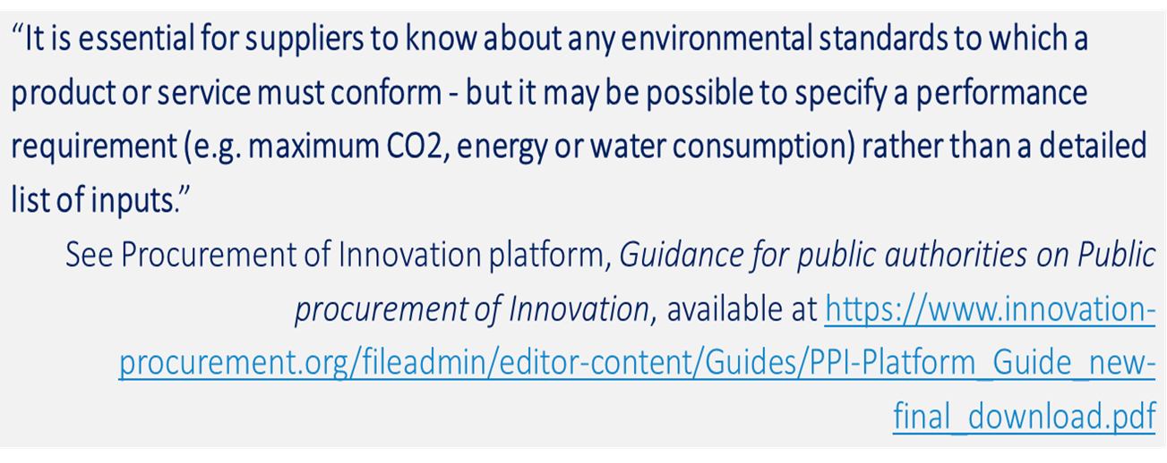
Open market consultation
Technical specs and criteria
Technical specifications directly influence the number and quality of tenders
To encourage innovation, they should be:
  Based on market consultation outcome
  Expressed in terms of outcome / performance based specifications

Slide 52
Open market consultation
Technical specs and criteria
  Described by reference to standards / GPP criteria
  Refer to appropriate specifications that are defined in eco-labels (see the “Coffee Arrest Case” C-368/10)
  Not excessively technically descriptive
  “There is a fine line between making sure the market knows what your requirements are and leaving the door open to different and new ways of meeting those requirements”
  (Procurement of Innovation Platform)
Notes:
Art. 42 of PSD and art. 60 of UD include all requirements that the public procurer must remember when drafting the technical specifications (e.g., to publish them upfront in the tender documentation, to ensure they are proportionate to the value and objectives of the procurement, to ensure equal access to the procurement for all potentially interested bidders; to avoid the creation of any unjustified obstacles to competition, to allow equivalent means of proof etc.).
Case C-368/10, European Commission v The Netherlands (the “Coffee Arrest case”): This case regarded tendering procedure for a public contract for the supply and management of drink dispensing machines and of coffee with the Max Havelaar label. The ECJfound that the public procurer has laid down a technical specification incompatible with Article 23(6) of Directive 2004/18 by requiring that certain products to be supplied were to bear a specific eco-label (Max Havelaar label in this case), rather than using detailed specifications in this standard.

Slide 53
Open market consultation
Technical specs and criteria
“The technical specifications drawn up by public purchasers need to allow public procurement to be open to competition as well as to achieve objectives of sustainability. To that end, it should be possible to submit tenders that reflect the diversity of technical solutions standards and technical specifications in the marketplace, including those drawn up on the basis of performance criteria linked to the life cycle and the sustainability of the production process of the works, supplies and services.” (R74&R83)
Sustainability included in the tender specifications – 3P
People – social sustainability & ethical considerations (e.g., labor conditions & standards)
Planet – environmental sustainability (e.g., product life cycle analysis)
Profit – economic sustainability (e.g., value for money)

Slide 54
Open market consultation
Technical specs and criteria
Selection criteria regard the bidders:
  Suitability to perform the professional activity
  Economic and financial standing (new provisions on turnover to allow more SMEs to compete)
  Technical and professional ability
Public procurers will check whether bidders:
  have previous experience with the type of the tendered contract;
  have access to or employ personnel with the required educational and professional background;
  have access to the necessary technical equipment;
  have experience in employing ethical and socially responsible approaches, focusing on sustainability.

Slide 55
Open market consultation
Technical specs and criteria
Award criteria regard the tenders, based on MEAT (art. 67 PSD & art. 82 UD):
  Identified on the basis of price/cost using a LCC approach
  Could include best price-quality ratio, assessed based on criteria linked to the subject matter of the contract:
    Qualitative (e.g., technical merit, functionality, accesibility etc.)
    Organisation/qualificaiton of staff used for the contract implementation
    Environmental
    Social
    After-sales services / technical assistance etc.

Slide 56
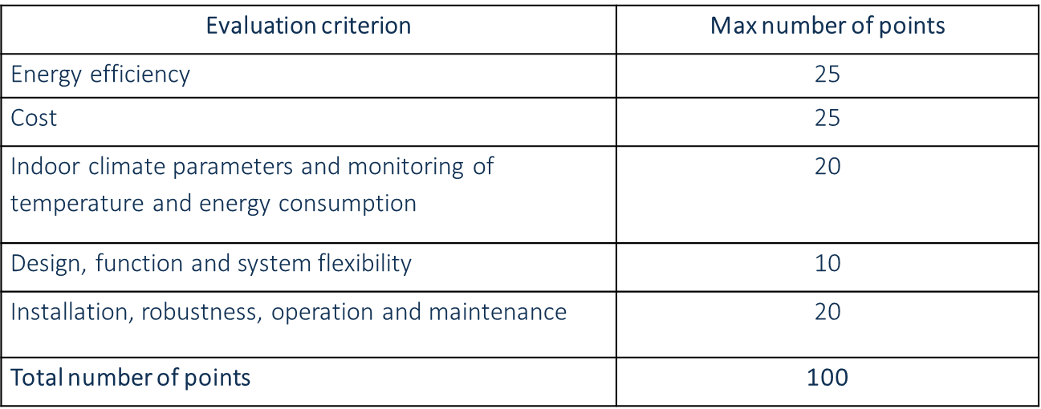
Open market consultation
Technical specs and criteria
The following award criteria were applied by the Swedish public procurers for the purchase of heat recycling systems for existing apartment blocks:
Source: http://www.bebostad.se/wp-content/uploads/2013/08/Heat_Recycling_Procurement_eng_invitation.pdf

Slide 57
Open market consultation
Technical specs and criteria
For PCP projects, award criteria could also include:
  quality - regarding:
    the ability to address the challenge raised in the tender;
    the novelty/innovativeness of the proposed solution approach (progress beyond-state-of-the-art);
    the technological soundness of the solution concept;
  implementation - referring to the quality and effectiveness / appropriateness of the proposed R&D work plan and resource allocation, as well as to the qualification of the personnel proposed;
  impact - referring to the added value for society/economy, the soundness of the commercialization plan etc.

Slide 58
Open market consultation
Technical specs and criteria
  An optimum combination of whole life costs, long term costs and quality that meets the users’ requirements will favor innovations which offer best value on the long term, despite looking more expensive or less advantageous on the short term
  Should be based on the aspects highlighted (by users) during the needs identification phase and subsequently verified during the market consultation
  CSR requirements/LCC included in the award criteria

Slide 59
Preparing an innovation procurement
Before the procurement stage
Needs identification and assessment
Prior art analysis and IPR search
Open market consultation
Business case
Technical specs and criteria
Contractual strategy

Slide 60
Preparing an innovation procurement
Contractual strategy
Performance clauses – meant to incentivize contractors
  could include, for example, environmental / energy performance and other specific commitments related considerations
  must be published and set out clearly within the tender documentation in order to ensure full information of the interested bidders
  must be linked to the performance of the contract
Monitoring performance clauses
  to assess development during project implementation
  to assess the progress made by the contractors

Slide 61
Preparing an innovation procurement
Contractual strategy
Examples of performance clauses
  Performance payments for key performance indicators (e.g., energy efficiency, minimization of waste, efficient use of resources);
  Provide for the possibility to negotiate contract extensions for innovative design alterations, however, conditioned upon mentioning this possibility under the tender documentation;
  Guarantees that the contractors having implemented the project will be mentioned in the publicity done for the outcome which meet high performance standards;
  Incorporation of a “share gain” clause and/or an “innovation pot” clause, according to which savings on initially planned budget which are triggered by the employment of innovative solutions could be shared between the public procurer and the contractor (VE).

Slide 62
Preparing an innovation procurement
Contractual strategy
VE - Value Engineering clauses
  offer the possibility to improve VFM during contract execution of when it becomes clearer which elements of the project increase costs, while not adding commensurate value to the overall performance;
  may allow contractors to propose, and public procurers to accept, new state of the art solutions occurring during the contract execution => amendment of an existing contract (art 72 PSD & art 89 UD)
  the substantial or material core of the contract must not change;
  an improvement for the achievement of the needs would result
  in savings and the innovation of a service or process.

Slide 63

Oana Pantilimon Voda
Corvers Procurement Services BV
www.corvers.com
Email: o.pantilimon@corvers.com

