Slide 1




The eafip innovation procurement Toolkit
Leeuwarden, 9th of February 2016

Slide 2
Context of eafip
What is Europe’s 2020 strategy ?
Why is innovation important ?
What is the role of public procurement ?
How can the eafip initiative support you ?

Slide 3
Europe’s 2020 strategy
Smart
Sustainable
Inclusive
Innovation
Education
Climate/
energy
Employment
Social inclusion
Notes:
Interrelated targets: Europe 2020 – A strategy for a smart, sustainable and inclusive economy.
invest 3% of the EU’s GDP in R&D
Education: 40% of the younger generation a tertiary degree;
Climate/energy: reduction of greenhouse gas emissions by 20 - 30% (as compared to 1990); share of renewal energies 20%; 20% increase in energy efficiency;
Employment: 75% of the population employed;
Social inclusion: 20 million less people at risk of poverty;
EU states -> very divers

Slide 4

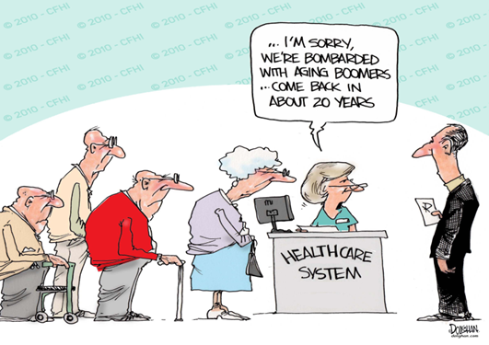

Europe’s 2020 strategy
LONG-TERM CHALLENGES:
*competitiveness *scarcity of resources *aging population
CHOICE:
  Regain competitiveness, boost productivity;
  Slow uncoordinated pace of reform --> high levels of
  unemployment and social distress.
Notes:
Globalisation (competition): Countries such as China or India are investing heavily in research and technology in order to move their industries up the value chain and "leapfrog" into the global economy. This puts pressure on some sectors of our economy to remain competitive, but every threat is also an opportunity. As these countries develop, new markets will open up for many European companies.
Resources: Strong dependence on fossil fuels such as oil and inefficient use of raw materials expose our consumers and businesses to harmful and costly price shocks, threatening our economic security and contributing to climate change. The expansion of the world population from 6 to 9 billion will intensify global competition for natural resources, and put pressure on the environment. The EU must continue its outreach to other parts of the world in pursuit of a worldwide solution to the problems of climate change at the same time as we implement our agreed climate and energy strategy across the territory of the Union.
Ageing: pressure on the welfare system, on the health care system.

Slide 5
Context of eafip
What is Europe’s 2020 strategy ?
Why is innovation important ?
What is the role of public procurement ?
How can the eafip initiative support you ?

Slide 6
What is innovation?
”connecting knowledge and technology with the exploitation of market opportunities for new or improved products, services and business processes ” (2006)
“when an invention is introduced commercially as a new or improved product of process” (Maclaurin, 1953)
”invention implemented and taken to market” (Chesbrough, 2006)

Slide 7
Why is innovation important?
Overcome the limitation of physical resources
New markets
New employment opportunities
Solution to challenges

Slide 8
Context of eafip
What is Europe’s 2020 strategy ?
Why is innovation important ?
What is the role of public procurement ?
How can the eafip initiative support you ?

Slide 9
Role of public procurement
Europe 2020 Flagship Initiative
Innovation Union
“The challenge is to use public procurement and public services to lead the way, shape the market for innovative solutions and equip society to meet the challenges of the future”.

Slide 10
Role of public procurement
Europe 2020 Flagship Initiative
Innovation Union
“From 2011, Member States and regions should set aside dedicated budgets for pre-commercial procurements and public procurements of innovative products and services. (…)
This should create procurement markets across the EU starting from at least €10 billion a year for innovations that improve the efficiency and quality of public services, while addressing the major societal challenges.”

Slide 11
Role of public procurement
National processes:
- Administrative task;
- Small scale;
- National competition.
European coordination:
- Integrate the EU public
markets;
- Improve value for money.
Smart use of procurement:
- Professionalization;
- Economies of scale;
- Innovation;
- Sustainability.

Slide 12
Strategic objectives & Procurement
Innovation Procurement
Legislation
Policy
Funding

Slide 13
Strategic objectives & Procurement
Barriers to innovation procurement:
Lack of knowledge and capabilities
Disconnection between public procurement and innovation policy objectives
Risk aversion

Slide 14
Context of eafip
What is Europe’s 2020 strategy ?
Why is innovation important ?
What is the role of public procurement ?
How can the eafip initiative support you ?

Slide 15
eafip INITIATIVE
Toolkit
Free assistance
Workshops&
Conferences

Slide 16

eafip TOOLKIT OBJECTIVES - THE “WHY WE DID IT”
Explain innovation procurement
Clarify and demonstrate the principles and the benefits of innovation procurement
Provide best procurement practices for the implementation of
innovation procurement projects

Slide 17


eafip TOOLKIT BASIS - THE “HOW WE DID IT”
Legislative & policy review
(EU directives, Commission Communications, policy documents, economic studies etc.)
Literature review
Information gained during conferences
Case studies, lessons learned from completed and/or on-going innovation procurement projects
Latest trends in innovation procurement methodologies and
practical experiences

Slide 18

eafip TOOLKIT BASIS - THE “HOW WE DID IT”
User friendly
Clear
Concise
Checklists
Text
Images / diagrams
Text boxes including case examples
Cross references

Slide 19
eafip TOOLKIT - THE “HOW IT LOOKS”

Slide 20
eafip TOOLKIT - THE “HOW IT LOOKS”
STEP-BY-STEP PROCESS | CHECKLIST / TO DO LIST | QUESTIONS TO ANSWER | INSTRUMENTS
Needs identification and assessment | Start early Everything starts with a need Make sure it is an unmet need Recognize unmet needs and opportunities Make sure the need it clearly identified and it responds to a societal challenge Define outcome-based requirements | Did I identify the correct need? Is the meet unmet? Did I pull unmet needs and opportunities into focus? Does the need meet a societal challenge for which I am responsible? | WIGBI approach Workshops with customers Identify-Validate-Verify approach Methodology used to identify and assess needs Relevant section in the Toolkit
Constructing a business case | Plan wisely Allocate resources Calculate available budget | Did I carefully consider all resources needed for the implementation of the project? Is the business case viable and sustainable? Do I have the required resources? | Business case template Relevant section in the Toolkit
Conduct market consultations | This is the moment to validate the identified need Make sure to clearly differentiate the market consultation from the tender procedure Build trust between the public and the private sector Involve end users | Is there a solution ready available to meet the need? If not, is it possible to develop a solution to meet the need? Does the technology exist on the market or does it need to be created / developed? Is the business case viable? Is PCP the right procurement model or is PPI better? Did I secure transparency, equal treatment and non-discrimination for all parties? | Templates Best practices examples and fact sheets Relevant section in the Toolkit

Slide 21
eafip TOOLKIT BASIS - THE “HOW IT LOOKS”

Slide 22

eafip TOOLKIT - A “LIVING DOCUMENT”
To be updated during eafip
Feedback from:
  Workshops
  Assistance
  FAQ
  Your input
  Changes in legislation
  New case law from the ECJ
  Lessons learned and best practices

Slide 23
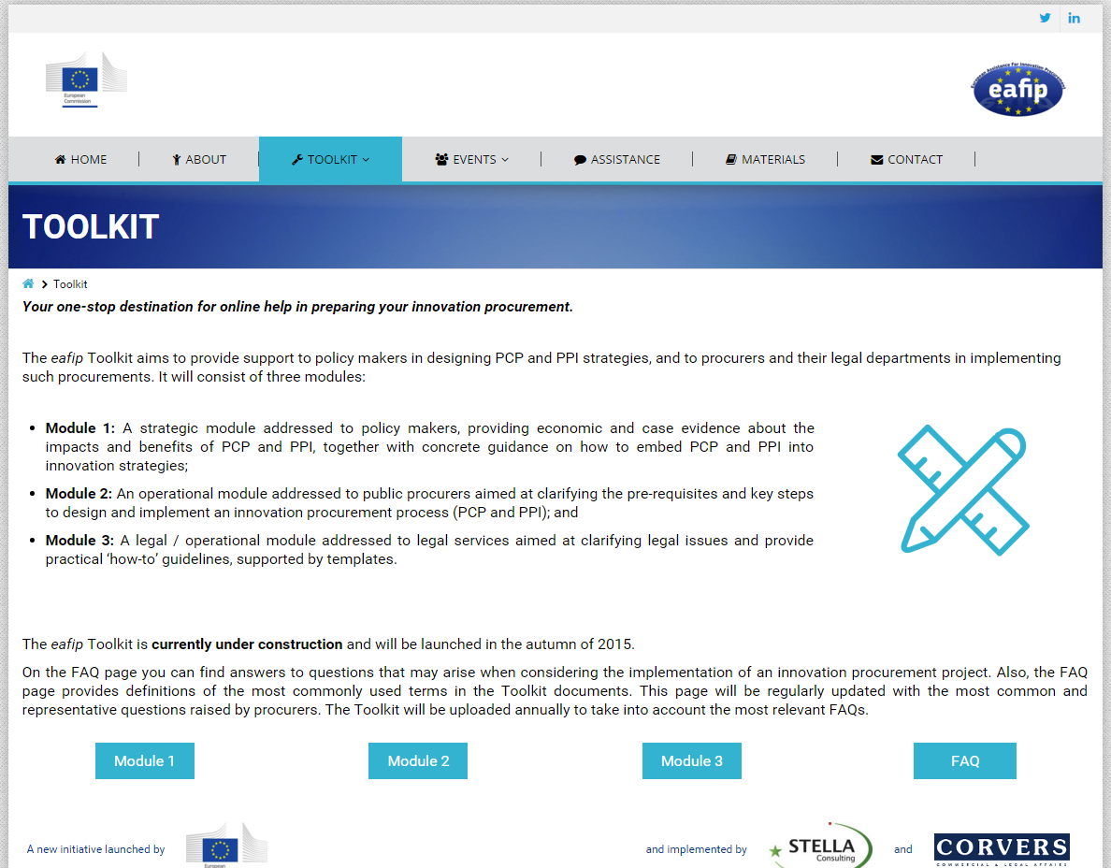
eafip TOOLKIT – WHERE TO FIND IT
eafip.eu

Slide 24
eafip TOOLKIT MODULES
Toolkit
MODULE 1
Policy maker
MODULE 2
Public procurer
MODULE 3
Legal expert

Slide 25
eafip TOOLKIT – MODULE 1
Section 1: Introduction
Section 2: What is innovation procurement
Section 3: Why is innovation procurement important
Section 4: Defining an innovation procurement policy
Section 5: Finding synergies with funding under Horizon 2020 and the European Structural and Investment Funds (ESIF)

Slide 26
eafip TOOLKIT – MODULE 1
Defining an innovation procurement policy
Political commitment
OFFICIAL
GOVERNMENT
DECISION
Preparation
- Understand;
- Involve stakeholders;
- Integrated policies;
- Analyze framework conditions;
- Address obstacles.
Action Plan
- Starting situation;
- Vision, mission & objectives;
- Implementation (pilot, timeframe, budget, resources and roles allocation etc.);
- Monitoring evaluation and review.

Slide 27
eafip TOOLKIT – MODULE 1
Periodical assessment of an innovation procurement policy
evaluation
review
monitoring

Slide 28
eafip TOOLKIT MODULES
Toolkit
MODULE 1
Policy maker
MODULE 2
Public procurer
MODULE 3
Legal expert

Slide 29

eafip TOOLKIT – MODULE 2
THE “WHO WE DID IT FOR”
  The decision makers and the procurement officers involved in the procurement process
  Those professionals responsible for the procurement planning and execution of related activities

Slide 30
eafip TOOLKIT – MODULE 2
Structure:
  Section 1: Introduction
  Section 2: A step-by-step approach to innovation procurement (PCP&PPI)
  Section 3: Joint procurement
Objectives:
  What form of innovation procurement a public procurer could choose
  What are the main steps that public procurers should consider when preparing and implementing an innovation procurement procedure
  Why each of these steps is important
  How to implement each of these steps
  How to implement joint procurement

Slide 31


eafip TOOLKIT – MODULE 2
Important issues clarified by Module 2:
  The pre-requisites for a successful implementation of Pre-Commercial Procurement (PCP) and of Public Procurement of Innovative Solutions (PPI);
  How to prepare and implement a PCP and/or PPI procurement, covering the activities before and during the procurement procedure up to the award of the procurement contract(s); and
  How to manage and monitor an ongoing PCP and/or PPI procurement, covering the activities to be undertaken after the award of the procurement contract(s) and during the implementation of the PCP / PPI contract.

Slide 32
eafip TOOLKIT – MODULE 2
  Covers all the phases in a procurement process, namely the steps required in the “before procurement”, “during procurement” and “after procurement” stages and explains how to address each step:
    Needs identification and assessment;
    Prior art analysis and IPR search;
    Analysis of the regulatory, certification, standardisation environment;
    Drafting a business-case;
    Open market consultation;
    IPR and confidentiality strategies and setting the link to standardization;
    Drafting the tender documentation;
    Conducting the procedure;
    Monitoring and evaluating the contract performance;
    Managing “after the contract” issues

Slide 33
eafip TOOLKIT – MODULE 2

Slide 34

eafip TOOLKIT – MODULE 2 – LINKS
  There is a particularly strong link between Module 2 and Module 1 and, respectively, between Module 2 and Module 3:
  Module 2 is based on and builds upon the content of Module 1, which sets the underlying rationale and benefits to undertaking innovation procurement, and explains the steps for the adoption of a national/regional innovation procurement policy
  Module 2 outlines the steps to be followed in the implementation of PCP and PPI, in full compliance with the legal framework detailed in Module 3

Slide 35
eafip TOOLKIT MODULES
Toolkit
MODULE 1
Policy maker
MODULE 2
Public procurer
MODULE 3
Legal expert

Slide 36

eafip TOOLKIT – MODULE 3
THE “WHO WE DID IT FOR”
  The legal expert within the public procurer
  The persons responsible for checking compliance of the procurement documents with the applicable legal provisions

Slide 37
eafip TOOLKIT – MODULE 3
Structure:
  Section 1: Introduction
  Section 2: A step-by-step approach to innovation procurement (PCP&PPI)
  Section 3: Joint procurement
Objectives:
  To clarify the main legal provisions to consider in a PCP or PPI;
  To explain why it is paramount to comply with the applicable legal provisions;
  To list the legal instruments available to capitalize on the potential of innovative solutions to modernize public services;
  To provide examples on how to formulate procurement
  documents in compliance with the applicable legal provisions.

Slide 38
eafip TOOLKIT – MODULE 3
Important issues clarified by Module 3:
  How to draft the documentation for a PCP and/or a PPI procurement in compliance with the applicable legal provisions, covering the activities before and during the procurement procedure up to the award of the procurement contract(s);
    How to enforce the PCP/PPI contract in compliance with the applicable legal provisions; and
  How to implement joint procurement models in compliance with the applicable legal provisions.

Slide 39
eafip TOOLKIT – MODULE 3
  → Same as Module 2
  Covers all the phases in a procurement process, namely the steps required in the “before procurement”, “during procurement” and
  “after procurement” stages and explains how to legally address
  each step:
    Needs identification and assessment;
    Prior art analysis and IPR search;
    Analysis of the regulatory, certification, standardization environment;
    Drafting a business-case;
    Open market consultation;
    IPR and confidentiality strategies and setting the link to standardization;
    Drafting the tender documentation;
    Conducting the procedure;
    Monitoring and evaluating the contract performance;
    Managing “after the contract” issues.

Slide 40
eafip TOOLKIT – MODULE 3 – LINKS
  There is a particularly strong link between
  Module 3 and Module 2:
  Module 2 outlines the steps to be followed in the implementation of PCP and PPI, in full compliance with the legal framework detailed in Module 3.

Slide 41

Stephan Corvers
Corvers Procurement Services BV
www.corvers.com
Email: s.corvers@corvers.com

